Slide 1
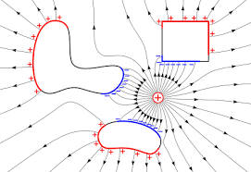
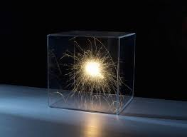
Electrostatics
Electrostatics can be defined as the study of electric charges at rest.

Slide 2
Coulomb's Law :
Coulomb's Law states that the force between two point charges Q1and Q2 is directly proportional to the product of the charges and inversely proportional to the square of the distance between them.
Coulomb's law is applicable in finding electric field due to any charge distribution.

Slide 5
Vector Form of Coulomb’s Law

Slide 7



Electric Field intensity:
The electric field intensity or the electric field strength at a point is defined as the force per unit charge.
The electric field intensity E at a point r (observation point) due a point charge Q located at (source point) is given by:
For a collection of N point charges Q1 ,Q2 ,.........QN located at , ,...... , the electric field intensity at point is obtained as
The expression (6) can be modified suitably to compute the electric filed due to a continuous distribution of charges.

Slide 8
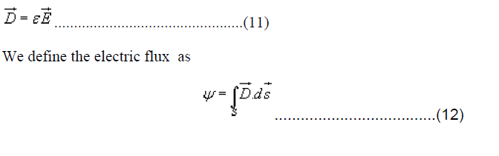
Electric flux density:
Electric field intensity or simply ‘Electric field' gives the strength of the field at a particular point.
The electric field depends on the material media in which the field is being considered.
The flux density vector is defined to be independent of the material media (as we'll see that it relates to the charge that is producing it)
For a linear isotropic medium under consideration; the flux density vector is defined as:

