Slide 1
BINESWAR BRAHMA ENGINEERING COLLEGE
subject: Electromagnetic field theory
Department Of Electrical Engineering
6th Semester

Slide 2
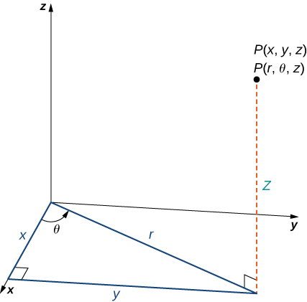
The Cylindrical Coordinate System
In the cylindrical coordinate system, a point in space is represented by the ordered triple (r,θ,z) , where
(r,θ) are the polar coordinates of the point’s projection in the xy -plane
z is the usual z -coordinate in the Cartesian coordinate system
In the xy-plane, the right triangle provides the key to transformation between cylindrical and Cartesian, or rectangular, coordinates.

Slide 3
The rectangular coordinates (x,y,z) and the cylindrical coordinates (r,θ,z) of a point are related as follows:
These equations are used to convert from cylindrical coordinates to rectangular coordinates.
x=rcosθ
y=rsinθ
z=z are used to convert from cylindrical coordinates to rectangular coordinates.
These equations aThese equations are used to convert from rectangular coordinates to cylindrical coordinates
r2=x2+y2
tanθ=y/x
z=z used to convert from rectangular coordinates to cylindrical coordinates

Slide 4
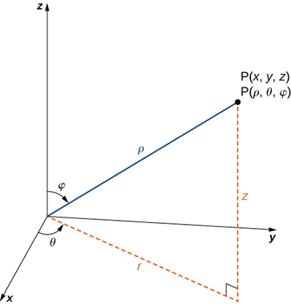
Spherical coordinate system
In the spherical coordinate system, a point P in space is represented by the ordered triple (ρ,θ,φ) where
ρ (the Greek letter rho) is the distance between P and the origin (ρ≠0);
θ is the same angle used to describe the location in cylindrical coordinates;
φ (the Greek letter phi) is the angle formed by the positive z -axis and line segment OP¯ , where O is the origin and 0≤φ≤π.
By convention, the origin is represented as (0,0,0) in spherical coordinates.

Slide 5
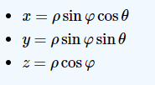
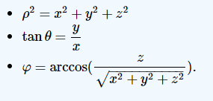
Rectangular coordinates (x,y,z) , cylindrical coordinates (r,θ,z), and spherical coordinates (ρ,θ,φ) of a point are related as follows:
Convert from spherical coordinates to rectangular coordinates
These equations are used to convert from spherical coordinates to rectangular coordinates.
Convert from rectangular coordinates to spherical coordinates
These equations are used to convert from rectangular coordinates to spherical coordinates.

Slide 6
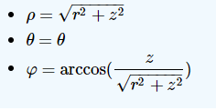
Convert from spherical coordinates to cylindrical coordinates
Convert from cylindrical coordinates to spherical coordinates

Slide 7
Divergence and stokes theorem
Divergence Theorem

Slide 8
Stokes theorem
Just as the spatial Divergence Theorem of this section is an extension of the planar Divergence Theorem, Stokes' Theorem is the spatial extension of Green's Theorem.
Green's Theorem states that the circulation of a vector field around a closed curve in the plane is equal to the sum of the curl of the field over the region enclosed by the curve.
Stokes' Theorem effectively makes the same statement: given a closed curve that lies on a surface S, the circulation of a vector field around that curve is the same as the sum of “the curl of the field” across the enclosed surface.

Slide 9
THANK YOU

