Slide 1
Bineswar Brahma Engineering College
subject: Electromagnetic field theory
Department Of Electrical Engineering
6th Semester

Slide 3
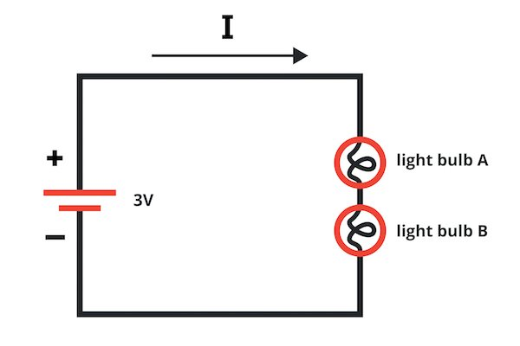
What is field ?
Field is a function that specifies a particular quantity everywhere in a region.
ELECTROMAGNETIC FIELD
This electromagnetic field is produced by interaction of time varying electric and magnetic field.
Voltage produces electric field.
Time varying electric field produces magnetic field
Magnetic field may be stationary or time varying it depends on time varying current.
When the current is varying with respect to time then the magnetic field will also vary with respect to time.
Time varying magnetic field produces electric field. Ex- transformer (flux varying with respect to time produces emf)

Slide 4
Difference between Circuit Theory and Field Theory
Circuit Theory | Field Theory
Deals with Voltage and Current | Deals with the Electric field and magnetic field
V & I are scalar | E and H are Vector quantity
Radiation and effect are neglected | Radiation effect is considered
Its useful only in low frequency | Independent of frequency

Slide 5
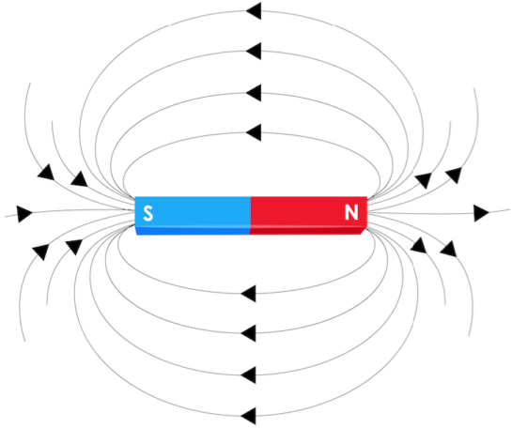
Static electric field
Static electric fields are constant fields, which do not change in intensity or direction over time, in contrast to low and high frequency alternating fields.
Static Magnetic field:
A static magnetic field is created by a magnet or charges that move as a steady flow (as in appliances using direct current).
Which is also called magnetostatics.
Electromagnetic field, a property of space caused by the motion of an electric charge.
A stationary charge will produce only an electric field in the surrounding space.
If the charge is moving, a magnetic field is also produced.
An electric field can be produced also by a changing magnetic field.
The mutual interaction of electric and magnetic fields produces an electromagnetic field.

Slide 6
APPLICATIONS
Microwave
Analysis of Antennas
Electric machine, transformers
Analysis of power system
Electromechanical Energy Conversion
Wireless communication Engineering
Optical fiber

Slide 7
Scalar Quantity
Scalar quantity is defined as the physical quantity with magnitude and no direction.
Some physical quantities can be described just by their numerical value (with their respective units) without directions (they don’t have any direction).
Examples of Scalar Quantities
Mass
Speed
Distance
Time
Area
Volume
Density
Temperature

Slide 8
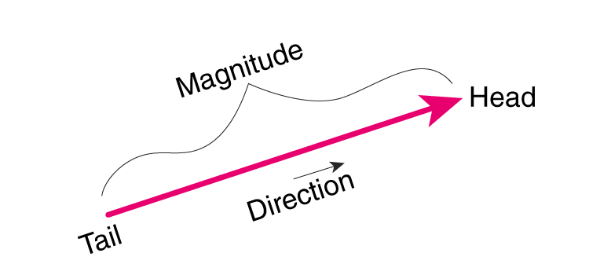
Vector Analysis
Vector are those quantities which can be represented by magnitude and Direction both.
Types of Vectors
Zero Vector
Unit Vector
Position Vector
Co-initial Vector
Like and Unlike Vectors
Co-planar Vector
Collinear Vector
Equal Vector
Displacement Vector
Negative of a Vector

Slide 9
Examples of Vector Quantities
Linear momentum
Acceleration
Displacement
Momentum
Angular velocity
Force
Electric field
Polarization

Slide 10
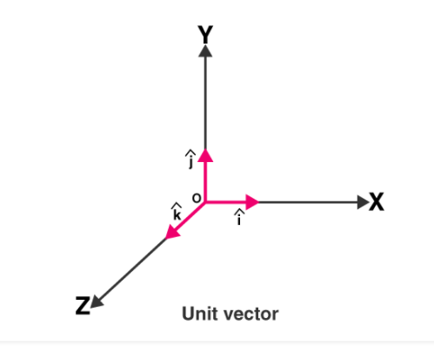
Unit vector
A vector which has a magnitude of unit length is called a unit vector.
Suppose if $\vec{x}$ is a vector having a magnitude x then the unit vector is denoted by x̂ in the direction of the vector $\vec{x}$ and has the magnitude equal to 1 .
Its used to indicate the direction of vector quantity.
1.a⃗ = (x, y, z) using the brackets 2. a⃗ = xi^ + y j^ +z k^

Slide 11
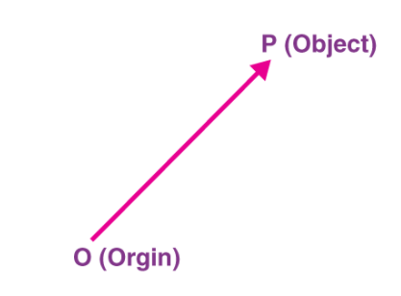
Position Vector
If O is taken as reference origin and P is an arbitrary point in space then the vector $\vec{OP}$ is called as the position vector of the point.
Position vector simply denotes the position or location of a point in the three-dimensional Cartesian system with respect to a reference origin.

Slide 12
Properties of vectors
: If A, B, C are vectors and m, n are scalars then
(1) Addition
A + B = B +A Commutative law
A + ( B + C) = (A + B) + C Associative law
(2) Subtraction
A - B = A + (- B)

Slide 13
Vector Properties
(3) Multiplication by a scalar
m A = A m Commutative law
m (n A) = n (m A) Associative law
(m + n) A = m A + n A Distributive law
m (A + B) = m A + m B Distributive law
A Position vector‘ is represented graphically by a directed line segment.
A Unit vector‘ is a vector of unit magnitude and directed along that vector‘.
aˆ A is a Unit vector along the direction of A .

Slide 14
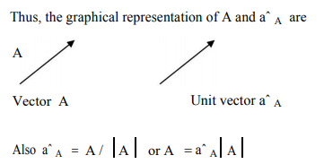

Slide 15
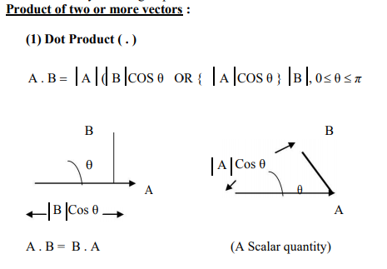
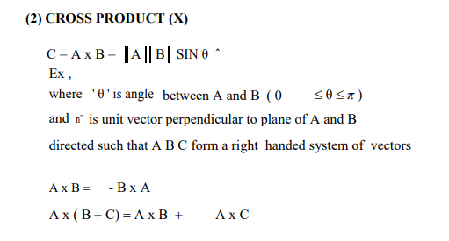

Slide 16
Coordinate system
For an explicit representation of a vector quantity, a ‗co-ordinate system‘ is essential.

Slide 17
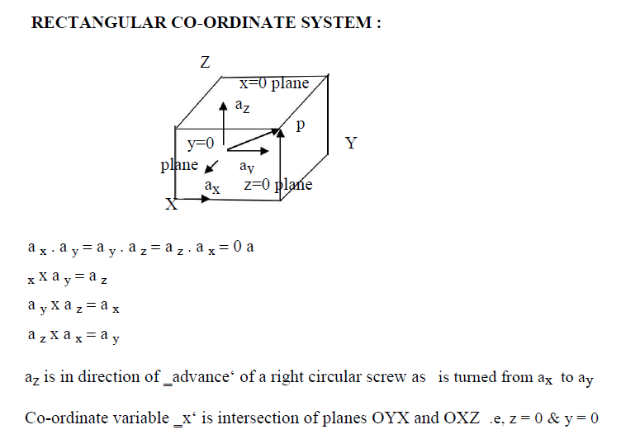

Slide 18
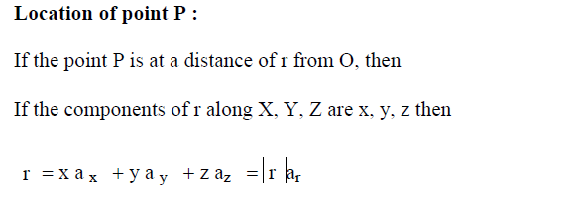
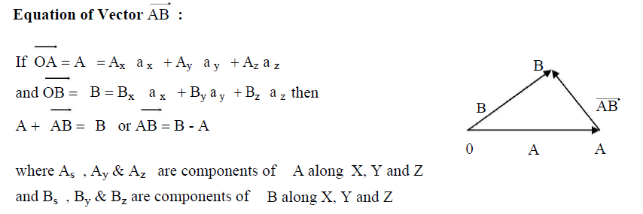

Slide 19
