Slide 1

High Voltage Engineering
Module 1I
Conduction and Breakdown in Liquid Dielectrics
Department of Electrical Engineering

Slide 2
LIQUIDS AS INSULATORS
Liquid dielectrics are used mainly in high-voltage cables and capacitors and for filling up of transformers, circuit breakers, etc.
Liquid dielectrics also act as heat transfer agents in transformers and as arc-quenching media in circuit breakers.
Petroleum oils (transformer oils) are the most commonly used liquid dielectrics.
1

Slide 3
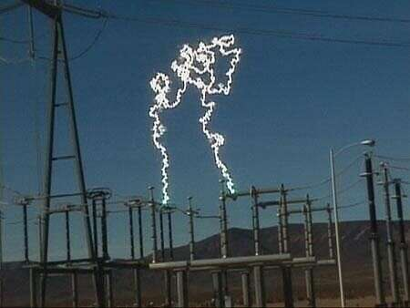
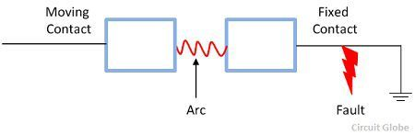
LIQUIDS AS INSULATORS
1

Slide 4
LIQUIDS AS INSULATORS contd..
For very high-temperature applications, silicone oils and fluorinated hydrocarbons are employed.
Liquid dielectrics normally are mixtures of hydrocarbons and are weakly polarized.
When used for electrical insulation purposes, they should be free from moisture, products of oxidation and other containments.
2

Slide 5
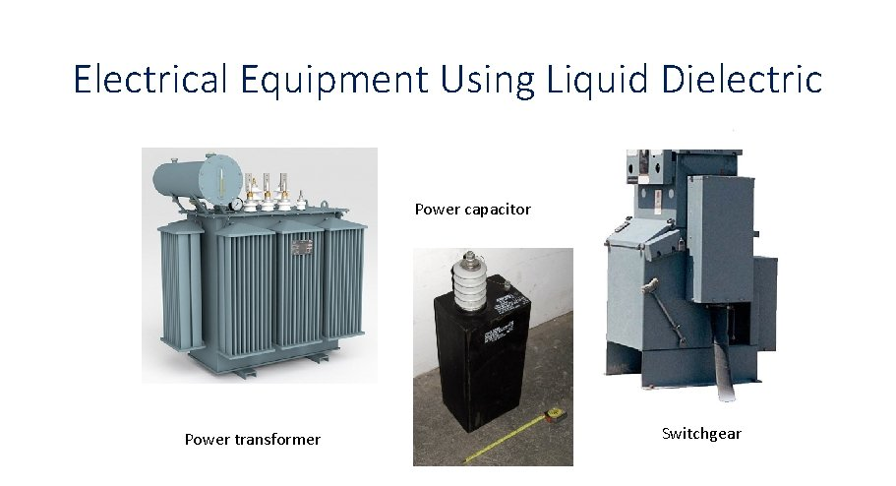
LIQUIDS AS INSULATORS contd..
3

Slide 6
LIQUIDS AS INSULATORS contd..
The most important factor that affects the electrical strength of an insulating oil is the presence of water in the form of fine droplets suspended in the oil.
The presence of even 0.01% water in transformer oil reduces its electrical strength to 20% of the dry oil value.
4

Slide 7
CLASSIFICATION OF LIQUID DIELECTRICS
Transformer oil (Mineral oil):
It is the most commonly used liquid dielectric in power apparatus.
It is an almost colourless liquid consisting of a mixture of hydrocarbons which include paraffins, isoparaffins, naphthalene and aromatics.
When in service, the liquid in a transformer is subjected to prolonged heating at high temperatures of about 95°C, and consequently it undergoes a gradual ageing process.
With time, the oil becomes darker due to the formation of acids and resins, or sludge in the liquid.
5

Slide 8
CLASSIFICATION OF LIQUID DIELECTRICS
(b) Synthetic Hydrocarbons
Among synthetic liquid dielectrics, polyolefins are the dielectrics of choice for applications in power cables.
Over 55% of synthetic hydrocarbons produced worldwide today are polyolefins.
The most commonly used olefins are poly-butylene and alkylaromatic hydrocarbons e.g., alkyl-benzene.
6

Slide 9
CLASSIFICATION OF LIQUID DIELECTRICS
(c) Chlorinated Hydrocarbons:
Two aromatic hydrocarbons, benzene and diphenyl, are chlorinated to produce chlorinated aromatic compounds called askarels or simply polychlorinated biphenyl (PBC).
They possess high fire point and excellent electrical properties.
7

Slide 10
CLASSIFICATION OF LIQUID DIELECTRICS
(d) Silicon Oils :
Silicon oils represent an alternative to PBCs but they are expensive.
Even at temperature of 150°, they exhibit high long-term thermal stability.
Silicon oils are resistant to most chemicals, and are oxidation resistant even at high temperatures.
8

Slide 11
CLASSIFICATION OF LIQUID DIELECTRICS
(e) Esters:
Natural esters such as castor oil has been used as a capacitor impregnate for many years, but currently two types of synthetic esters are being used, viz., organic esters and phosphate esters.
Organic esters have high boiling points in relation to their viscosity and therefore have high fire points.
9

Slide 12
CLASSIFICATION OF LIQUID DIELECTRICS
(f) Latest Developments:
Some new oils have been introduced in recent years.
These are being marketed under different commercial names, such as high temperature hydrocarbon oil, tetrachloroethylene and perfluoropolyether.
High temperature hydrocarbons (HTC) oils have good electrical insulating and adequate heat transfer properties.
10

Slide 13
CHARACTERISTICS OF LIQUID DIELECTRICS
A liquid dielectric should possess
Good dielectric properties
Excellent heat transfer characteristics
Must be chemically stable under the range of conditions under which the equipment operates.
11

Slide 14
CHARACTERISTICS OF LIQUID DIELECTRICS
Electrical Properties The electrical properties that are essential in determining the dielectric performance of a liquid dielectric are :
  Capacitance per unit volume or its relative permittivity
  Resistivity
  Loss tangent (tan δ) or its power factor which is an indicator of the power loss under ac voltage application
  Its ability to withstand high electric stresses.
12

Slide 15
CHARACTERISTICS OF LIQUID DIELECTRICS
Permittivities of most of the petroleum oils from 2.0 to 2.6 while those of silicon oils from 2.0 to 73.
In case of the non-polar liquids, the permittivity is independent of frequency but in the case of polar liquids, such as water, it changes with frequency.
For example:
The permittivity of water is 78 at 50 Hz and reduces to about 5.0 at 1 MHz.
13

Slide 16
CHARACTERISTICS OF LIQUID DIELECTRICS
Resistivities of insulating liquids used for high-voltage applications should be more than 10¹⁶ ohm-metre and most of the liquids in their pure state exhibit this property.
14

Slide 17
CHARACTERISTICS OF LIQUID DIELECTRICS
Power Factor of a liquid dielectric under ac voltage will determine its performance under load conditions.
Power factor is a measure of the power loss and is an important parameter in cable and capacitor system.
However, in the case of transformers, the dielectric loss in the oil is negligible when compared to copper and iron losses.
Pure and dry transformer oil will have a very low power factor varying between 10⁻⁴ at 20°C and 10⁻³ at 90°C at a frequency of 50 Hz
15

Slide 18
CHARACTERISTICS OF LIQUID DIELECTRICS
Dielectric Strength is the most important parameter in the choice of a given liquid dielectric for a given application.
The dielectric strength depends on the atomic and molecular properties of the liquid itself.
However, under practical conditions the dielectric strength depends on the material of the electrodes, temperature, type of applied voltage, gas content in the liquid, etc., which change the dielectric strength by changing the molecular properties of the liquid.
16

Slide 19
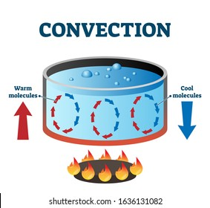
CHARACTERISTICS OF LIQUID DIELECTRICS
b) Heat Transfer Characteristics
In equipments filled with a liquid dielectric (transformer, cable, circuit breaker, etc.), heat is transferred mainly by convection.
Under natural atmospheric cooling conditions convection (N) is given by
N= f[K³ AC/v]^{n} ……..(1)
17

Slide 20
CHARACTERISTICS OF LIQUID DIELECTRICS
Where K=thermal conductivity
A= coefficient of expansion
C=specific heat per unit volume,
v= kinetic viscosity, and
n=0.25~ 0.33.
The main factors that control the heat transfer are thermal conductivity (K) and viscosity (v).
From eqn.1 it can be seen that a higher value for K is preferable for apparatus likely to operate continuously at a high temperature.
18

Slide 21
CHARACTERISTICS OF LIQUID DIELECTRICS
On the other hand, a low value of K and high viscosity can lead to localized overheating or even electrical ‘burn out’.
Silicon oils do not exhibit these properties and therefore can pose severe overheating problems in equipment that use these oils.
19

Slide 22
CHARACTERISTICS OF LIQUID DIELECTRICS
c) Chemical Stability
In service, insulating liquids are subjected to thermal and electrical stresses in the presence of materials like O₂ , water, fibers and decomposition products of solid insulation. These, either singly or in combination, cause degradation of the liquid with the result that soluble solid and gaseous products are found, which can result in:
Corrosion, impairment of heat transfer , deterioration of electrical properties, increased dielectric losses, discharges and arching.
20

Slide 23
PURE LIQUIDS AND COMMERCIAL LIQUIDS
Pure liquids are those which are chemically pure and do not contain any other impurity even in traces of 1 in 10⁹ , and are structurally simple.
Example: n-hexane (C₆ H₁₄), n-heptane (C₇ H₁₆) and other paraffin hydrocarbons.
Commercial liquid oils are not chemically pure, normally consists of mixtures of complex organic molecules which cannot be easily specified or reproduced in series of experiments.
21

Slide 24
PURE LIQUIDS AND COMMERCIAL LIQUIDS
Purification
The main impurities in liquid dielectrics are dust, moisture, dissolved gases and ionic impurities.
Various methods employed for purification are:
Filtration (through mechanical filters, spray filters and electrostatic filters).
Centrifuging
Degassing and distillation
Chemical treatment (adding ion exchange materials such as alumina, fuller’s earth etc and filtering )
22

Slide 25
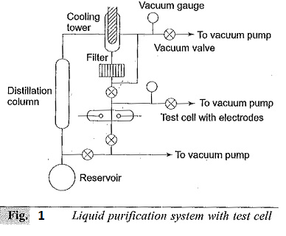
PURE LIQUIDS AND COMMERCIAL LIQUIDS
23

Slide 26
PURE LIQUIDS AND COMMERCIAL LIQUIDS
A commonly used closed-cycle liquid purification system is shown in fig 1.
This system provides for cycling the liquid.
The liquid from the reservoir flows through the distillation column where ionic impurities are removed.
Water is removed by drying agents or frozen out in the low- temperature bath.
24

Slide 27
PURE LIQUIDS AND COMMERCIAL LIQUIDS
The gases dissolved in the liquid are removed by passing them through the cooling tower and/or pumped out by the vacuum pumps.
The liquid then passes through the filter where dust particles are removed.
The liquid thus purified is then used in the test cell.
The used liquid then flows back into the reservoir.
The vacuum system thus helps to remove the moisture and other gaseous impurities.
25

Slide 28
CONDUCTION AND BREAKDOWN IN COMMERCIAL LIQUIDS
The breakdown mechanism in commercial liquids are dependent on several factors such as the nature and condition of the electrodes, the physical properties of the liquid, and the impurities and gases present in the liquid.
Several theories have been proposed to explain the breakdown in liquids and they are classified as follows:
Suspended Particle Mechanism
Cavitation and Bubble Mechanism
Stressed Oil Volume Mechanism
26

Slide 29
CONDUCTION AND BREAKDOWN IN COMMERCIAL LIQUIDS
Suspended Particle Mechanism
In commercial liquids, the presence of solid impurities cannot be avoided.
These impurities will be present as fibers or as dispersed solid particles.
The permittivity of these particles(ε₂) will be different from the permittivity of the liquid (ε₁).
If we consider these impurities to be spherical particles of radius r, and if the applied field is E, then the particles experience a force F, where
27

Slide 30
CONDUCTION AND BREAKDOWN IN COMMERCIAL LIQUIDS
If we consider these impurities to be spherical particles of radius r, and if the applied field is E, then the particles experience a force F, where
F=1/2r³ (ε₂ –ε₁)/(2ε₁ + ε₂) grad E²
This force is directed towards areas of maximum stress, if ε₂ > ε_{1,} force will be in the direction of areas of low stress.
If the voltage is continuously applied (dc) or the duration of the voltage is long (ac), then this force drives the particles towards the areas of maximum stress.
28

Slide 31
CONDUCTION AND BREAKDOWN IN COMMERCIAL LIQUIDS
If the number of particles present are large, they become aligned due to these forces, and thus form a stable chain bridging the electrode gap causing a breakdown between the electrodes.
If there is only a single conducting particle between the electrodes, it will give rise to local field enhancement depending on its shape.
29

Slide 32
CONDUCTION AND BREAKDOWN IN COMMERCIAL LIQUIDS
b) Cultivation and the Bubble Theory
The breakdown strength depends strongly on the applied hydrostatic pressure, suggesting that a change of phase of the medium is involved in the breakdown process.
The following process have been suggested to be responsible for the formation of the vapour bubbles:
30

Slide 33
CONDUCTION AND BREAKDOWN IN COMMERCIAL LIQUIDS
Gas pockets at the surfaces of the electrodes.
Electrostatic repulsive forces between space charges which may be sufficient to overcome the surface tension.
Gaseous products due to the dissociation of liquid molecules by electron collisions and
Vaporization of the liquid by corona type discharge from sharp points and irregularities on the electrode surfaces.
31

Slide 34

CONDUCTION AND BREAKDOWN IN COMMERCIAL LIQUIDS
Once a bubble is formed, it will elongate in the direction of the electric field under the influence of electrostatic forces.
Breakdown occurs when the voltage drop along the length of the bubble becomes equal to the minimum vale of Paschen’s curve.
The breakdown field is given as:
32

Slide 35
CONDUCTION AND BREAKDOWN IN COMMERCIAL LIQUIDS
Where σ is the surface tension of the liquid, ε₁ is the permittivity of the liquid, ε₂ permittivity of the gas bubble, r initial radius of the bubble assumed as sphere and V_{b} is the voltage drop in the bubble
From the equation it can be seen that the breakdown strength depends on the initial size of the bubble, which in turn is influenced by the hydrostatic pressure and temperature of the liquid.
33

Slide 36
Thank You

