Slide 1

Problem Solving Through Programming Using C
Code-CS181106
Module 3

Slide 2
Decision making and branching
if
The statement evaluates the expression and executes a statement or set of statements only when the expression evaluates to true. When the expression is false, the statement(s) after the if statement will not be executed.
Syntax of if statement:
If (expression)
{
Statement 1;
Statement 2;
……..
……..
Statement n;
}

Slide 3
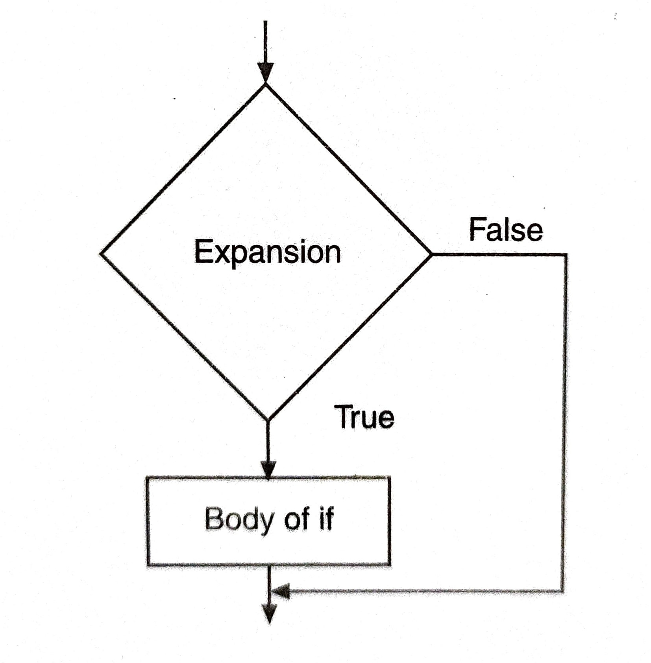
Decision making and branching continued…
Flowchart of if statement

Slide 4
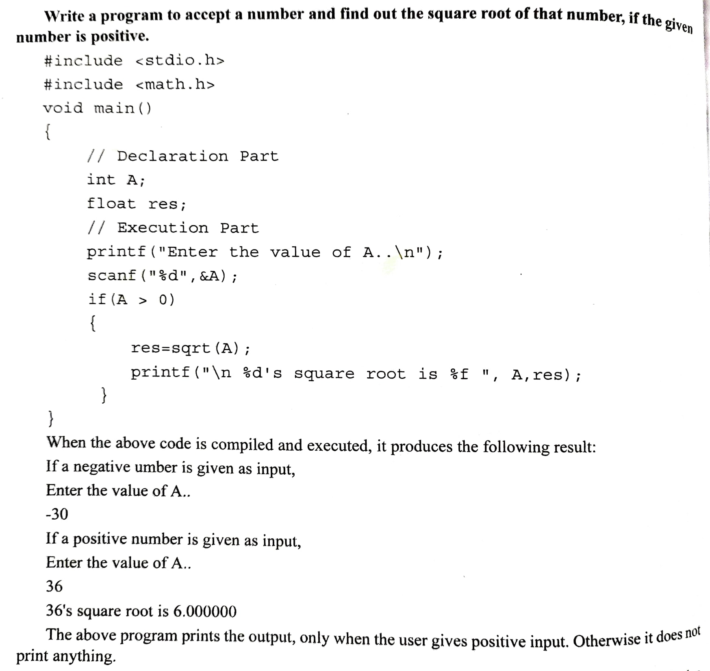
Decision making and branching continued….

Slide 5
Decision making and branching continued….
2. if …else
This statement is used to carry out one of the two sets of statements either within if block or in else block. When the logic expression is true, the compiler executes the if block. If the condition is false, it will execute the else block.
Syntax of if ..else
if (expression)
{
set of statements; →Body of if
}
else
{
Set of statements;→ Body of else
}

Slide 6
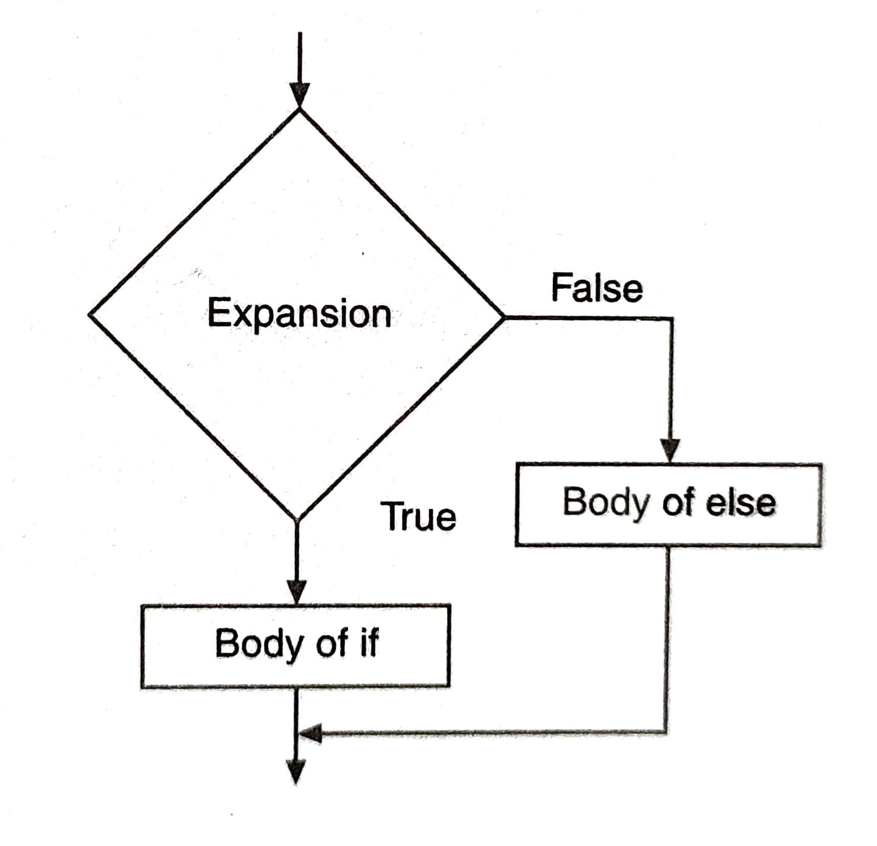
Decision making and branching continued….
Flowchart of if..else

Slide 7
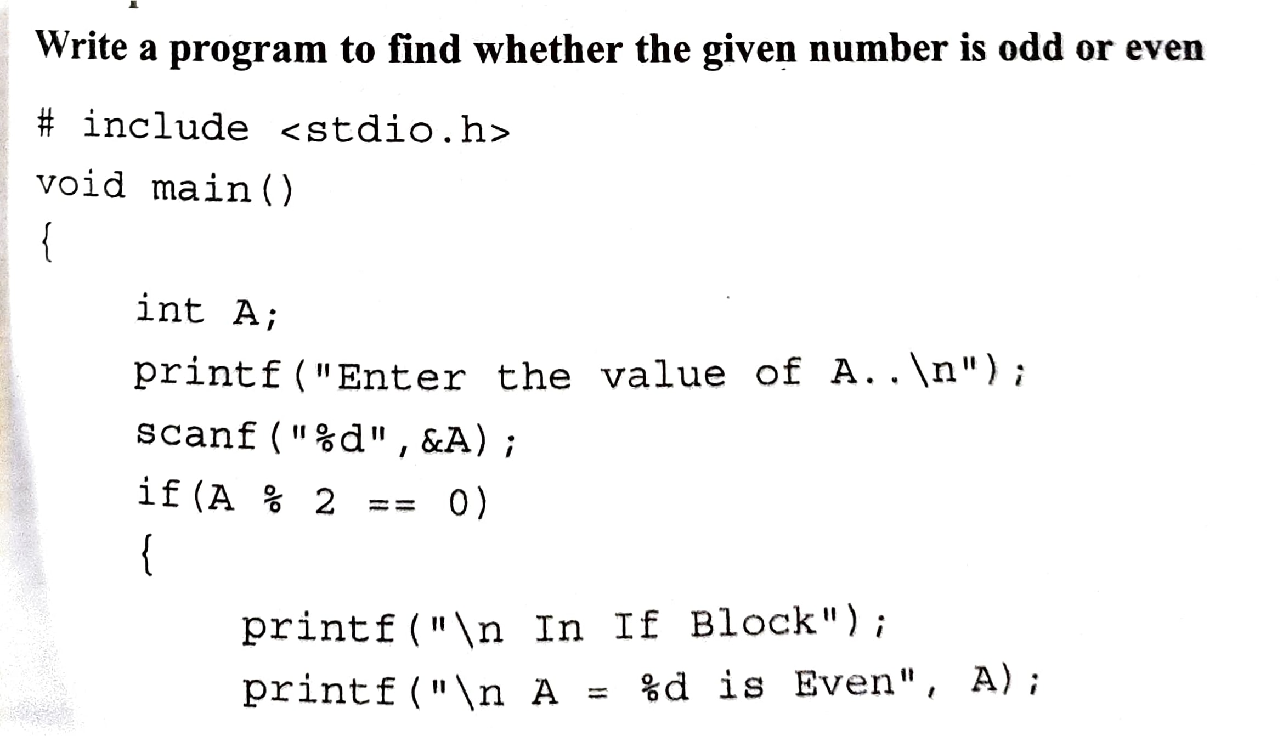
Decision making and branching continued….

Slide 8
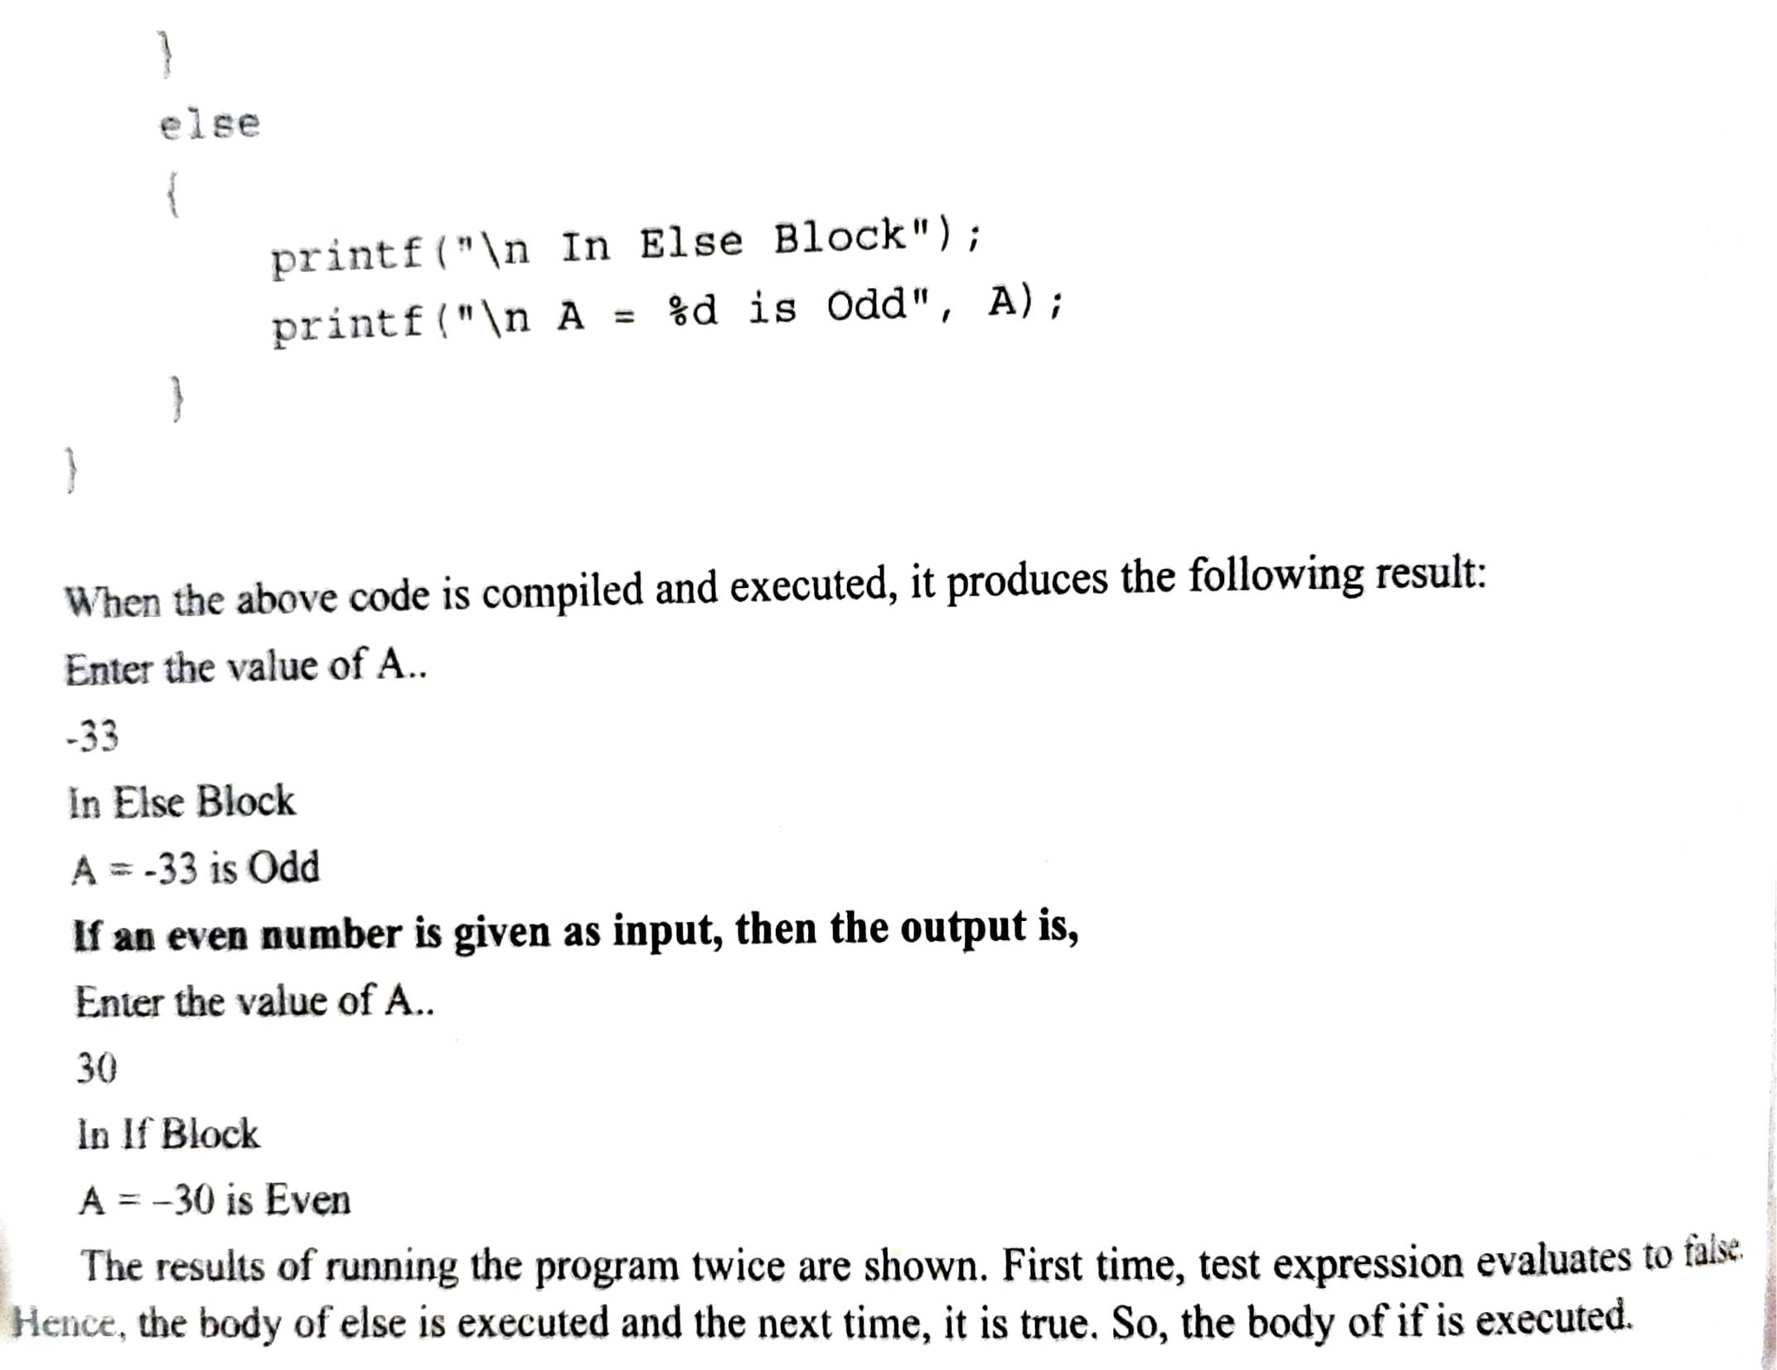
Decision making and branching continued….

Slide 9
Decision making and branching continued….
3. Nested if
Within the if block or else block another if..else statement can be placed. Such statements are called nested if statements. The statement is useful when many conditions need to be checked

Slide 10
Decision making and branching continued….
The syntax of nested if is
if (expression)
{
if (expression)
{
set of statements;
}
else
{
set of statements;
}
}
else
{
set of statements;
}

Slide 11
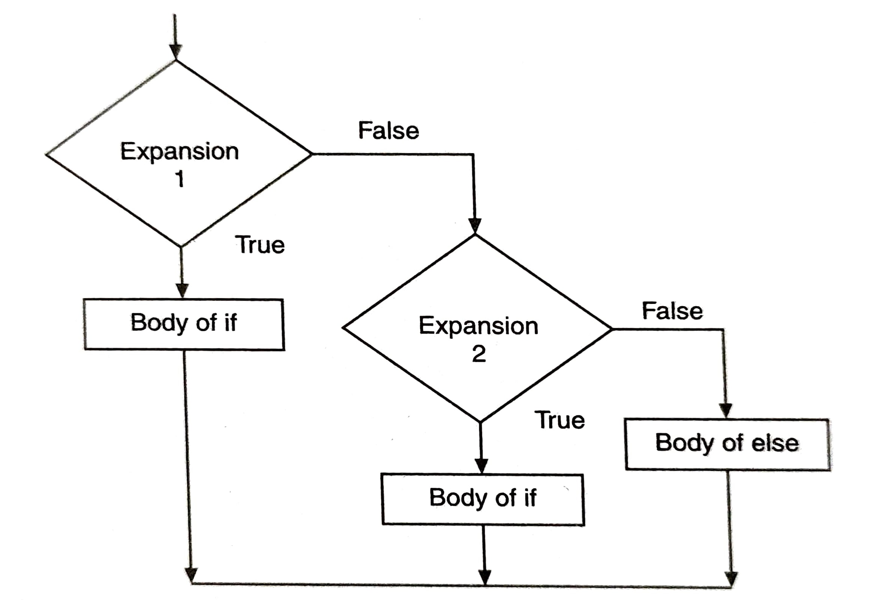
Decision making and branching continued….
The flowchart of nested if

Slide 12
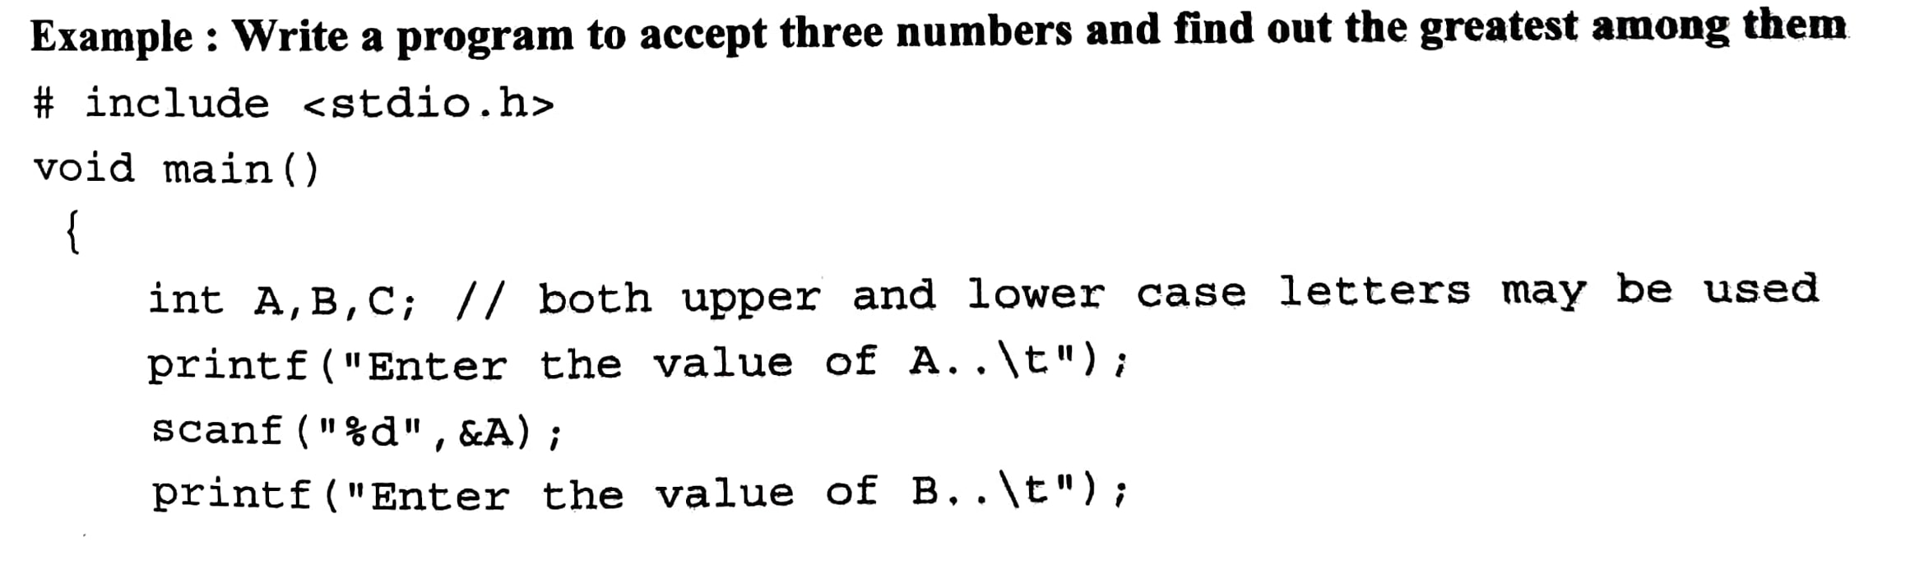
Decision making and branching continued….

Slide 13
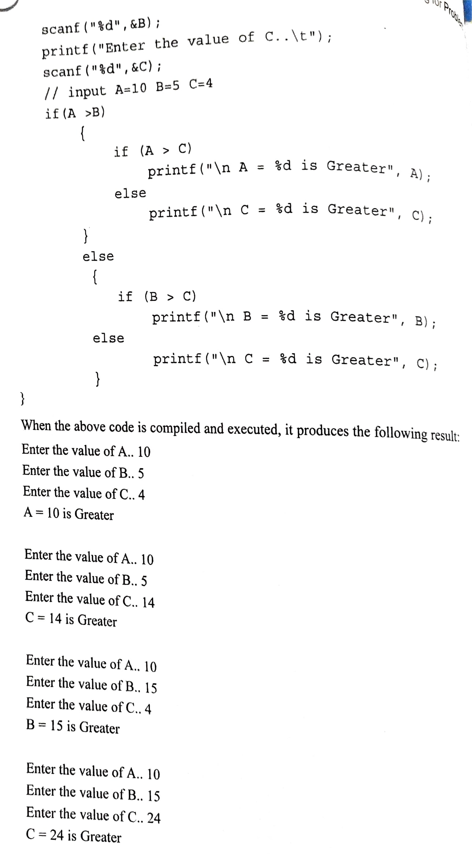
Decision making and branching continued….

Slide 14
Decision making and branching continued….
4. Switch case
Switch case statement is a control flow statement that tests whether an expression matches one of a number of constant integer values or character values, and branches accordingly.
Syntax
Switch (expression)
{
case value:
set of statements;
break;

Slide 15
Decision making and branching continued….
Case value 2:
Set of statements;
Break;
Case value 3:
Set of statements;
Break;
:
:
:
Default:
Set of statements;
Break;
}

Slide 16
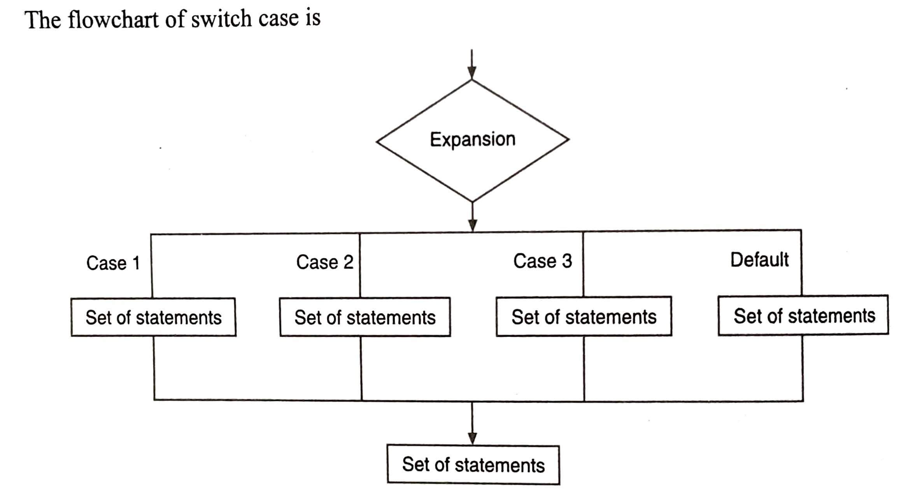
Decision making and branching continued….

Slide 17
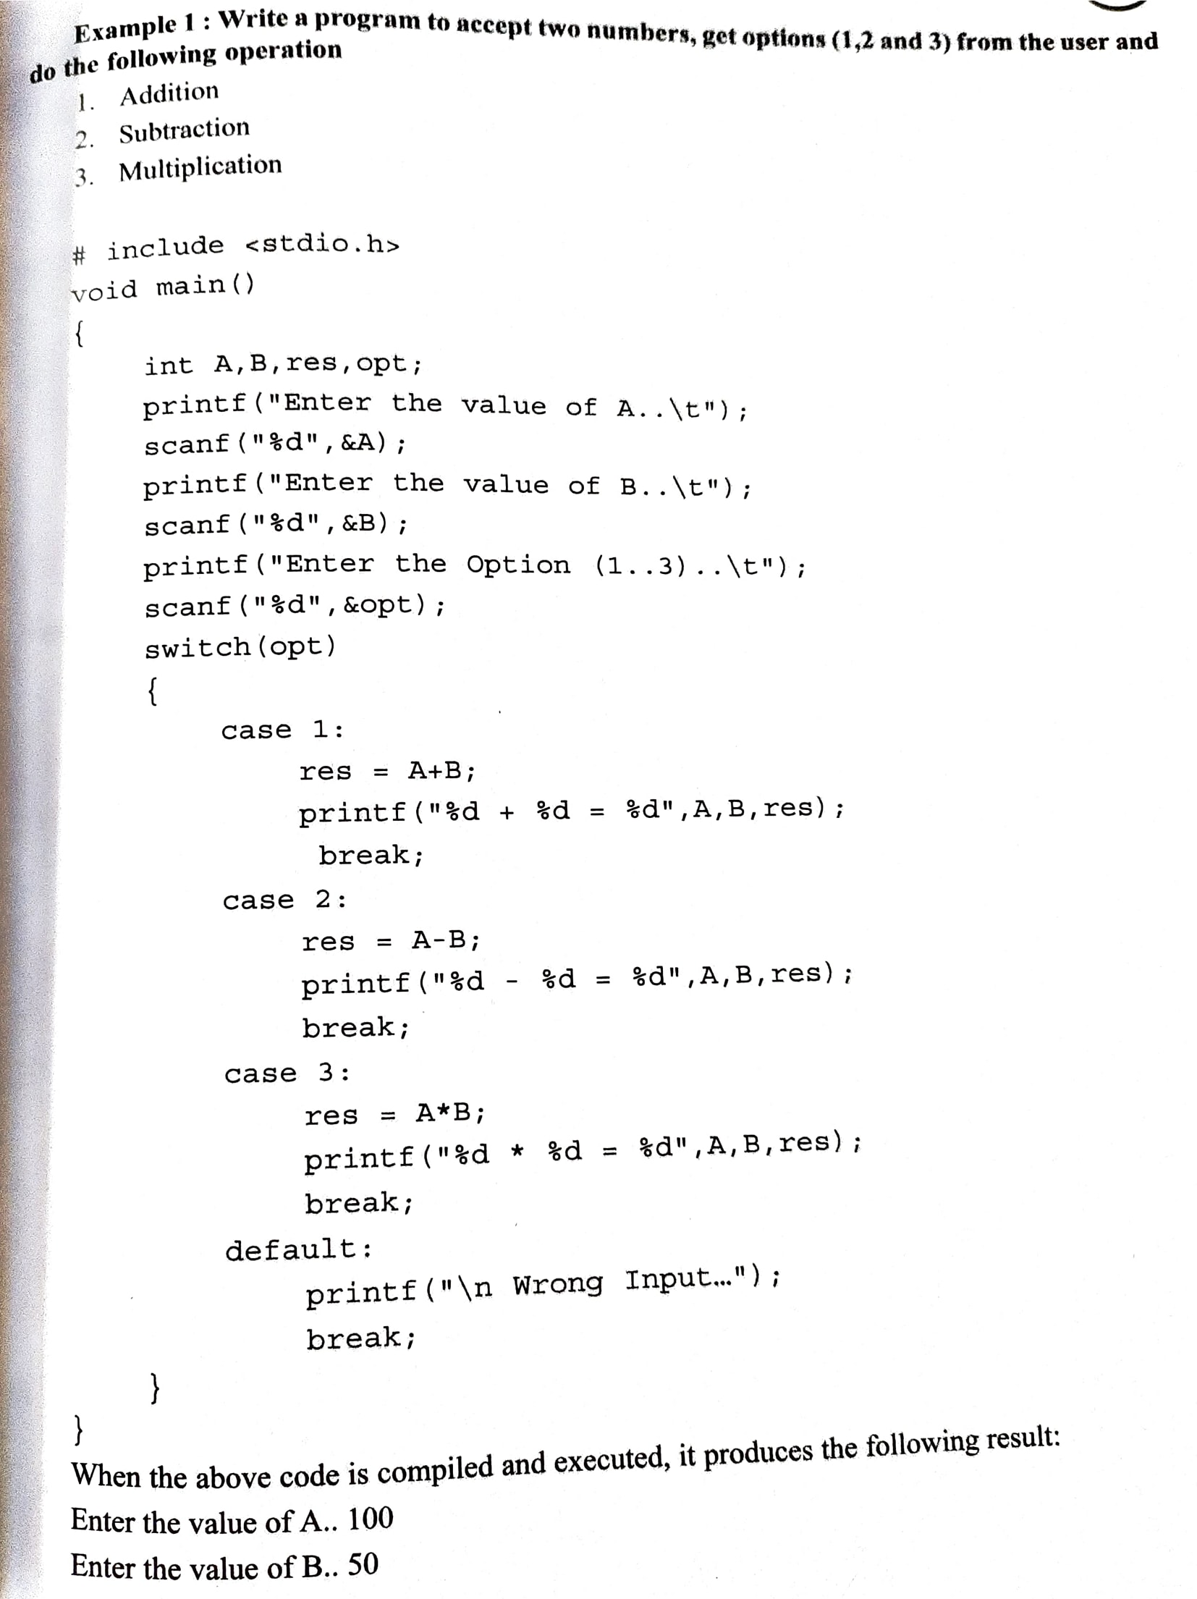
Decision making and branching continued….

Slide 18
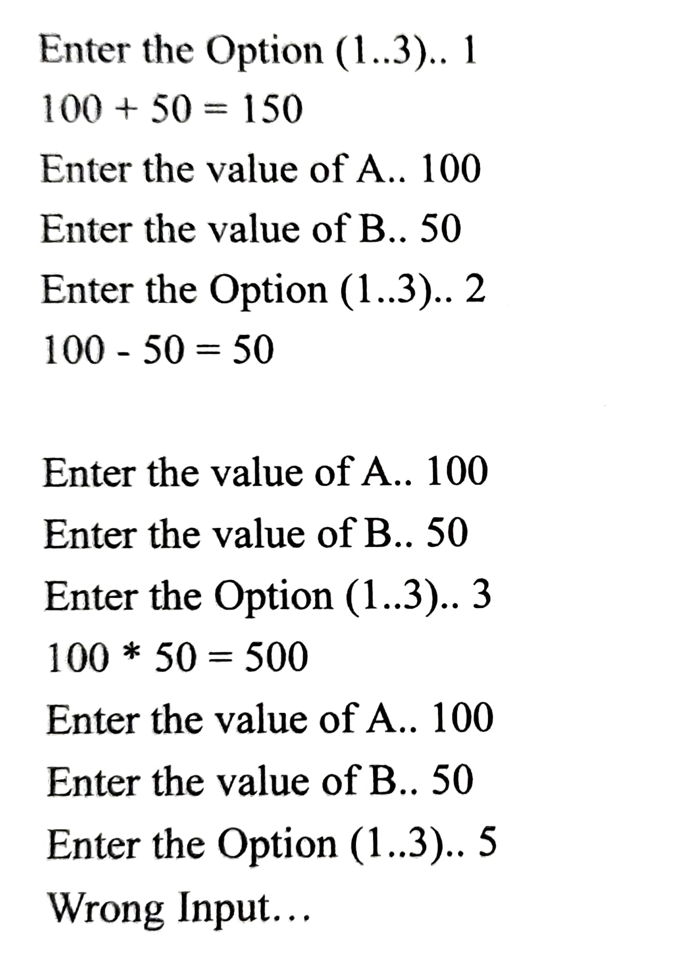
Decision making and branching continued….

Slide 19
Types of looping statements
There are two types of looping statements:
(a)Entry controlled loop
(b)Exit controlled loop
Entry controlled loop
In such type of loop, the test condition is checked first before the loop is executed.
Examples of this looping statements are:
While loop
For loop

Slide 20
Types of looping statements continued…
(b) Exit Controlled Loop
In such type of loop, the loop is executed first. Then condition is checked after the blocks of statements are execute. The loop is executed at least once.
Example of this looping statement is:
do-while loop

Slide 21
For statement
This is an entry controlled looping statement.
The syntax of the for statement is,
for (initialization; expression; update)
{
set of statements;→Body of for loop
}
set of statements;→ Statements after for
In this loop structure, more than one variable can be initialized.
The initialization allows the program to either declare a variable and give it a value or give a value to an already existing variable.

Slide 22
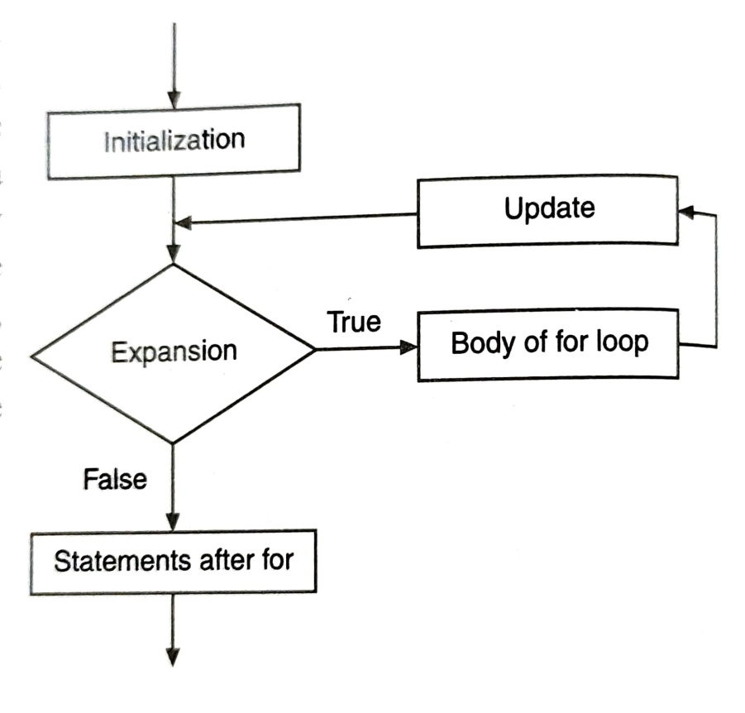
For statement continued…
Second, the condition tells the program that the while condition expression is true, the loop should continue to repeat itself.
The update allows the updation of a variable.
That is the variable may be incremented or decremented.

Slide 23
For statement continued…
Example
#include <stdio.h>
Void main () /* program introduces the for statement, counts to 10 */
{
int count;
For (count =1; count <= 10; count=count+1 )
{
printf (“%d ”, count );
printf(“\n”);
}
}

Slide 24
While statement
This is an entry controlled looping statement. It is used to repeat a block of statements till the condition is true. Its syntax is,
while ( condition)
{
set of statements; → Body of while loop
}
set of statements; → statements after while
Somewhere within the body of the while loop, a statement must alter the value of the variable used in the condition to allow the loop to finish.

Slide 25
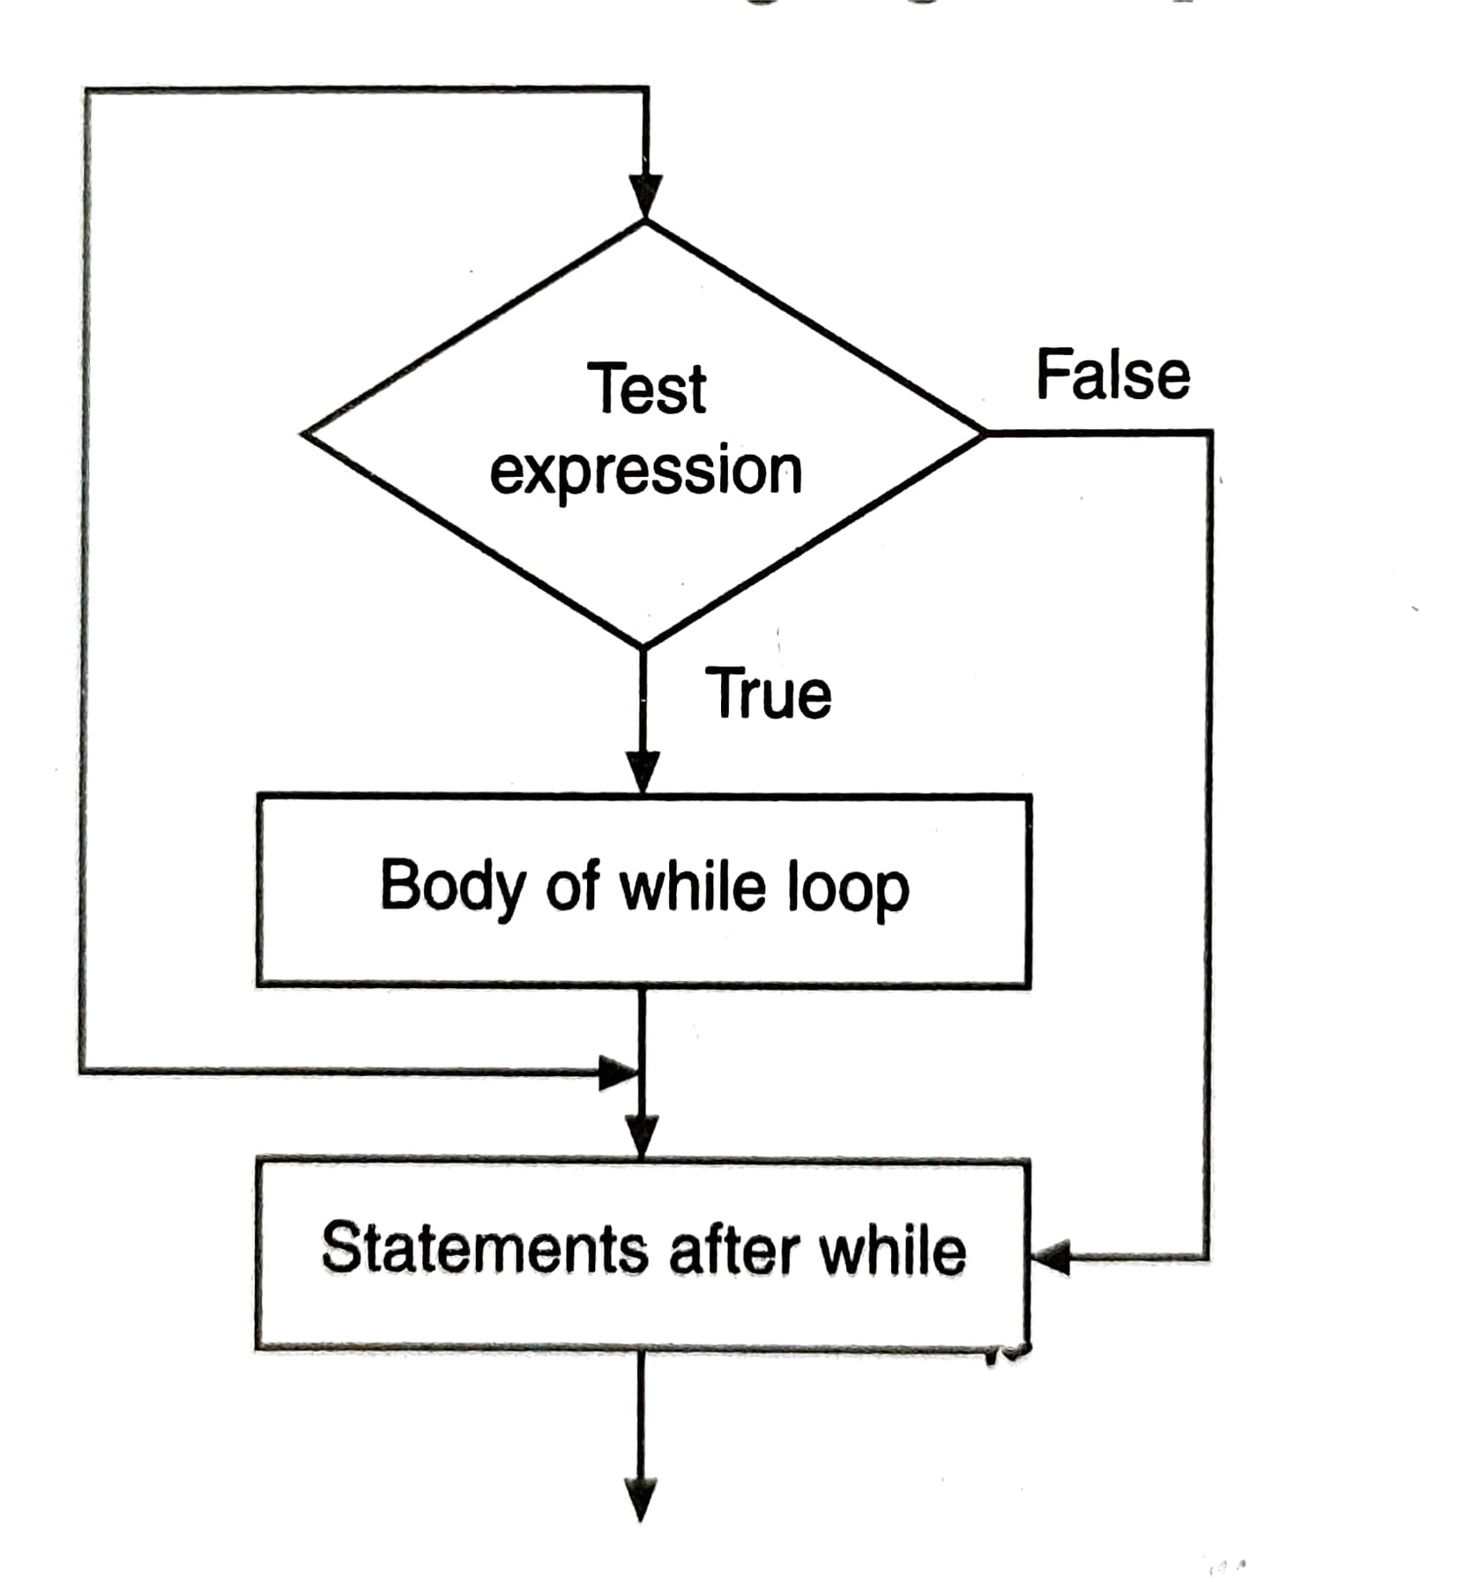
While statement continued..

Slide 26
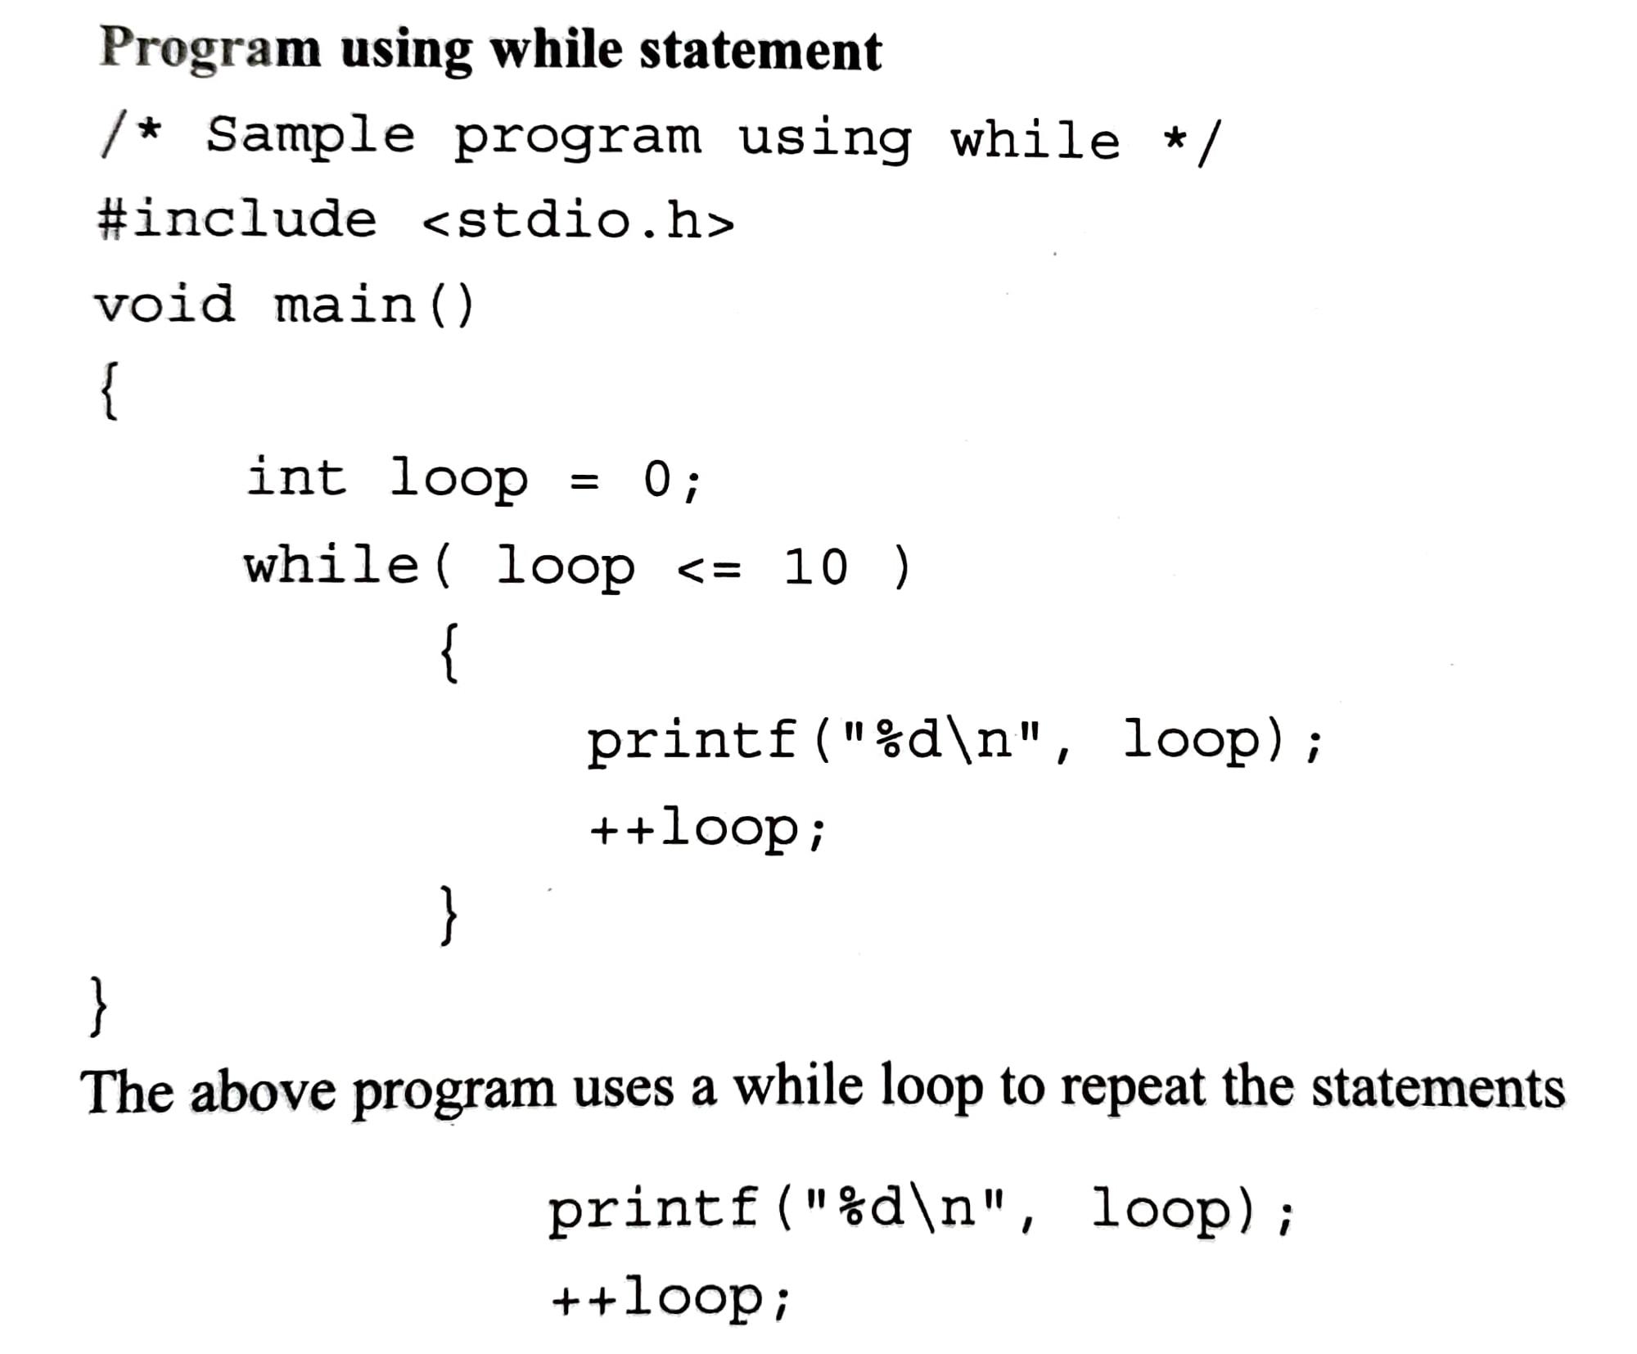
While statement continued…

Slide 27
Do-While statement
This is an exit controlled looping statements.
Sometimes there is a need to execute a block of statements first and then to check the condition.
The syntax of this statement is,
Do
{
set of statements;
}
while (condition);

Slide 28
Do-While statement continued..
Example
#include <stdio.h>
Void main()
{
int x=0;
do
{
printf(“%d\n”, x );
x++; /* update x so that condition can be met eventually */
} while ( x<=10 ); /* while x is less than 10*/
}

Slide 29
Break and continue
Break statement
In C programming, break is used in terminating the loop immediately after it is encountered.
The break statement can be used in terminating all three loops: for, while and do while loops.
In general it is used with if statement inside loop.
Syntax :
break;

Slide 30
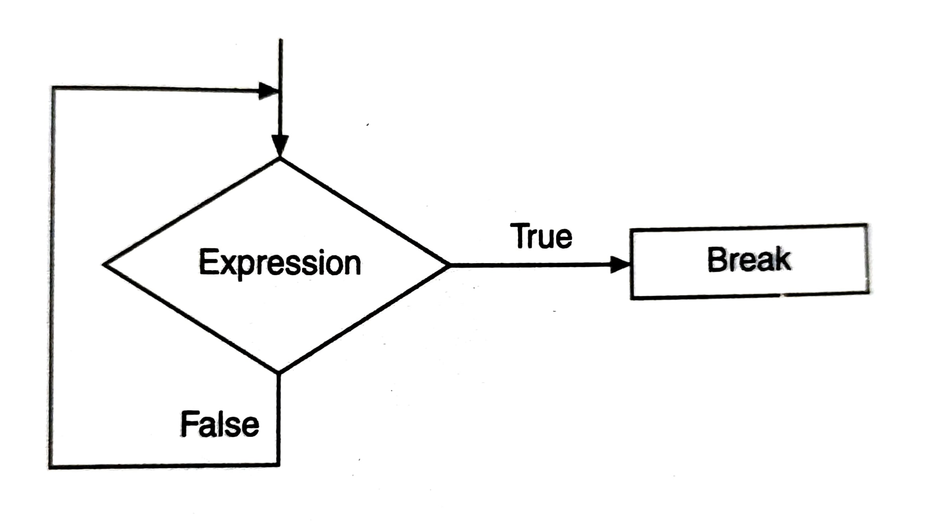
Break and continue

Slide 31
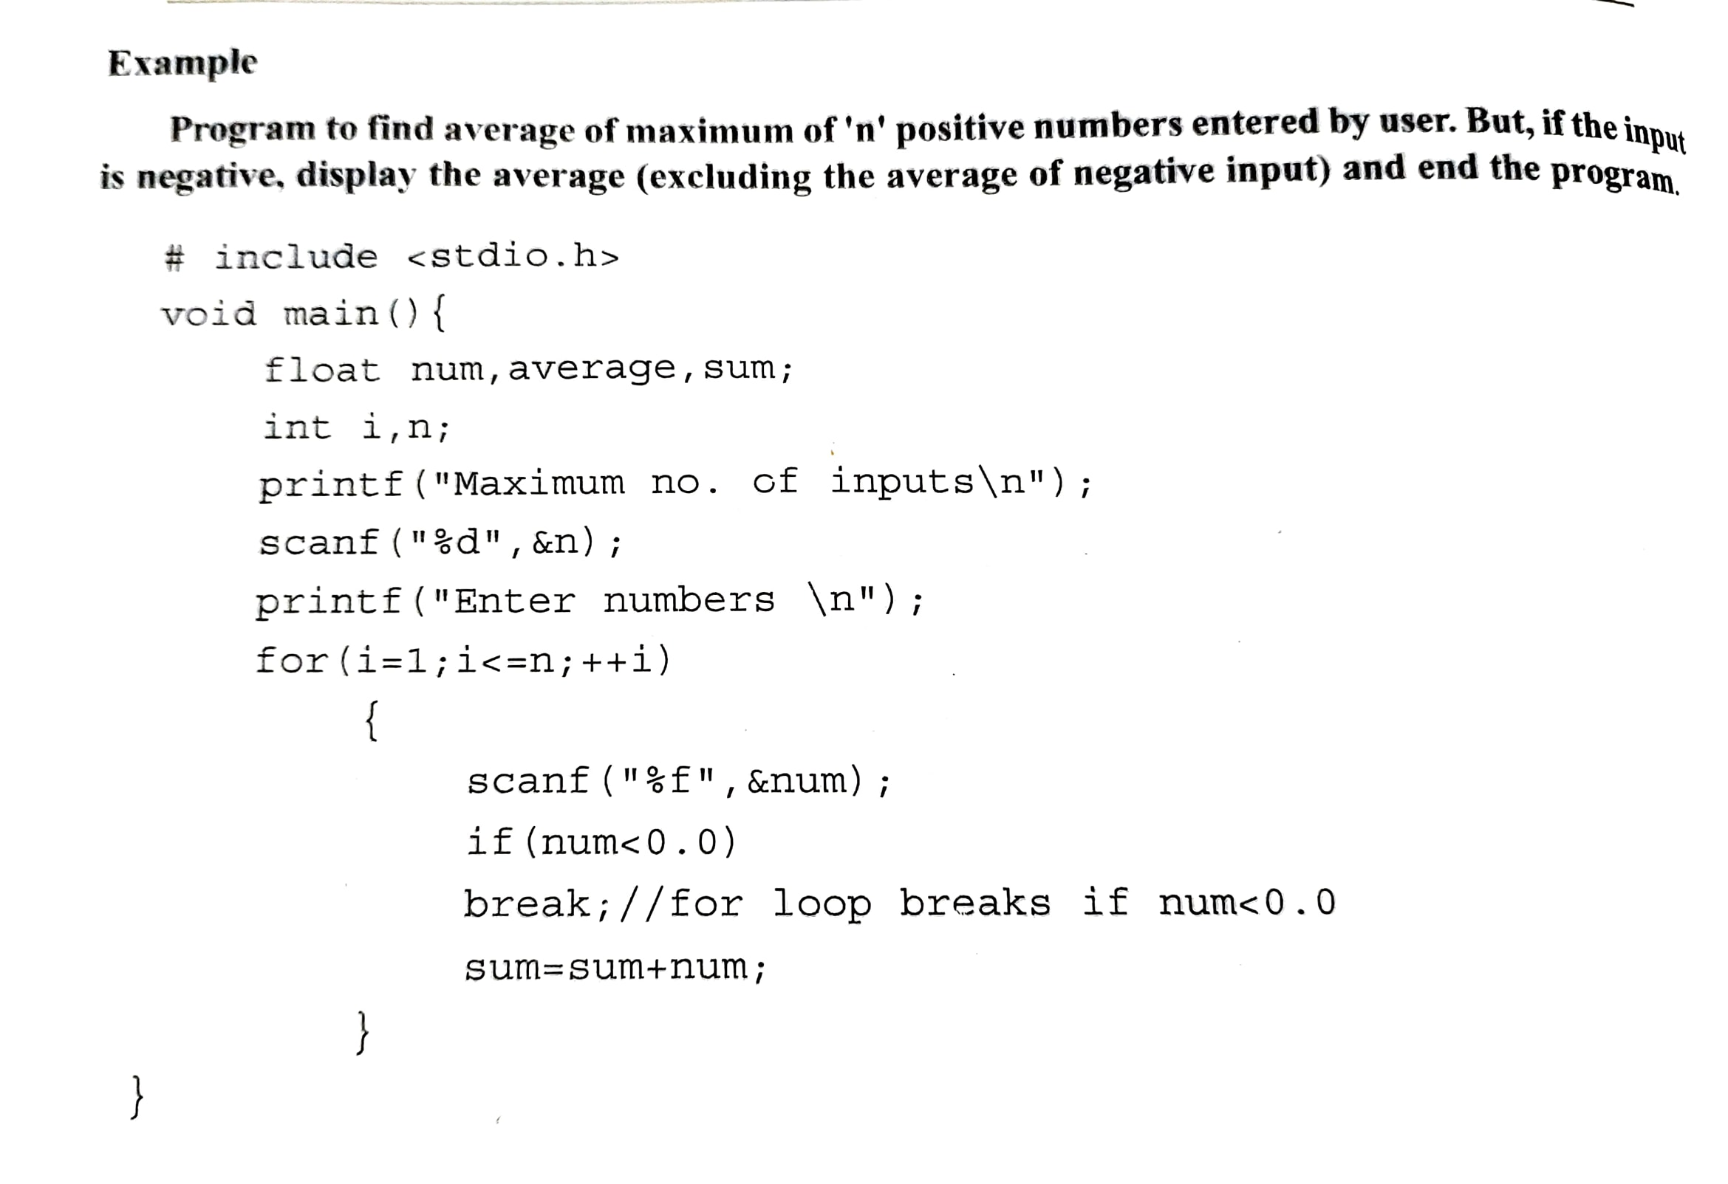
Break and continue

Slide 32
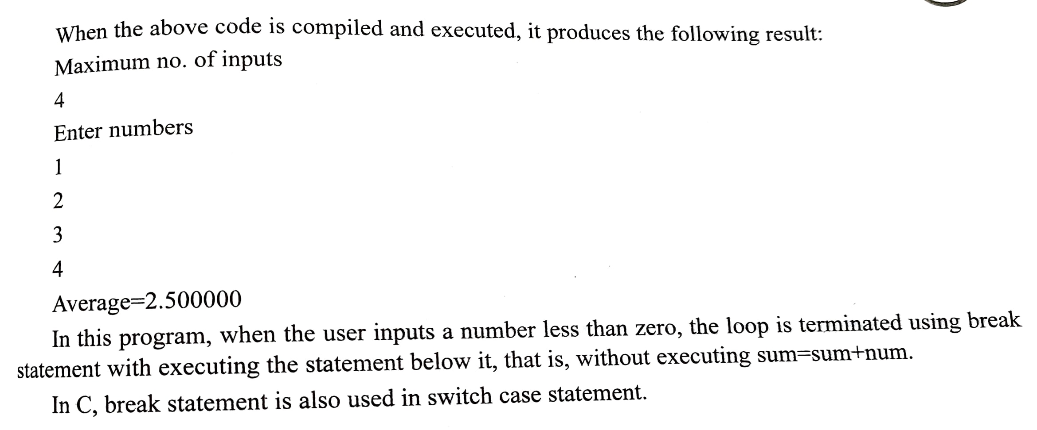
Break and continue

Slide 33
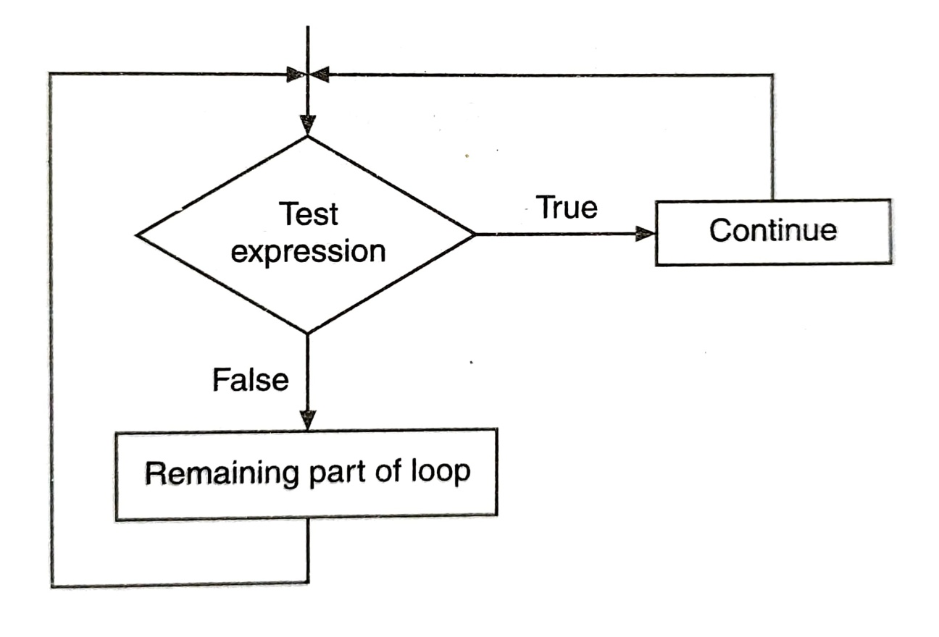
Break and continue
2. Continue
Just like break, continue is also used with if statement.

Slide 34
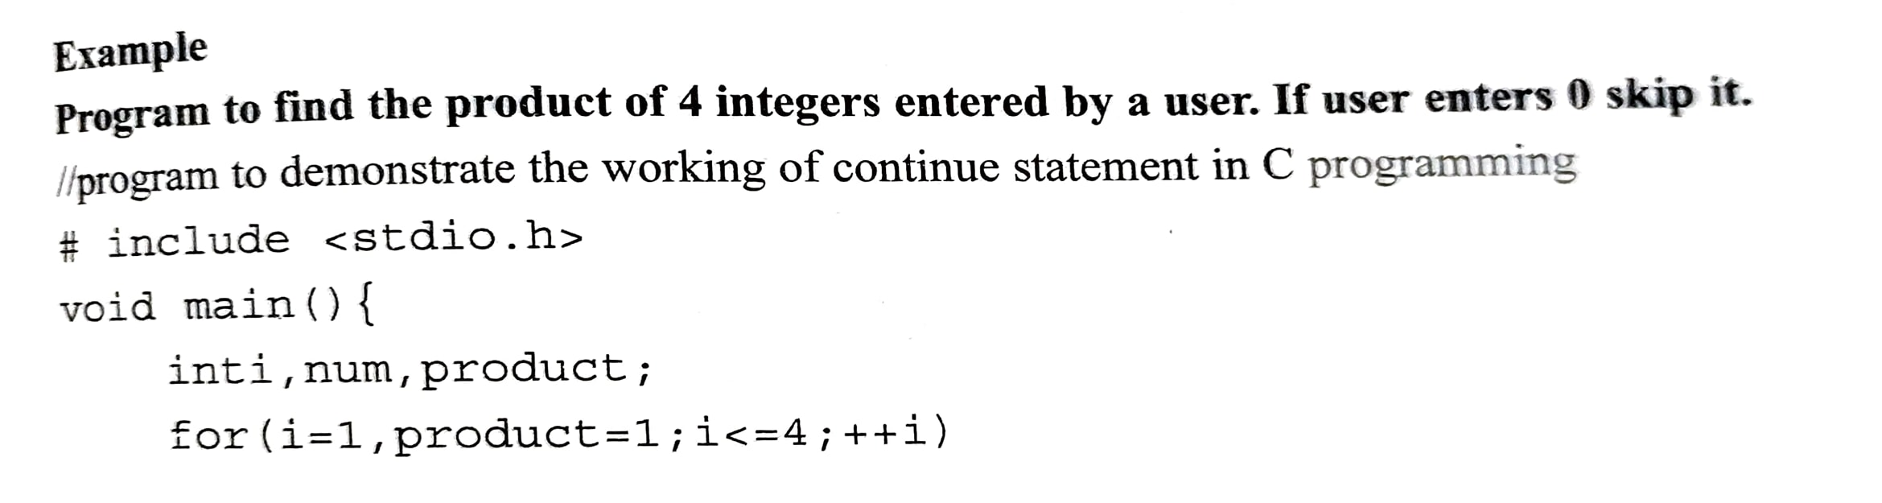
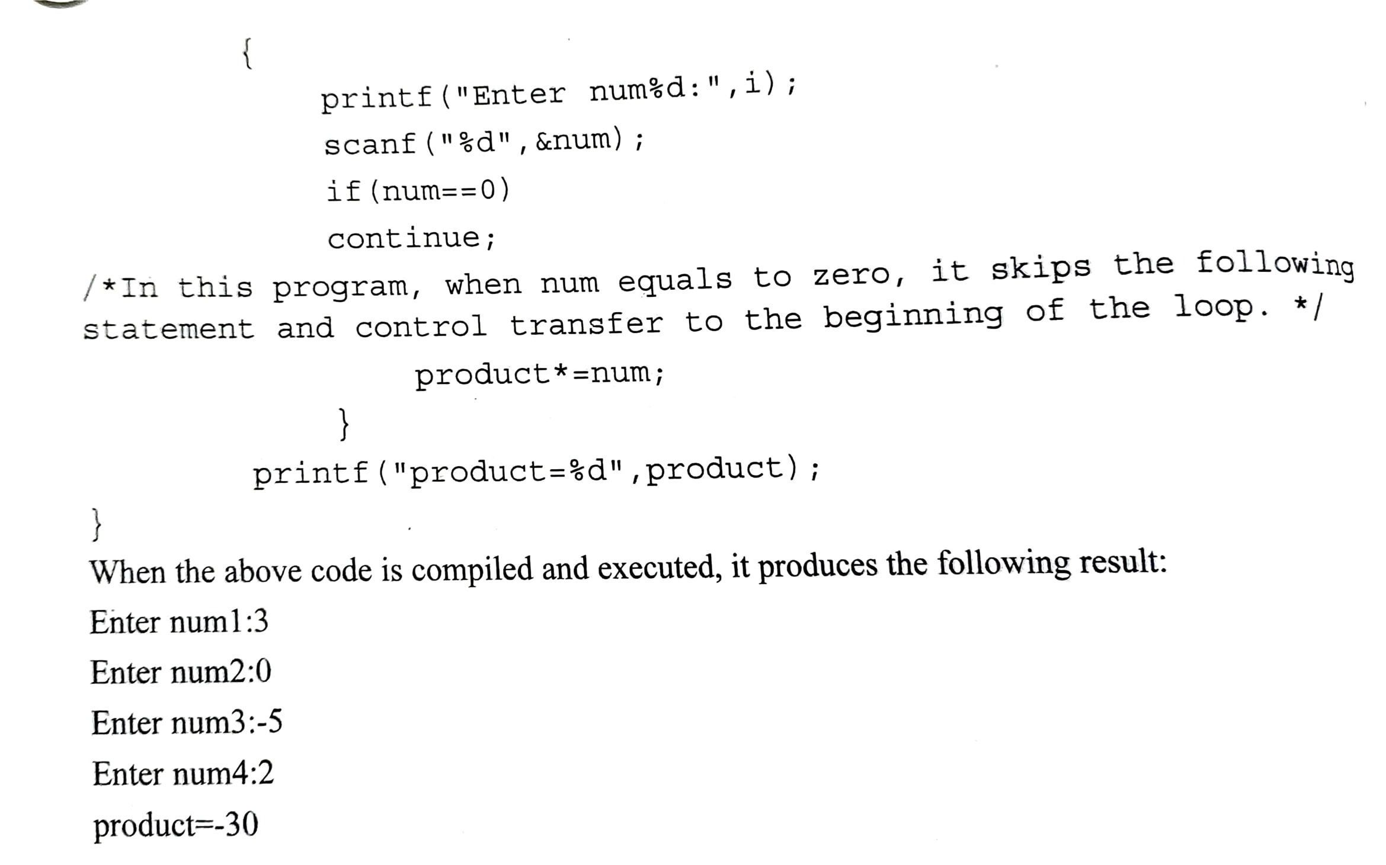
Break and continue

