Slide 1

Problem Solving Through Programming Using C
Code-CS181106
Module2

Slide 2
Operators and Expressions
Definition: An operator is a symbol that tells the compiler to perform specific mathematical or logical functions. In programming, an expression is any legal combination of symbols that represents a value. Each programming language and application has its own rules for what is legal and illegal

Slide 3
Operators and Expressions continued…
Types of operators
Assignment operator
Arithmetic operators
Relational operators
Logical operators
Increment and decrement operators
Bitwise operators
Conditional operators
Arithmetic assignment operators
Other operators

Slide 4
Operators and Expressions continued…
Assignment operator
This is a binary operator and it is used to assign value of an expression/constant on the right hand side to the variable on the left hand side. The general form is:
Variable=expression;
Where expression can be a constant, variable or valid C expression
Example:
a=10;
a= b + c;

Slide 5
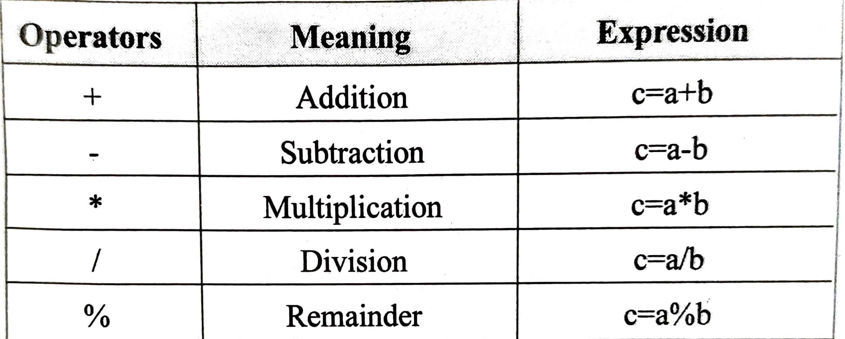
Operators and Expressions continued…
b) Arithmetic operators
They are used to perform arithmetic operations like addition, subtraction, multiplication, division etc. These are binary operators. They are:

Slide 6
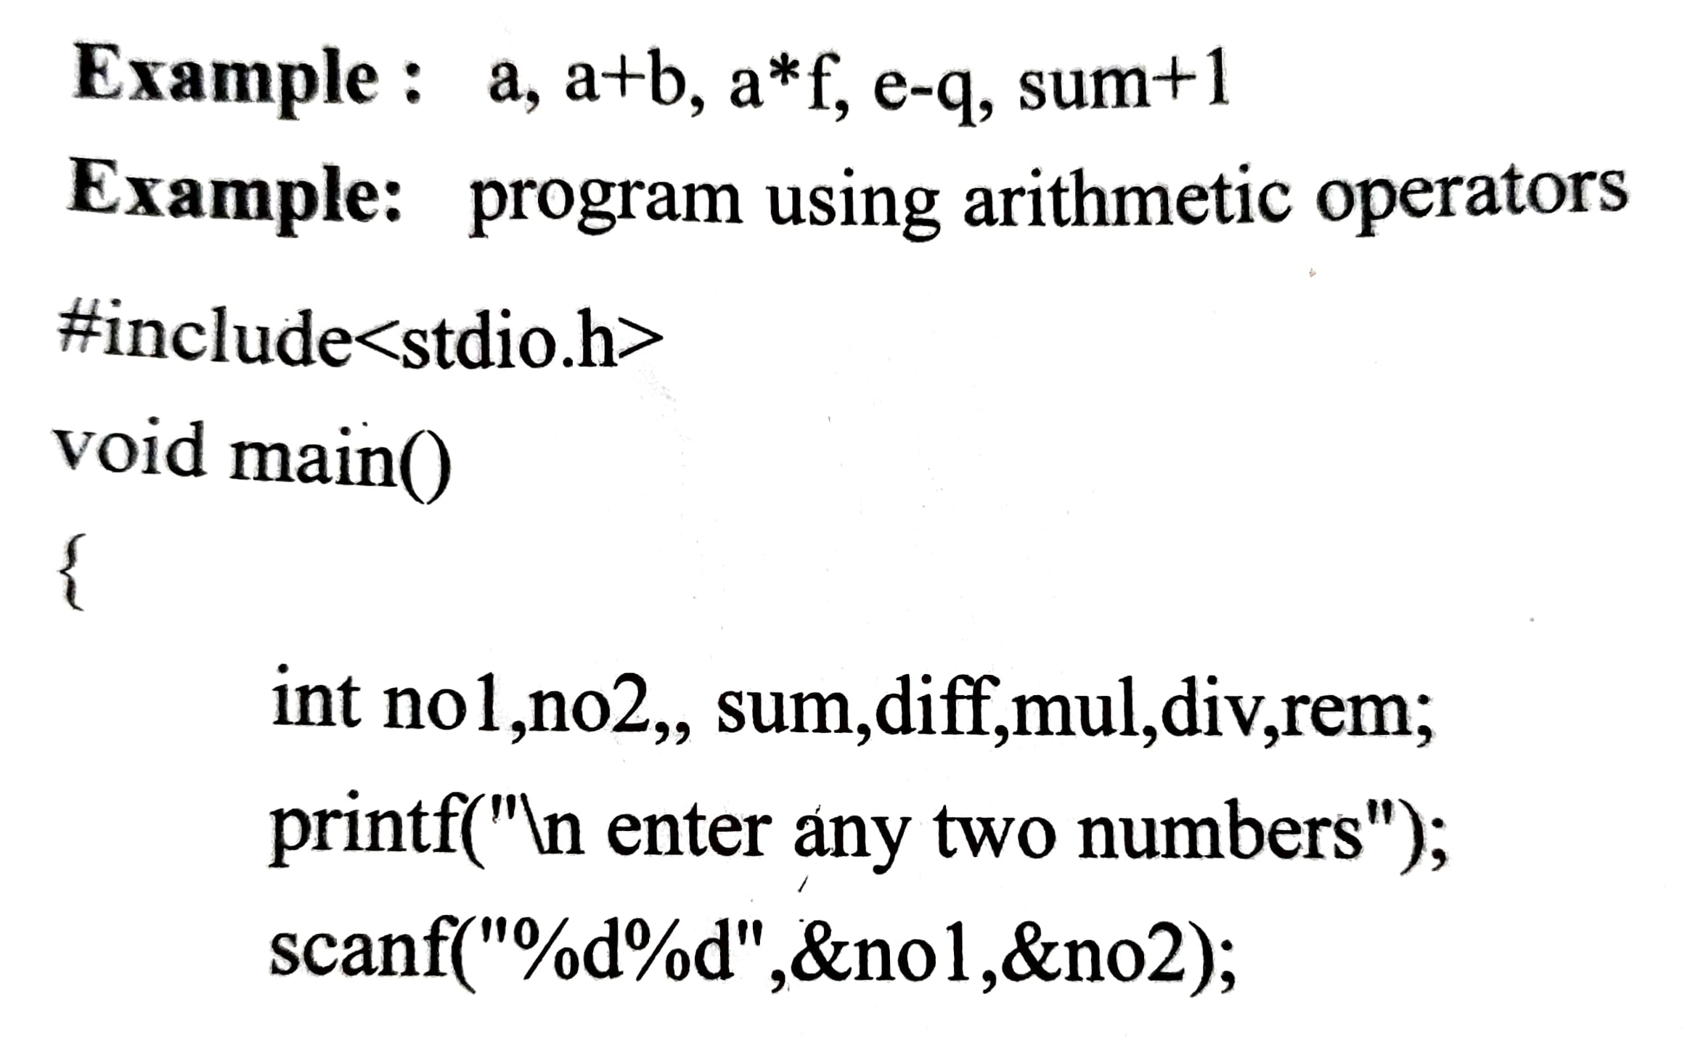
Operators and Expressions continued…
The expression formed with arithmetic operators and variables and/or constants are arithmetic expressions.

Slide 7
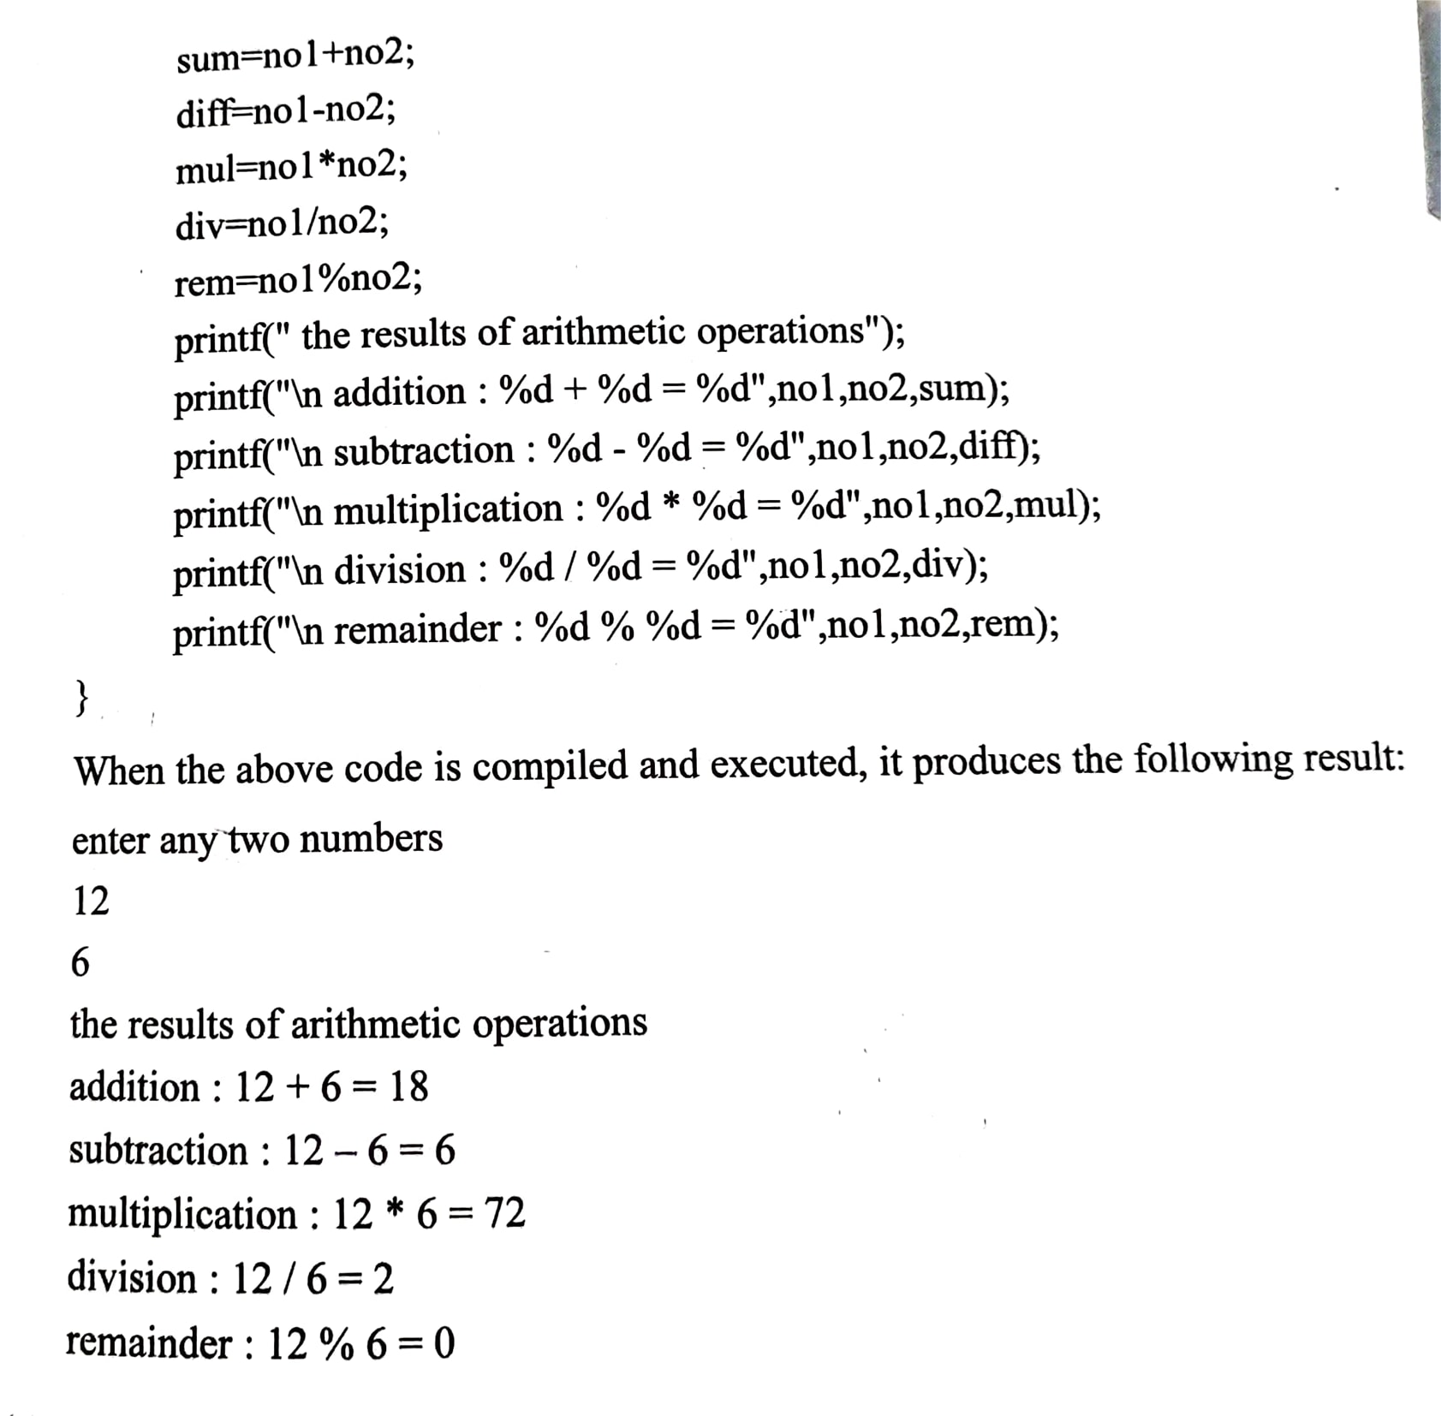
Operators and Expressions continued…

Slide 8
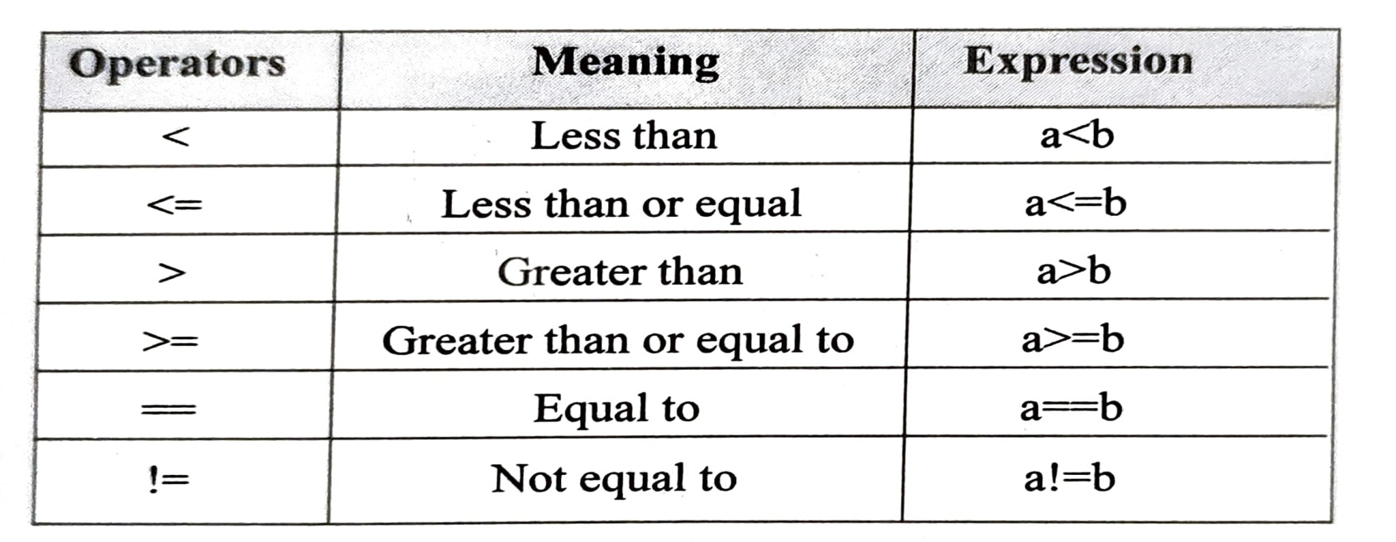
Operators and Expressions continued…
c) Relational operators
These operators are used to compare two values. They are all binary operators. The result of the comparison is either true (non zero) or false (0). The relational operators in C are:

Slide 9
Operators and Expressions continued…
c) Relational operators
These operators are used to compare two values. They are all binary operators. The result of the comparison is either true (non zero) or false (0). The relational operators in C are:

Slide 10
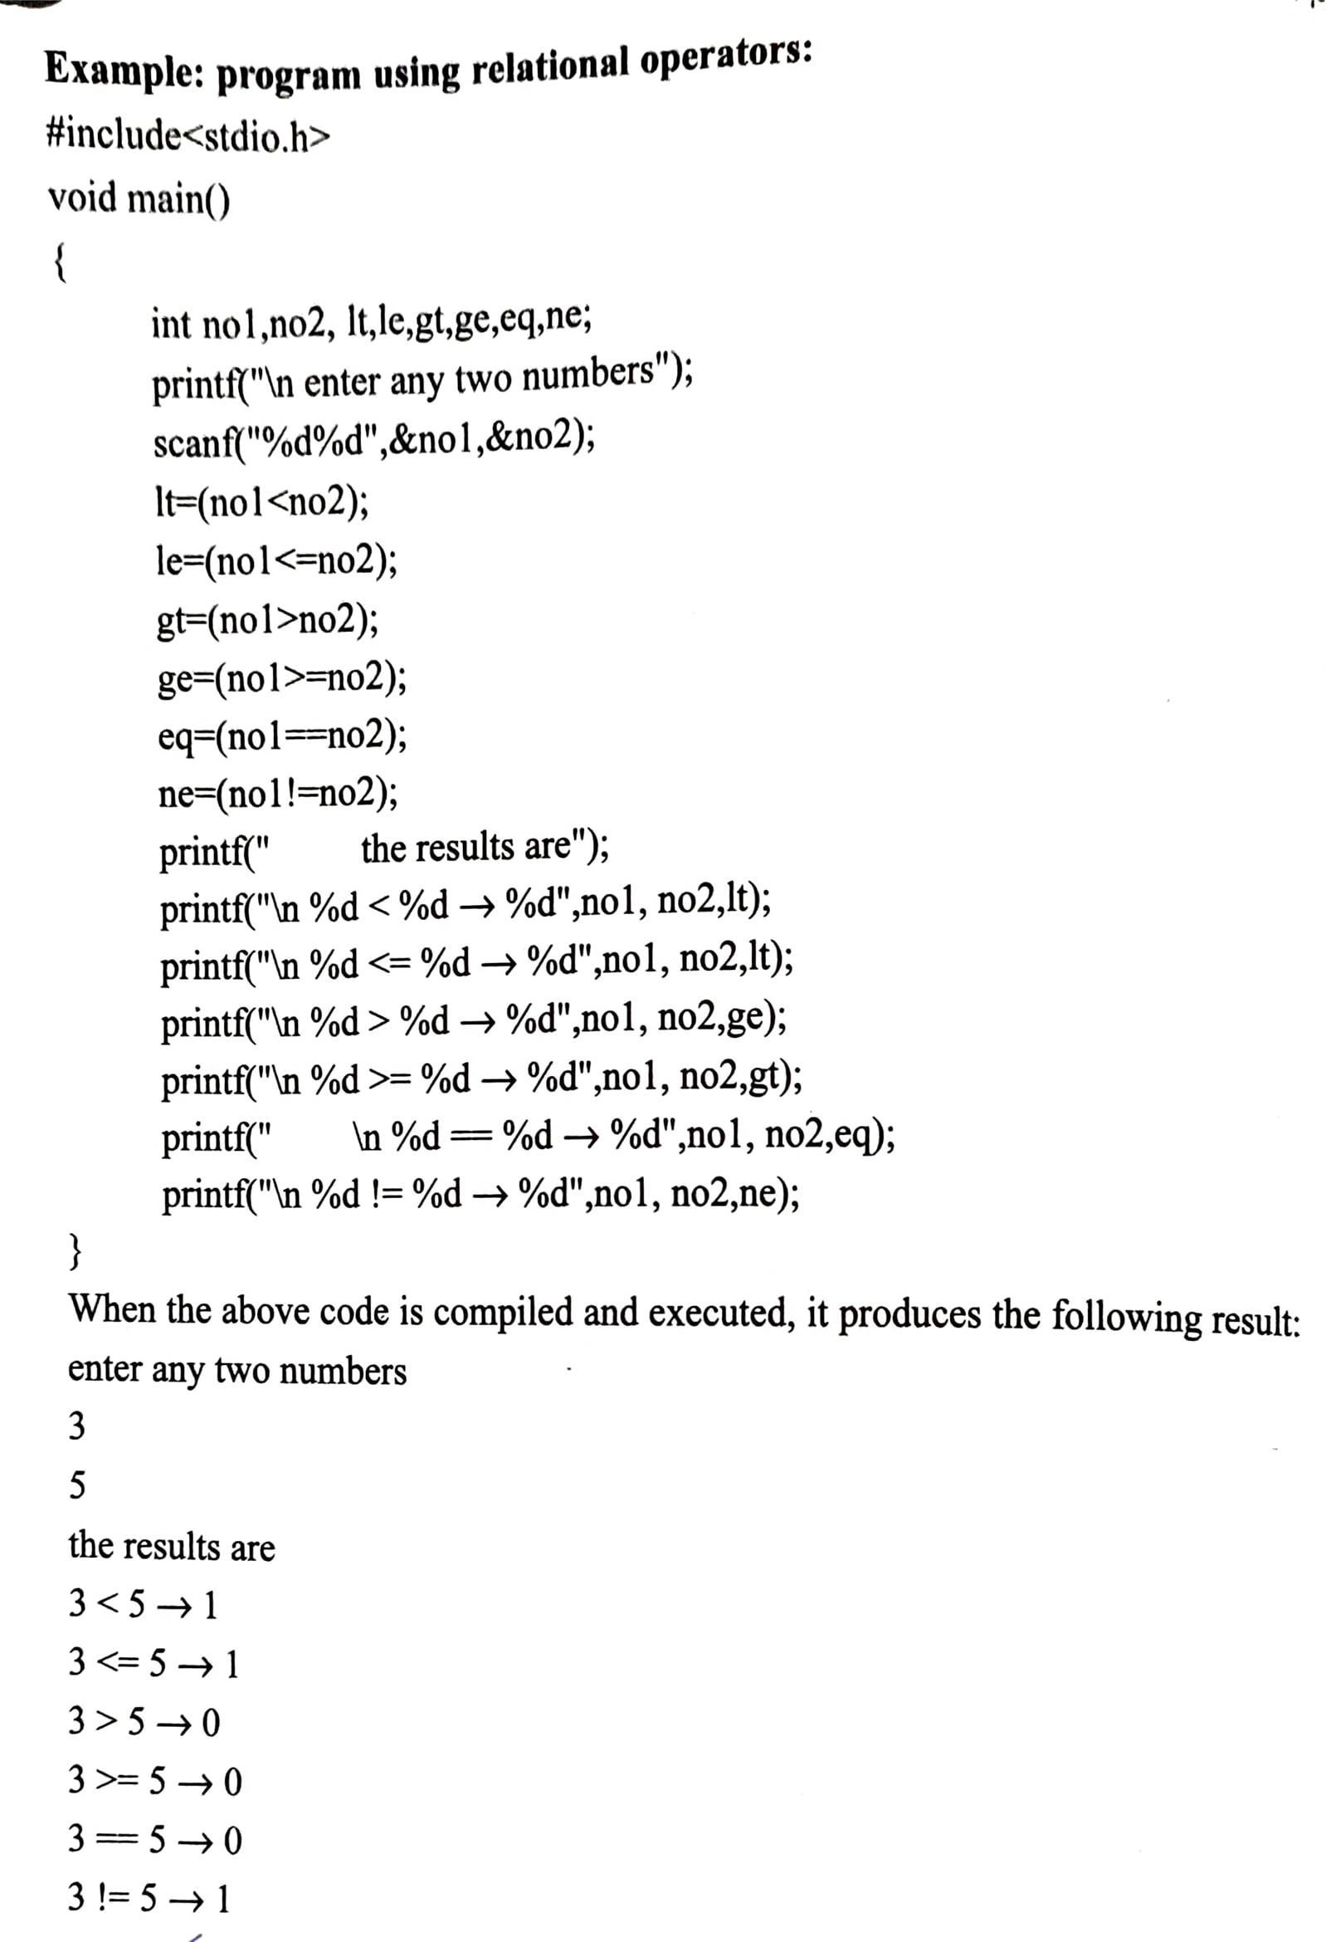
Operators and Expressions continued…

Slide 11
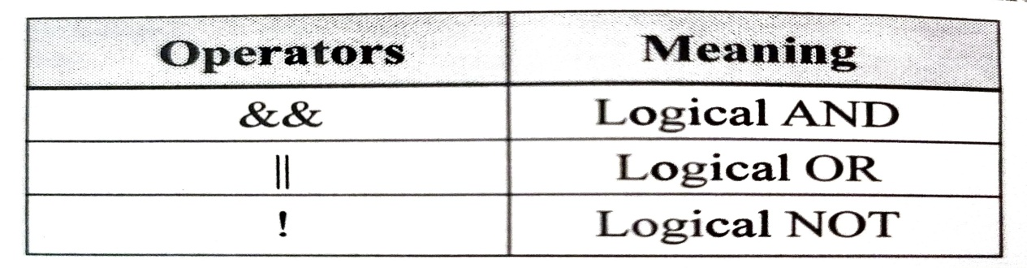
Operators and Expressions continued…
d) Logical Operator
The logical operators are used to combine relational expression.
Here ! is a unary operator. Other operators are binary.
The logical expression is formed by combining relational expressions and the result of the expression is either true(1) or false(0)

Slide 12
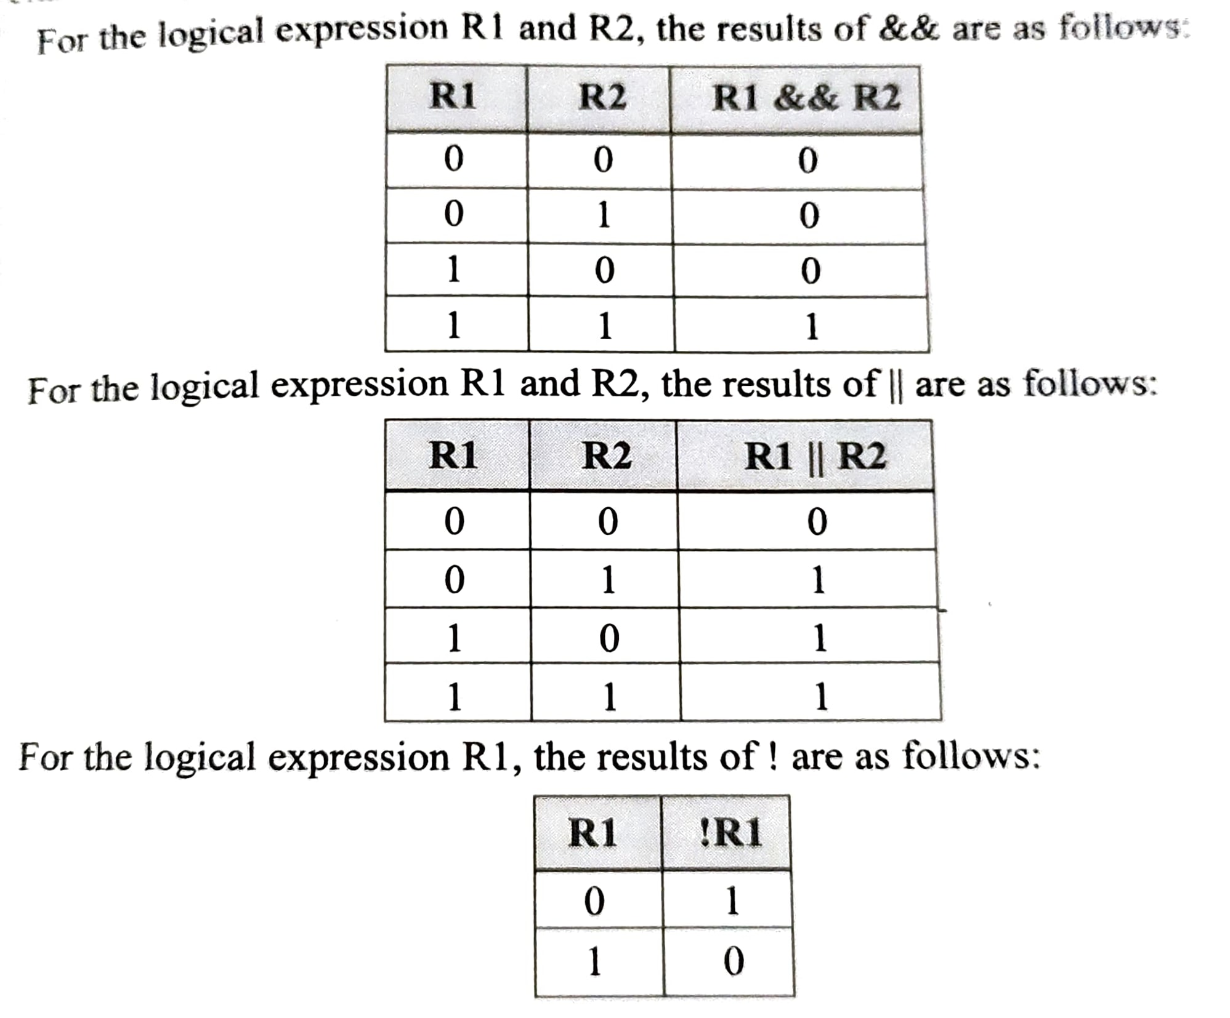
Operators and Expressions continued…

Slide 13
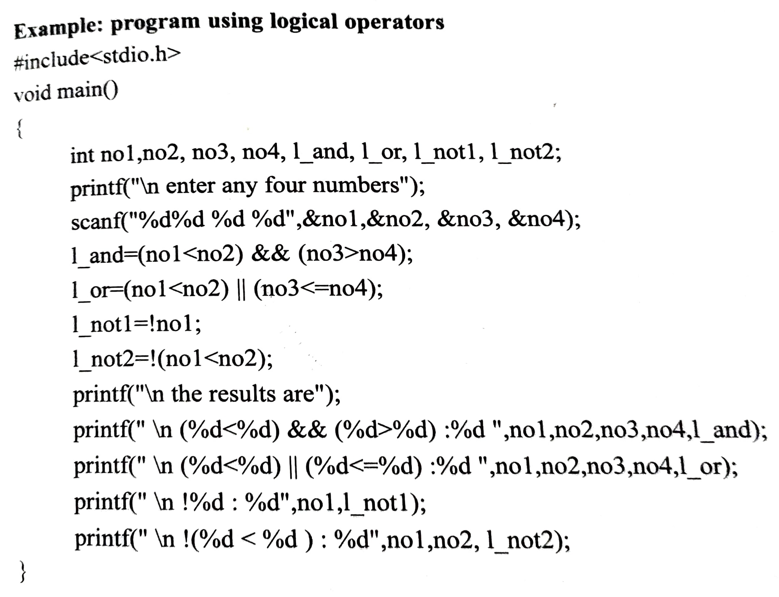
Operators and Expressions continued…

Slide 14
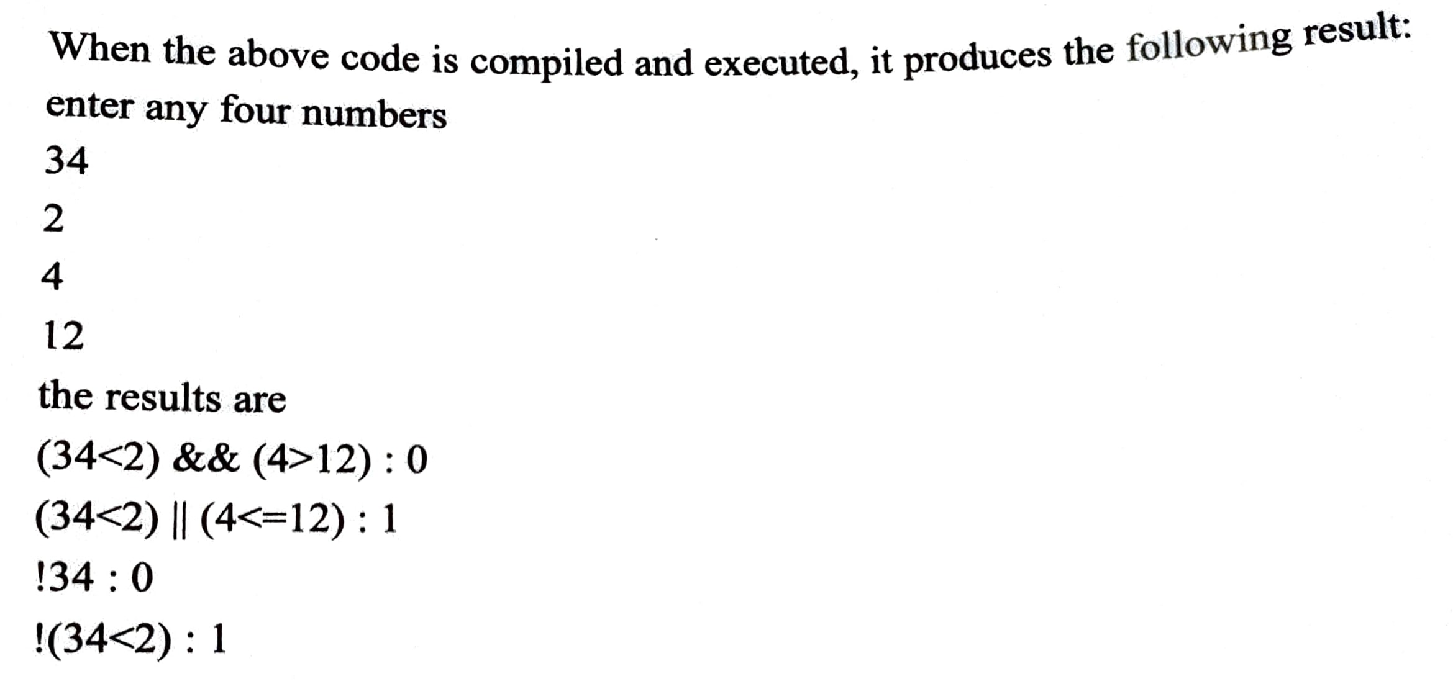
Operators and Expressions continued…

Slide 15
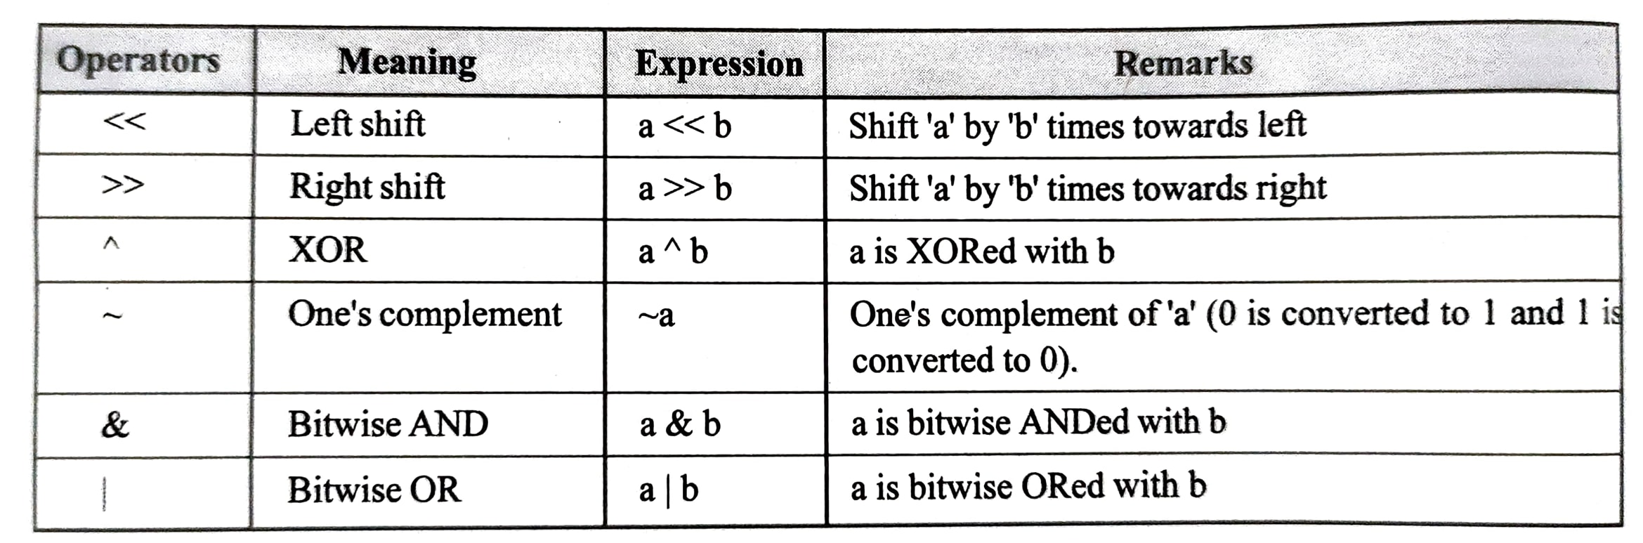
Operators and Expressions continued…
e) Bitwise operators
These operators are used to manipulate individual bits in an integer quantity. The bitwise operation in C are

Slide 16
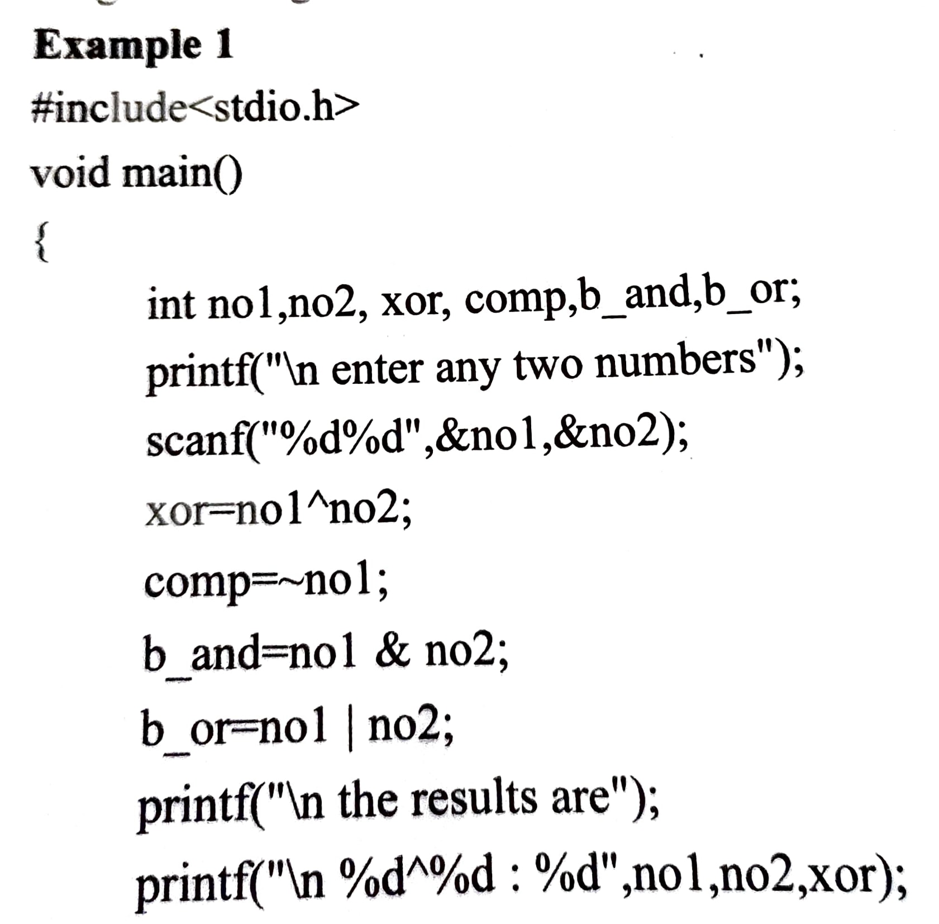
Operators and Expressions continued…

Slide 17
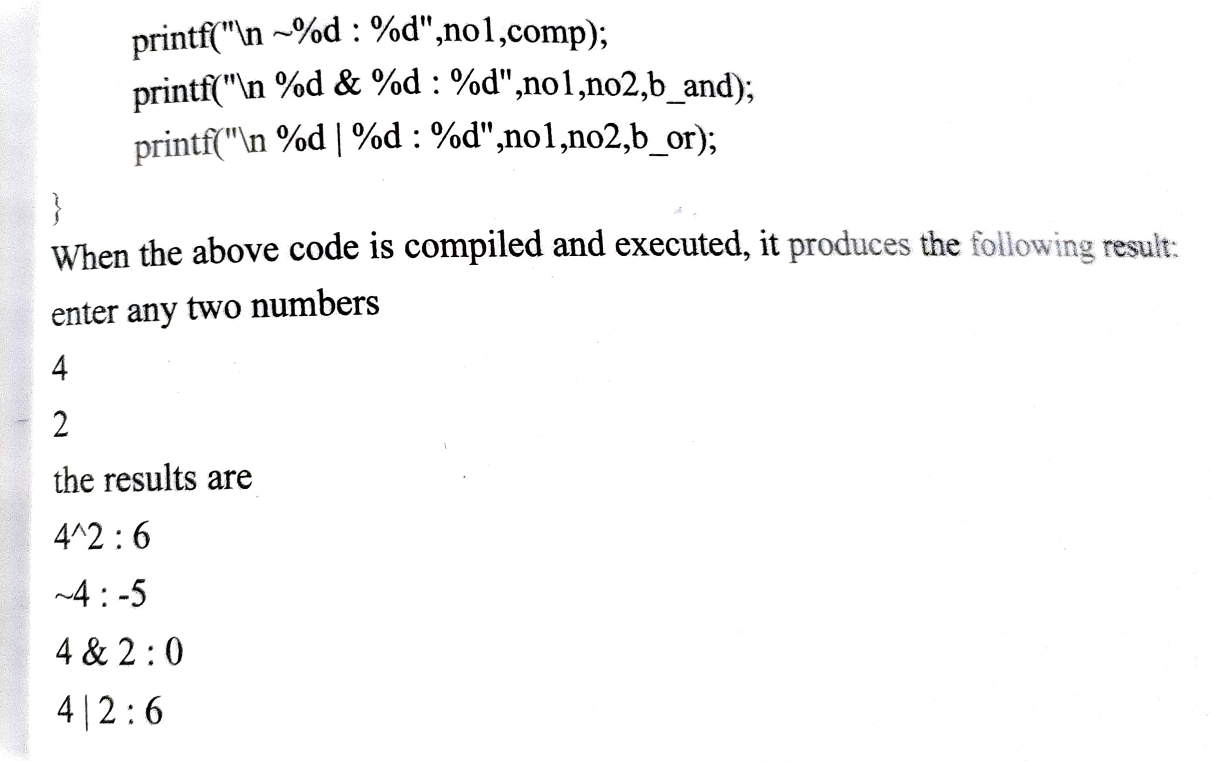
Operators and Expressions continued…

Slide 18
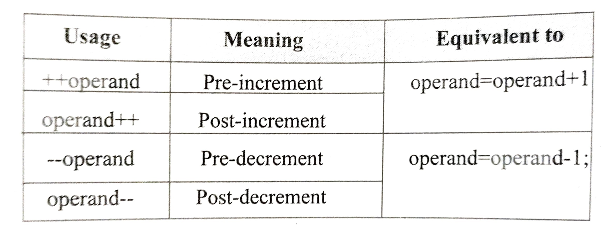
Operators and Expressions continued…
f) Increment and Decrement Operators
These operators are used to increment and decrement the value of the variable by 1.

Slide 19
Operators and Expressions continued…
a++ or ++a will increment the value of ‘a’ by 1. but if it is used as an expression, the behavior of the operator is different.
Some of the rules for using operators are:
If postfix ++ or – operator is used with a variable in an expression, the expression is evaluated using the original value and then the variable is incremented or decremented by one.
If prefix ++ or – operator is used with a variable in an expression, the value and then the variable is incremented or decremented by one and then the expression is evaluated using the new value of variable.

Slide 20
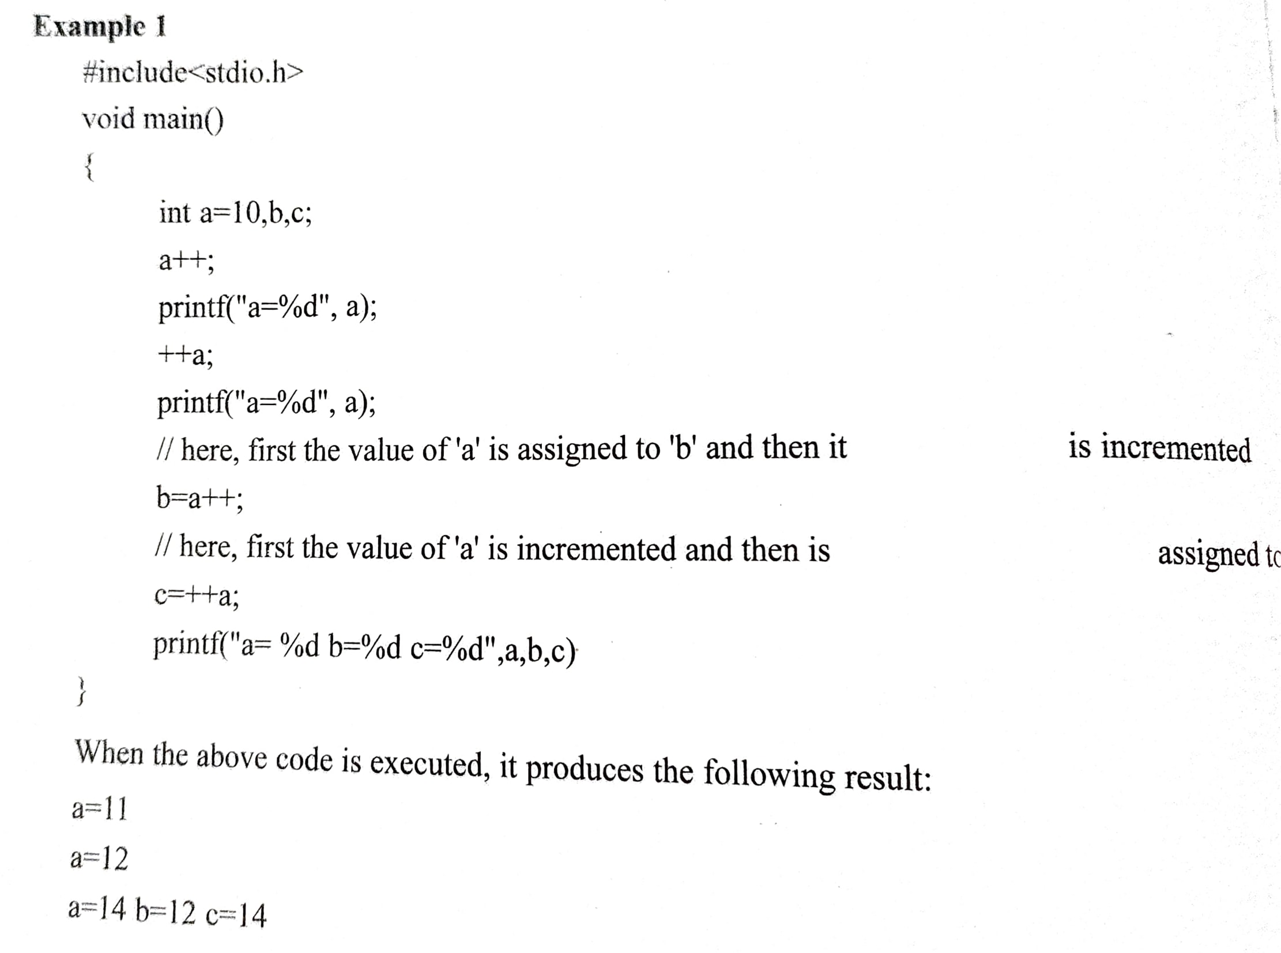
Operators and Expressions continued…

Slide 21
Operators and Expressions continued…
g) Conditional Operator
Conditional operator takes three operands and consists of two symbols ? And :
It is used for decision making in C
The syntax of this operator is,
Expression 1? Expression 2: expression 3;
Where
expression 1 is condition
expression 2 is the statement to be executed if condition is true.
expression 3 is the statement to be executed if condition is false.
It tests the result of the 1st operand and then evaluates one of the other two operands based on the result of the first.

Slide 22
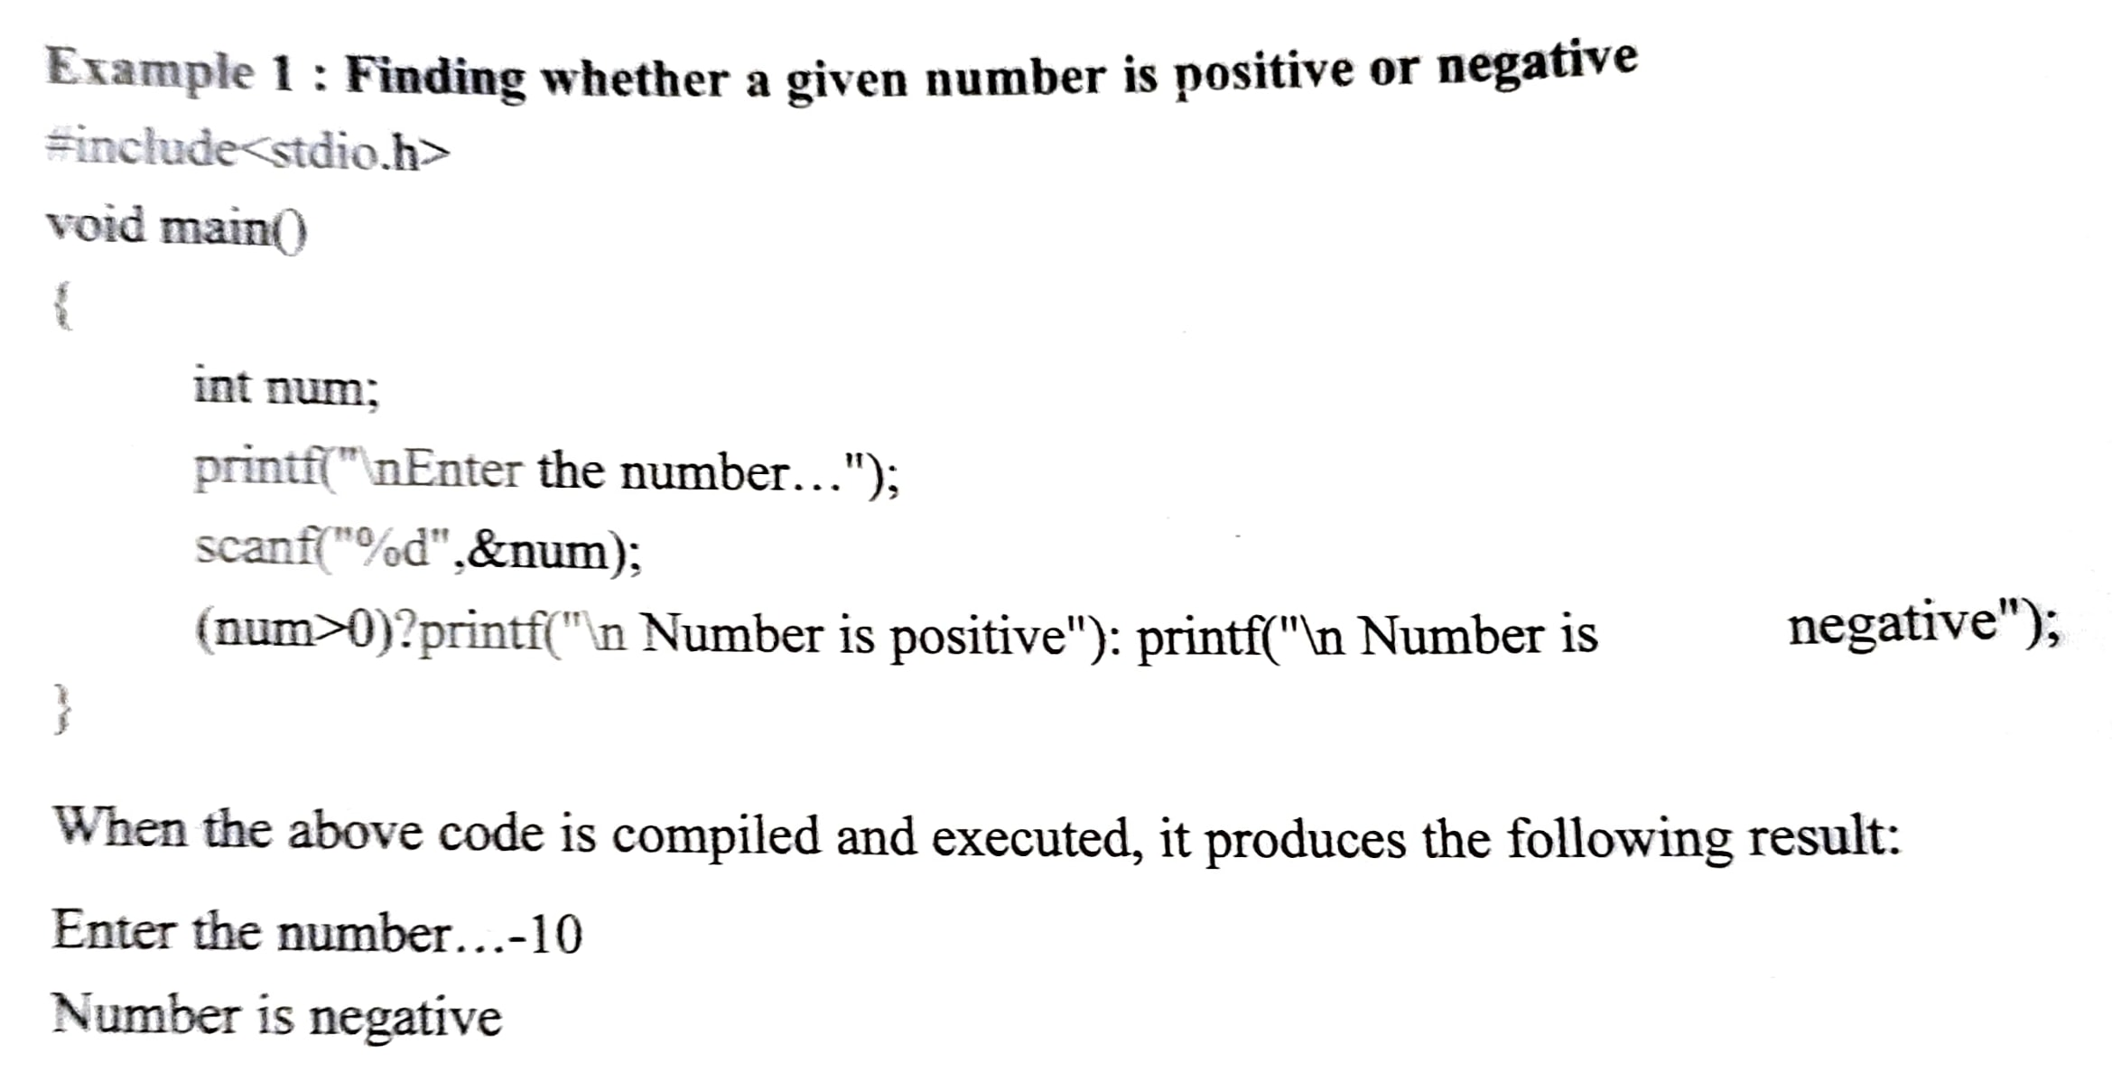
Operators and Expressions continued…

Slide 23
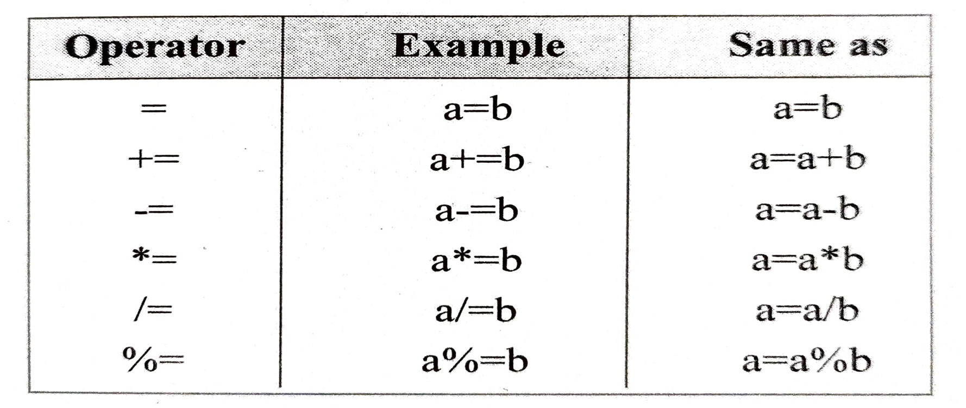
Operators and Expressions continued…
h) Arithmetic assignment operators
The most common assignment operator is =. The operator assigns the value in right side to the left side. Other assignment operators are:

Slide 24
Operators and Expressions continued…
Other Operators
Comma Operator: Used to link related expressions together.
For example int a, c=5,d;
Size of S operator: it is a unary operator used in finding the size of data type, constants, arrays, structure, etc.

Slide 25
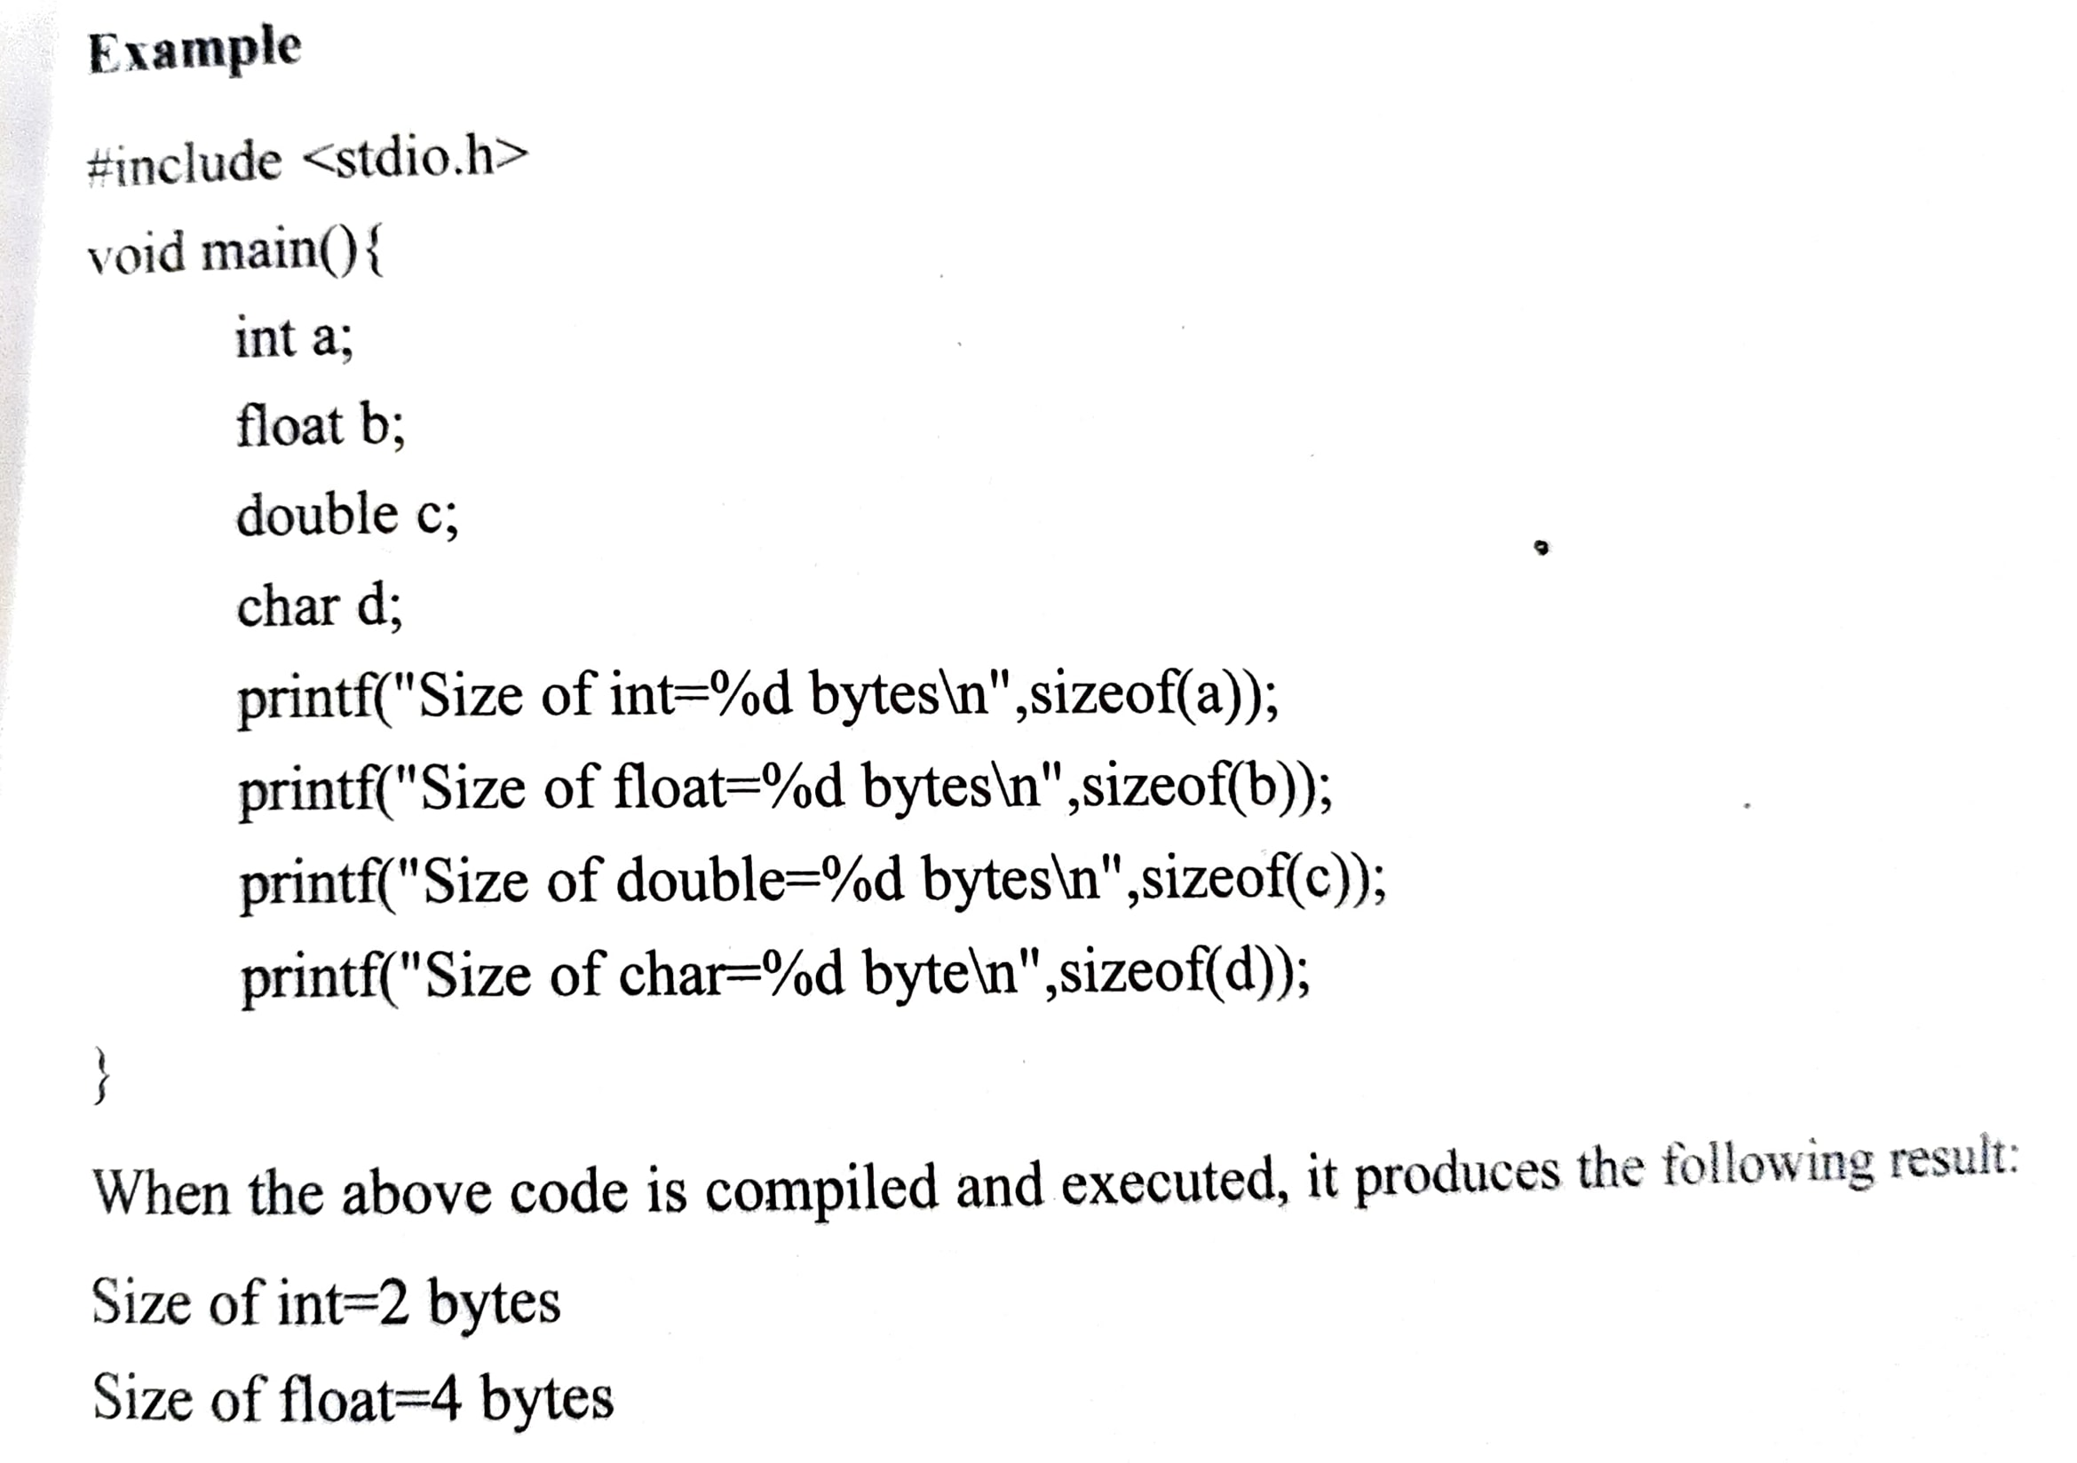
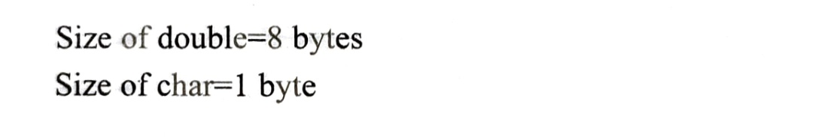
Operators and Expressions continued…

Slide 26
Operator precedence
Definition
Operator precedence describes the order in which C reads expressions.
Operators higher in the chart have a higher precedence, meaning that the C compiler evaluates them first.
Operators on the same line in the chart have the same precedence, and the “Associativity” column on the right gives their evaluation order.

Slide 27
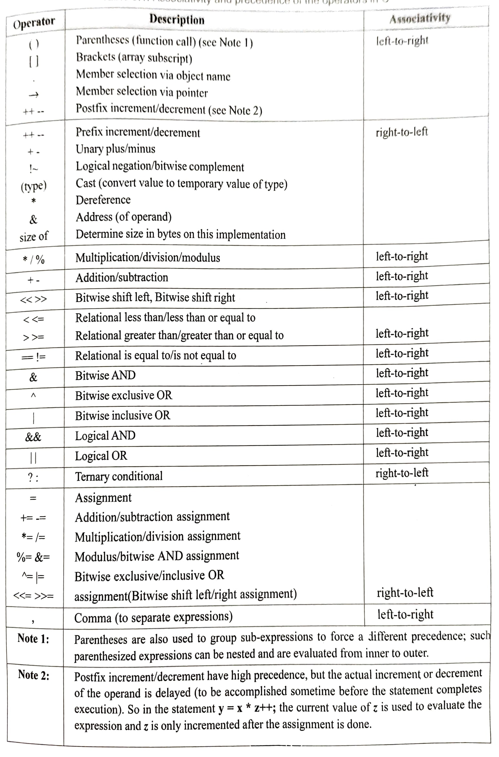

Slide 28
Operator precedence
Expression and evaluation
Expressions in C are built from combinations of operators and operands. For example
x= a + b * (-c)
In this expression, we have the operators=,+,* and -. The operands are the variables x, a, b and c.
An expression can contain more than one kind of operators. When it does the expression is evaluated from left to right using precedence

Slide 29
Operator precedence continued..
Expressions are evaluated using an assignment statement of the form
variable=expression ;
A variable is any valid C identifier name. When the statement is encountered, the expression is evaluated first and then places the previous value of the variable on the left hand side.
All variables used in the expression must be assigned values before evaluation is attempted.
Example:
x= a*b-c;
y= b/c*a;
z= a-b/c+d;

