Slide 1
Digital Signal Processing
Module 1

Slide 2
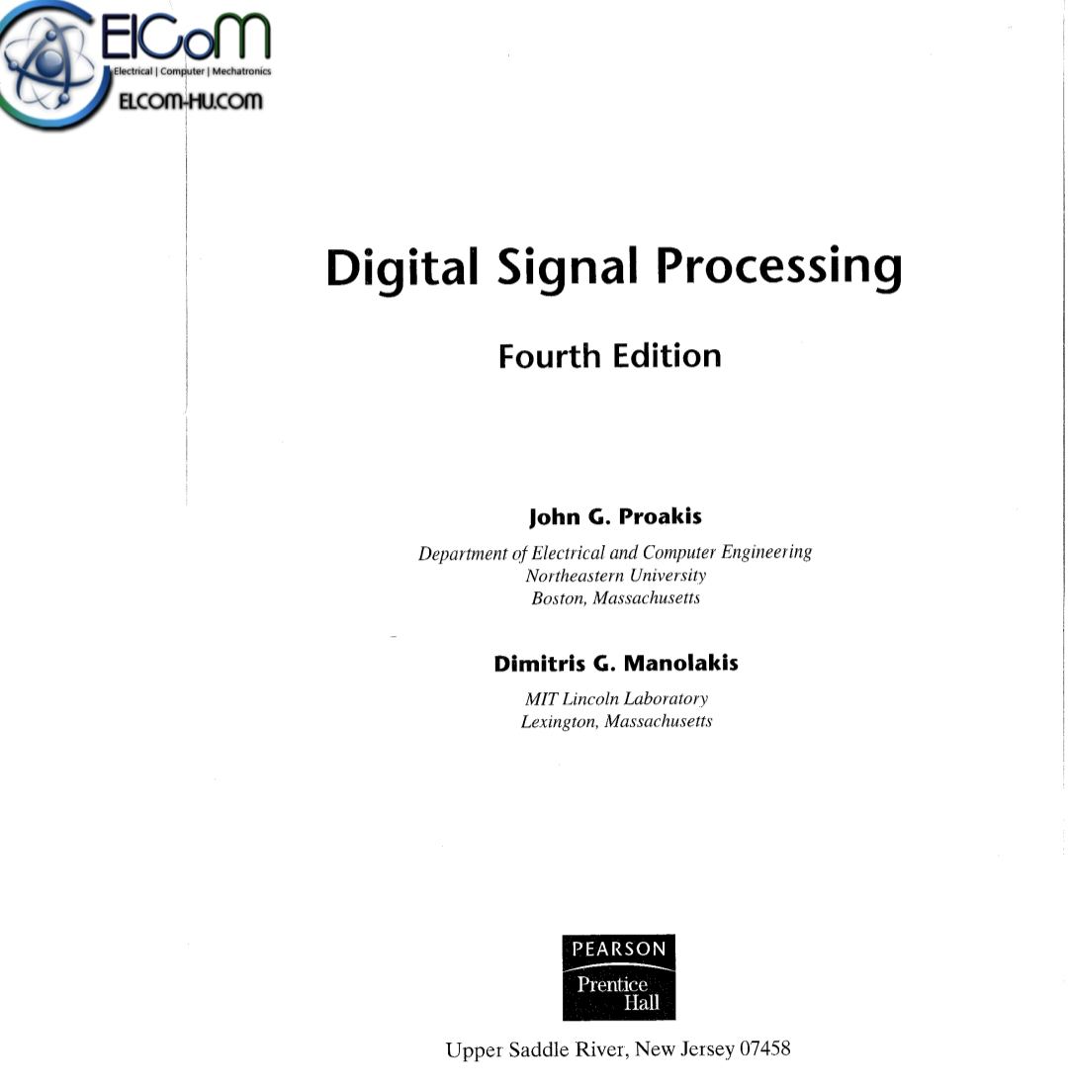

Slide 3
Digital Signal Processing
Digital signal-
Effect of distortion and interference is less
Digital circuit are more reliable
Easy to design and cheaper
Examples of digital signal- Computers, digital phones and pens
Examples of analog signal- Human voice, thermometer

Slide 4
Signal
Physical quantity that varies with time, space or any other independent variable or variables.
Mathematically,
S(t)= 5t , signal varies with time t
Examples- Speech signal,
ECG, EEG

Slide 5
Advantages of digital over analog signal processing
Flexibility in reconfiguration by simply changing the program in digital system.
Better control of accuracy requirements in digital system.
Can be easy stored on magnetic tapes and transportable.
Cheaper then analog

Slide 6
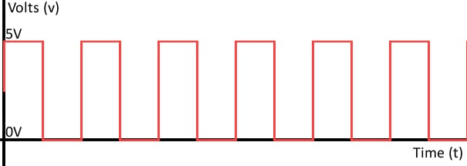
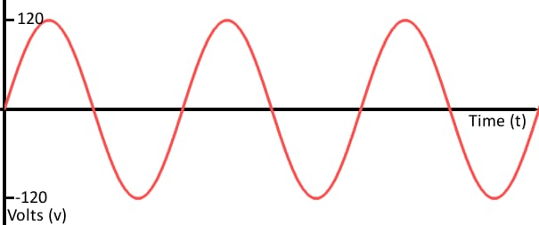
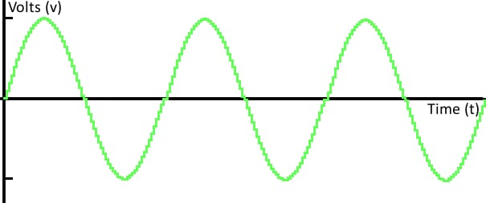
Analog vs Digital Signal
Analog signal
Digital signal

Slide 7
Digital signal
Digital signal is a discrete time, quantized amplitude signal.
In other words, it is a sampled signal consisting of samples that take on values from a discrete set.

Slide 8
The process of analog-to-digital conversion produces a digital signal. The conversion process can be thought of as occurring in two steps:
sampling, which produces a continuous-valued discrete-time signal, and
quantization, which replaces each sample value by an approximation selected from a given discrete set (for example by truncating or rounding).

Slide 9
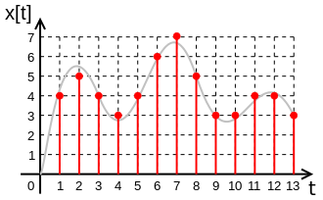
The red digital signal is the sampled and quantized representation of the grey analog signal. A digital signal consists of a sequence of samples, which in this case are integers: 4, 5, 4, 3, 4, 6...

