Slide 1
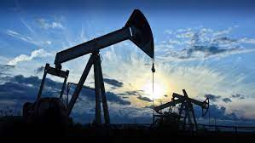

Petroleum Production Technology
By Mukunda Madhab gogoi
Department of Chemical Engineering, BBEC, kokrajhar

Slide 2
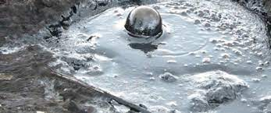
What is Petroleum?
It is a liquid mixture of hydrocarbons which is present in suitable rock strata and can be extracted and refined to produce fuels including petrol, paraffin, and diesel oil.
It’s a combination of two Greek word, Petra and Oleum. Petra means rock Oleum mens oil, so petroleum signifies the oil from rock.
Fig: Crude oil

Slide 3
How can it be findout and what are the extraction procedures?
Geological Surveying is the only technique to find out oil and natural gas
Exploration is a combination process; it includes:
Surface Geology
Subsurface Geology
Drilling Operations
Electric, Radioactivity and Acoustic (Sonic) Logging
Drill Stem Tests
Geophysical Surveys
Geochemical Surveys
Maps and Cross-Sections

Slide 4
Basics of Petroleum Production Technology
The seven basic steps of oil and natural gas extraction
STEP 1: Preparing the Rig Site
STEP 2: Drilling
STEP 3: Cementing and Testing
STEP 4: Well Completion
STEP 5: Fracking
STEP 6: Production and Fracking Fluid Recycling
STEP 7: Well Abandonment and Land Restoration

Slide 5
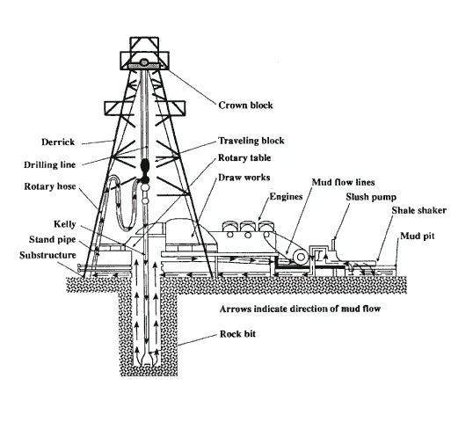
What is drilling rig?
Rig is a structure with required equipments in an oil field that is used for drilling operation
Fig: drilling rig
Contd……

