Slide 1

BINESWAR BRAHMA ENGINEERING COLLEGE
DEPARTMENT OF ELECTRICAL ENGINEERING
POWER SYSTEM-I
Module-6 Distribution System
BISWANATH HAJOARY
Asst. Professor
Department of electrical Engineering

Slide 2
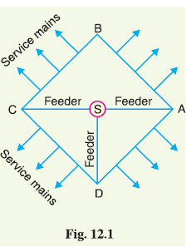
Distribution Systems
That part of power system which distributes electric power for local use is known as distribution system.
Consists of feeders, distributors and the service mains.
(i) Feeders. A feeder is a conductor which connects the sub-station (or localized generating
station) to the area where power is to be distributed.
No tappings are taken from the feeder so that current in it remains the same throughout.
The main consideration in the design of a feeder is the current carrying capacity.
(ii) Distributor. A distributor is a conductor from which tappings are taken for supply to the consumers.
In Fig. 12.1, AB, BC, CD and DA are the distributors.

Slide 3
Distribution Systems
The current through a distributor is not constant because tappings are taken at various places along its length.
While designing a distributor, voltage drop along its length is the main consideration since the statutory limit of voltage variations is ± 6% of rated value at the consumers’ terminals.
(iii) Service mains. A service mains is generally a small cable which connects the distributor to
the consumers’ terminals.

Slide 4
Classification of Distribution Systems
(i) Nature of current. According to nature of current, distribution system may be classified as
(a) d.c. distribution system
(b) a.c. distribution system.
Now-a-days, a.c. system is universally adopted for distribution of electric power as it is simpler and more economical than direct current method.
(ii) Type of construction. According to type of construction, distribution system may be classified as
(a) overhead system
(b) underground system.
The overhead system is generally employed for distribution as it is 5 to 10 times cheaper than the equivalent underground system.
The underground system is used at places where overhead construction is impracticable or prohibited by the local laws.

Slide 5
Classification of Distribution Systems
(iii) Scheme of connection. According to scheme of connection, The distribution system may be classified as (a) radial system
(b) ring main system
(c) inter-connected system.

Slide 6
A.C. Distribution
One important reason for the widespread use of alternating current in preference to direct current is the fact that alternating voltage can be conveniently changed in magnitude by means of a transformer.
Transformer has made it possible to transmit a.c. power at high voltage and utilize it at a safe potential.
The a.c. distribution system is the electrical system between the stepdown substation fed by the transmission system and the consumers’ meters.
The a.c. distribution system is classified into :
primary distribution system and
secondary distribution system.
(i) Primary distribution system. It is that part of a.c. distribution system which operates at voltages somewhat higher than general utilization and handles large blocks of electrical energy than the average low-voltage consumer uses.
The voltage used for primary distribution depends upon the amount of power to be conveyed and the distance of the substation required to be fed.

Slide 7
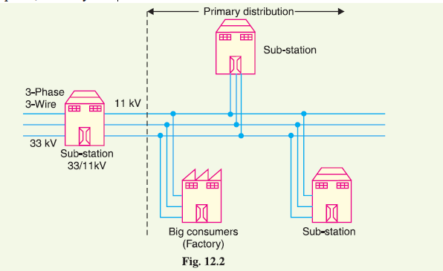
The most commonly used primary distribution voltages are 11 kV, 6·6 kV and 3·3 kV.
Due to economic considerations, primary distribution is carried out by 3-phase, 3-wire system.

Slide 8
Secondary distribution system.
(ii) Secondary distribution system. It is that part of a.c. distribution system which includes the range of voltages at which the ultimate consumer utilises the electrical energy delivered to him. The secondary distribution employs 400/230 V, 3-phase, 4-wire system.
The primary distribution circuit delivers power to various substations, called distribution substations.
The substations are situated near the consumers’ localities and contain stepdown transformers.
At each distribution substation, the voltage is stepped down to 400V and power is delivered by 3-phase,4-wire a.c. system.
The voltage between any two phases is 400 V and between any phase and neutral is 230 V.
The single phase domestic loads are connected between any one phase and the neutral, whereas 3-phase 400 V motor loads are connected across 3- phase lines directly.

Slide 9
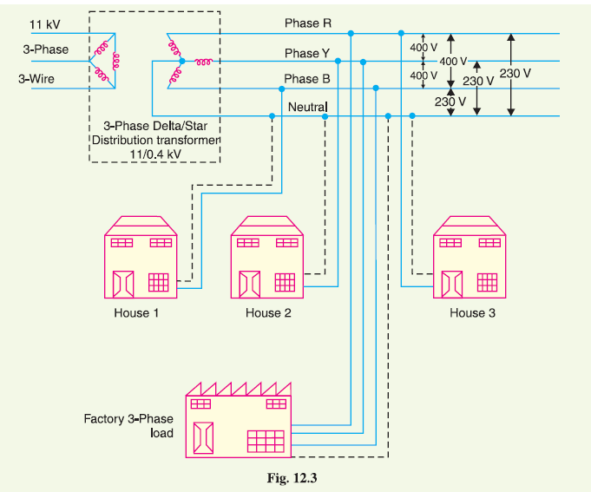

Slide 10
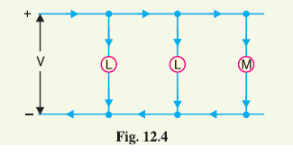
D.C. Distribution
For instance, d.c. supply is required for the operation of variable speed machinery (i.e., d.c. motors), for electrochemical work and for congested areas where storage battery reserves are necessary.
For this purpose, a.c. power is converted into d.c. power at the substation by using converting machinery e.g.,
mercury arc rectifiers, rotary converters and motor-generator sets.
The d.c. supply from the substation may be obtained in the form of
(i) 2-wire or (ii) 3-wire for distribution.
(i) 2-wire d.c. system. As the name implies, this system of distribution consists of two wires. One is the outgoing or positive wire and the other is the return or negative wire.
The loads such as lamps, motors etc. are connected in parallel between the two wires.
This system is never used for transmission purposes due to low efficiency but may be employed for distribution of d.c. power.

Slide 11
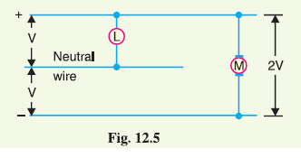
(ii) 3-wire d.c. system. It consists of two outers and a middle or neutral wire which is earthed at the substation.
The voltage between the outers is twice the voltage between either outer and neutral wire.
The principal advantage of this system is that it makes available two voltages at the consumer terminals viz., V between any outer and the neutral and 2V between the outers.
Loads requiring high voltage (e.g., motors) are connected across the outers, whereas lamps and heating circuits requiring less voltage are connected between either outer and the neutral.

Slide 12
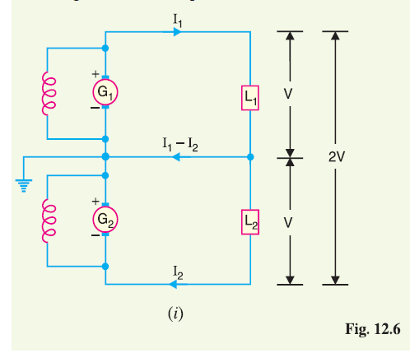
Methods of Obtaining 3-wire D.C. System
There are several methods of obtaining 3-wire d.c. system. However, the most important ones are:
(i) Two generator method. In this method, two shunt wound d.c. generators G1 and G2 are connected in series and the neutral is obtained from the common point between generators.
Each generator supplies the load on its own side. Thus generator G1 supplies a load current of I1, whereas generator G2 supplies a load current of I2.
The difference of load currents on the two sides, known as out of balance current (I1 - I2) flows through the neutral wire.
The principal disadvantage of this method is that two separate generators are required.

Slide 13
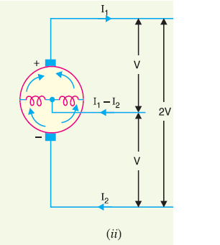
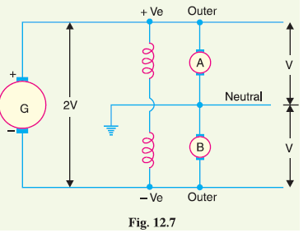
(ii) 3-wire d.c. generator. The above method is costly on account of the necessity of two generators.
For this reason, 3-wire d.c. generator was developed.
It consists of a standard 2-wire machine with one or two coils of high reactance and low resistance, connected permanently to diametrically opposite points of the armature winding. The neutral wire is obtained
from the common point.
(iii) Balancer set. The 3-wire system can be obtained from 2-wire d.c. system by the use of balancer set.
G is the main 2-wire d.c. generator and supplies power to the whole system.
The balancer set consists of two identical d.c shunt machines A and B coupled mechanically with their armatures and field windings joined in series across the outers.
The junction of their armatures is earthed and neutral wire is
taken out from here.
The balancer set has the additional advantage that it maintains the potential difference on two sides of neutral equal to each other.

Slide 14
Overhead Versus Underground System
Overhead lines are generally mounted on wooden, concrete or steel poles which are arranged to carry distribution transformers in addition to the conductors.
The underground system uses conduits, cables and manholes under the surface of streets and sidewalks. The choice between overhead and underground system depends upon a number of widely differing factors.
(i) Public safety. The underground system is more safe than overhead system because all distribution wiring is placed underground and there are little chances of any hazard.
(ii) Initial cost. The underground system is more expensive due to the high cost of trenching, conduits, cables, manholes and other special equipment. The initial cost of an underground system may be five to ten times than that of an overhead system.

Slide 15
Overhead Versus Underground System
(iii) Flexibility. The overhead system is much more flexible than the underground system.
(iv) Faults. The chances of faults in underground system are very rare as the cables are laid underground and are generally provided with better insulation.
(v) Appearance. The general appearance of an underground system is better as all the distribution lines are invisible.
(vi) Fault location and repairs. In general, there are little chances of faults in an underground system. However, if a fault does occur, it is difficult to locate and repair on this system. On an overhead system, the conductors are visible and easily accessible so that fault locations and repairs can be easily made.

Slide 16
Overhead Versus Underground System
(vii) Current carrying capacity and voltage drop. An overhead distribution conductor has a considerably higher current carrying capacity than an underground cable conductor of the same material and cross-section. On the other hand, underground cable conductor has much lower inductive reactance than that of an overhead conductor because of closer spacing of conductors.
(viii) Useful life. The useful life of underground system is much longer than that of an overhead system. An overhead system may have a useful life of 25 years, whereas an underground system may have a useful life of more than 50 years.
(ix) Maintenance cost. The maintenance cost of underground system is very low as compared with that of overhead system because of less chances of faults and service interruptions from wind, ice, lightning as well as from traffic hazards.

Slide 17
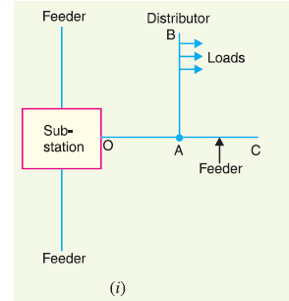
Connection Schemes of Distribution System
All distribution of electrical energy is done by constant voltage system. In practice, the following distribution circuits are generally used :
(i) Radial System.
In this system, separate feeders radiate from a single substation and feed the distributors at one end only.
Fig shows a single line diagram of a radial system for d.c.
distribution where a feeder OC supplies a distributor AB at point A.
The distributor is fed at one end only i.e., point A is this case.

Slide 18
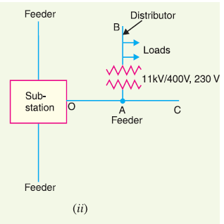
Fig. 12.8 (ii) shows a single line diagram of radial system for a.c. distribution.
The radial system is employed only when power is generated at low voltage and the substation is located at the centre of the load.
This is the simplest distribution circuit and has the lowest initial cost.
However, it suffers from the following drawbacks :
(a) The end of the distributor nearest to the feeding point will be heavily loaded.
(b) The consumers are dependent on a single feeder and single distributor. Therefore, any fault
on the feeder or distributor cuts off supply to the consumers who are on the side of the fault away from
the substation.
(c) The consumers at the distant end of the distributor would be subjected to serious voltage
fluctuations when the load on the distributor changes.
Due to these limitations, this system is used for short distances only.

Slide 19
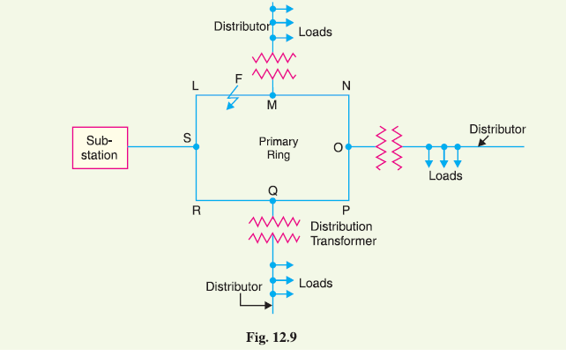
(ii) Ring main system.
In this system, the primaries of distribution transformers form a loop. The loop circuit starts from the substation bus-bars, makes a loop through the area to be served, and returns to the substation.
Fig. 12.9 shows the single line diagram of ring main system for a.c. distribution where substation supplies to the closed feeder LMNOPQRS.
The distributors are tapped from different points M, O and Q of the feeder through distribution transformers.

Slide 20
The ring main system has the following advantages :
(a) There are less voltage fluctuations at consumer’s terminals.
(b) The system is very reliable as each distributor is fed via *two feeders. In the event of fault on any section of the feeder, the continuity of supply is maintained. For example, suppose that fault occurs at any point F of section SLM of the feeder. Then section SLM of the feeder can be isolated for repairs and at the same time continuity of supply is maintained to all the consumers via the feeder SRQPONM.

Slide 21
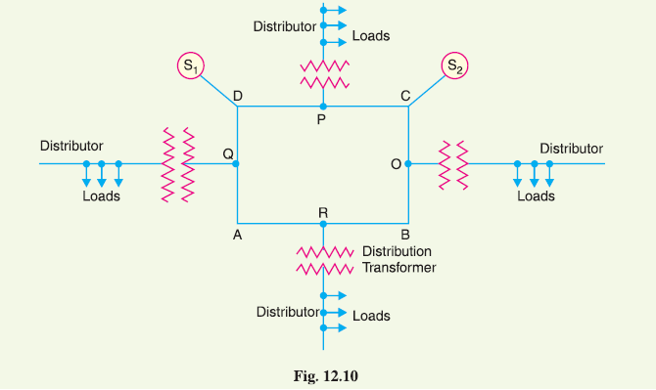
(iii) Interconnected system.
When the feeder ring is energised by two or more than two generating stations or substations, it is called inter-connected system.

Slide 22
Fig. 12.10 shows the single line diagram of interconnected system where the closed feeder ring ABCD is supplied by two substations S1 and S2 at points D and C respectively.
Distributors are connected to points O, P, Q and R of the feeder ring through distribution transformers.
The interconnected system has the following advantages :
(a) It increases the service reliability.
(b) Any area fed from one generating station during peak load hours can be fed from the other generating station. This reduces reserve power capacity and increases efficiency of the system.

Slide 23
Requirements of a Distribution System
A considerable amount of effort is necessary to maintain an electric power supply within the requirements of various types of consumers. Some of the requirements of a good distribution system are : proper voltage, availability of power on demand and reliability.
(i) Proper voltage. One important requirement of a distribution system is that voltage variations at consumer’s terminals should be as low as possible.
The changes in voltage are generally caused due to the variation of load on the system. Low voltage causes loss of revenue, inefficient lighting and possible burning out of motors.
High voltage causes lamps to burn out permanently and may cause failure of other appliances. Therefore, a good distribution system should ensure that the voltage variations at consumers terminals are within permissible limits.

Slide 24
(ii) Availability of power on demand. Power must be available to the consumers in any amount that they may require from time to time.
For example, motors may be started or shut down, lights may be turned on or off, without advance warning to the electric supply company. As electrical energy cannot be stored, therefore, the distribution system must be capable of supplying load demands of the consumers.
(iii) Reliability. Modern industry is almost dependent on electric power for its operation. Homes and office buildings are lighted, heated, cooled and ventilated by electric power. This calls for reliable service.
Unfortunately, electric power, like everything else that is man-made, can never be absolutely reliable. However, the reliability can be improved to a considerable extent by (a) interconnected system (b) reliable automatic control system (c) providing additional reserve facilities.

Slide 25
Design Considerations in Distribution System
Good voltage regulation of a distribution network is probably the most important factor responsible for delivering good service to the consumers. For this purpose, design of feeders and distributors requires careful consideration.
(i) Feeders. A feeder is designed from the point of view of its current carrying capacity while the voltage drop consideration is relatively unimportant. It is because voltage drop in a feeder can be compensated by means of voltage regulating equipment at the substation.
(ii) Distributors. A distributor is designed from the point of view of the voltage drop in it. It is because a distributor supplies power to the consumers and there is a statutory limit of voltage variations at the consumer’s terminals (± 6% of rated value). The size and length of the distributor should be such that voltage at the consumer’s terminals is within the permissible limits.

Slide 26
THANK YOU

