Slide 1

BINESWAR BRAHMA ENGINEERING COLLEGE
DEPARTMENT OF ELECTRICAL ENGINEERING
POWER SYSTEM-I
Medium Transmission Line
BISWANATH HAJOARY
Asst. Professor
Department of electrical Engineering

Slide 2
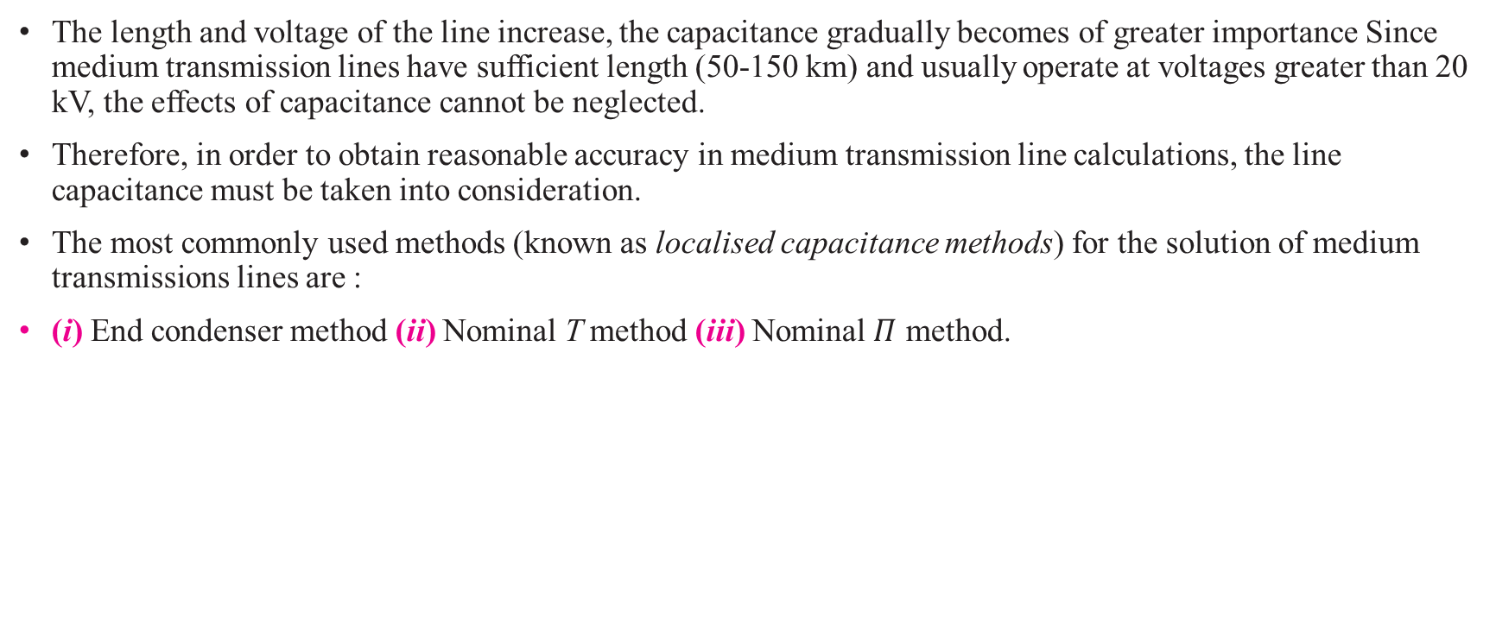
Medium Transmission Line
The length and voltage of the line increase, the capacitance gradually becomes of greater importance Since medium transmission lines have sufficient length (50-150 km) and usually operate at voltages greater than 20 kV, the effects of capacitance cannot be neglected.
Therefore, in order to obtain reasonable accuracy in medium transmission line calculations, the line capacitance must be taken into consideration.
The most commonly used methods (known as localised capacitance methods) for the solution of medium transmissions lines are :
(i) End condenser method (ii) Nominal T method (iii) Nominal $Π$ method.

Slide 3
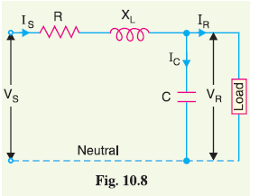
End Condenser Method
In this method, the capacitance of the line is lumped or concentrated at the receiving or load end.
Let IR = load current per phase
R = resistance per phase
XL = inductive reactance per phase
C = capacitance per phase
cos φR = receiving end power factor (lagging)

Slide 4
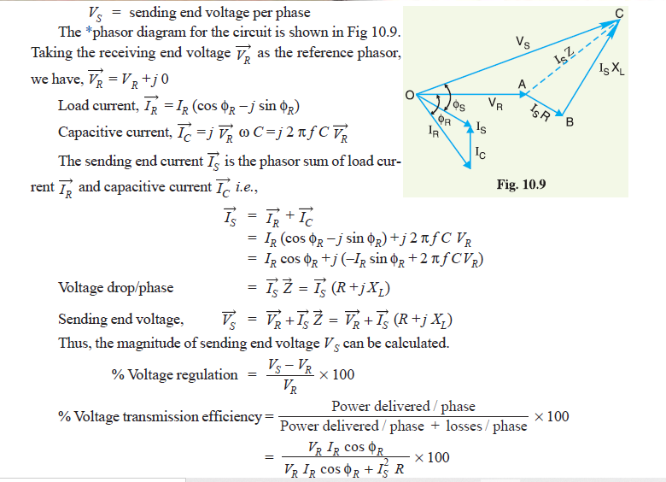

Slide 5
Limitations. Although end condenser method for the solution of medium lines is simple to work
out calculations, yet it has the following drawbacks :
(i) There is a considerable error (about 10%) in calculations because the distributed capacitance
has been assumed to be lumped or concentrated.
(ii) This method overestimates the effects of line capacitance.

Slide 6
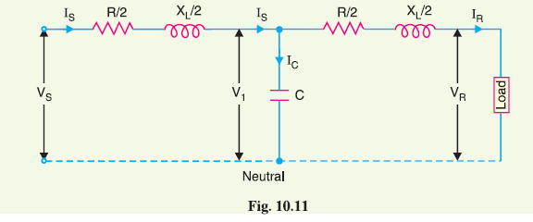
Nominal T Method
In this method, the whole line capacitance is assumed to be concentrated at the middle point of the line and half the line resistance and reactance are lumped on its either side.
Therefore, in this arrangement, full charging current flows over half the line.

Slide 7
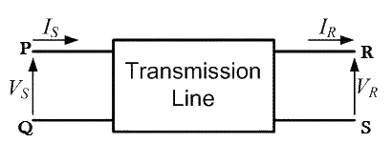
ABCD Parameters of Transmission Line
ABCD parameters (also known as chain or transmission line parameters) are generalized circuit constants used to help model transmission lines.
ABCD parameters are used in the two port network representation of a transmission line.
It is used to simplify these complex calculations.

Slide 8
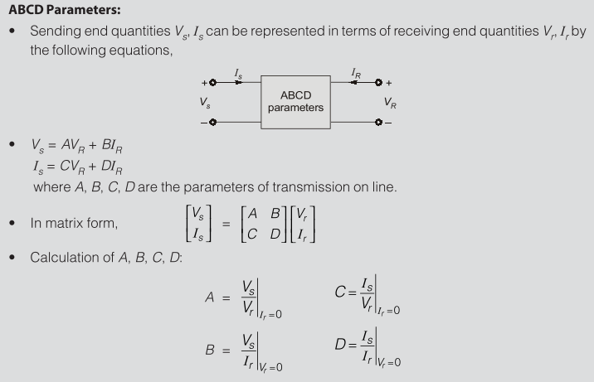

Slide 9
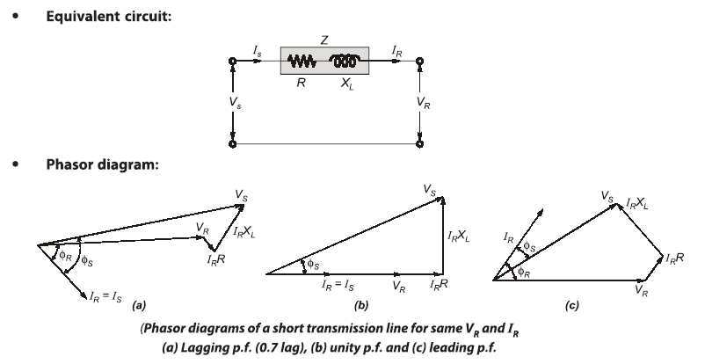
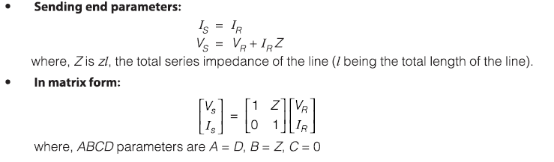
Short Transmission line

Slide 10
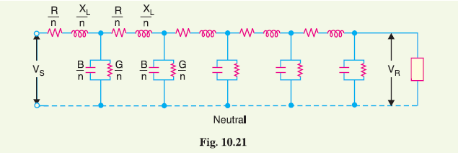
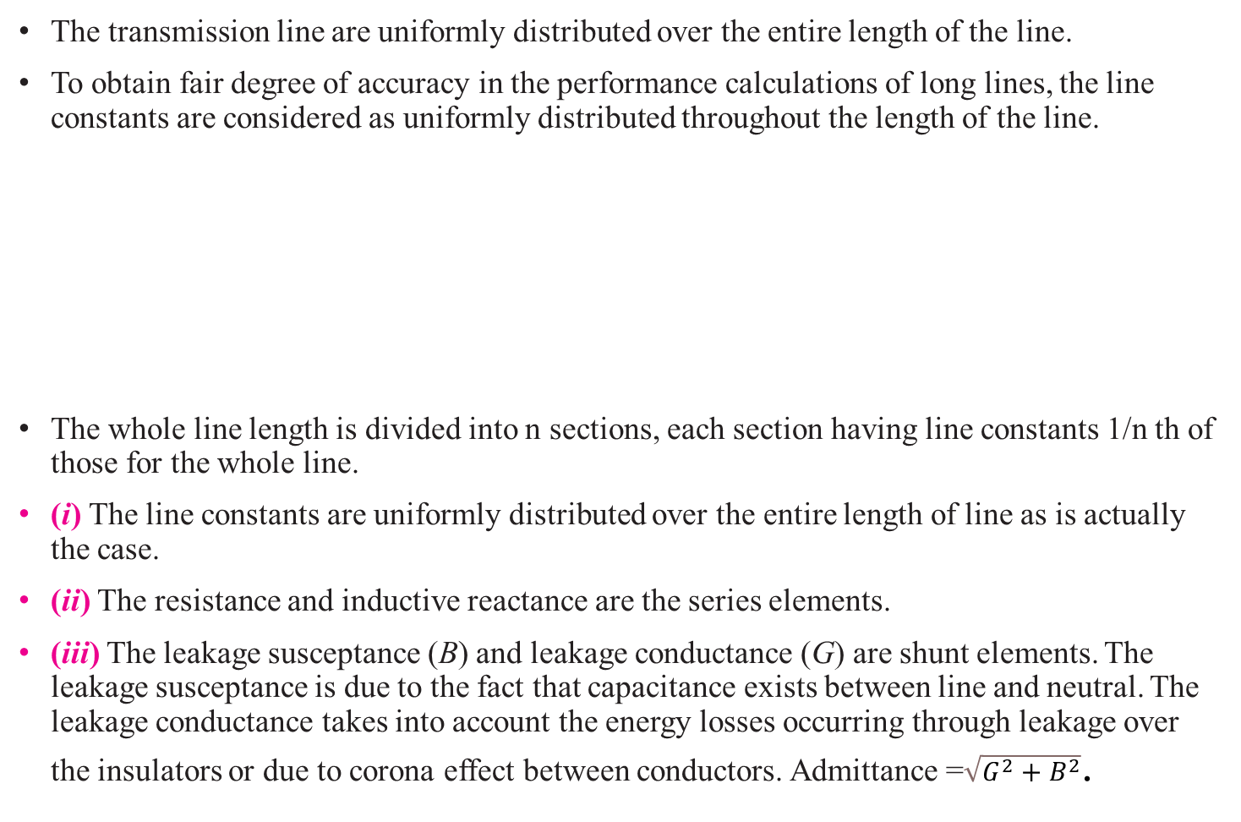
Long Transmission Line
The transmission line are uniformly distributed over the entire length of the line.
To obtain fair degree of accuracy in the performance calculations of long lines, the line constants are considered as uniformly distributed throughout the length of the line.
The whole line length is divided into n sections, each section having line constants 1/n th of those for the whole line.
(i) The line constants are uniformly distributed over the entire length of line as is actually the case.
(ii) The resistance and inductive reactance are the series elements.
(iii) The leakage susceptance (B) and leakage conductance (G) are shunt elements. The leakage susceptance is due to the fact that capacitance exists between line and neutral. The leakage conductance takes into account the energy losses occurring through leakage over the insulators or due to corona effect between conductors. Admittance =$\sqrt{G^{2}+B^{2}}$.

Slide 11
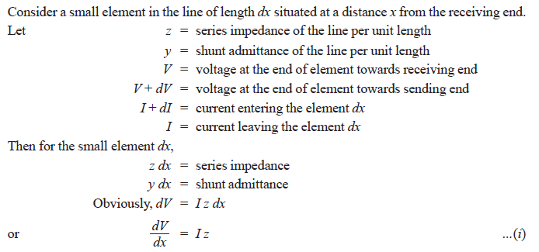
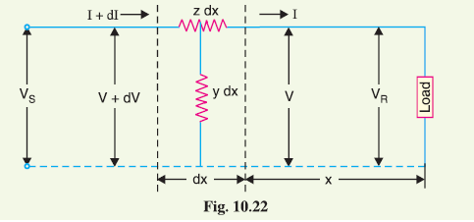
(iv) The leakage current through shunt admittance is maximum at the sending end of the line and
decreases continuously as the receiving end of the circuit is approached at which point its
value is zero.
Analysis of Long Transmission Line (Rigorous method)
Fig. 10.22 shows one phase and neutral connection of a 3-phase line with impedance and shunt admittance of the line uniformly distributed.

Slide 12
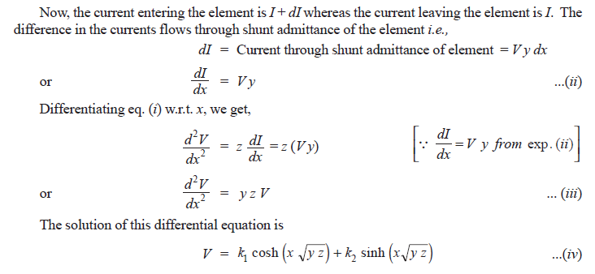
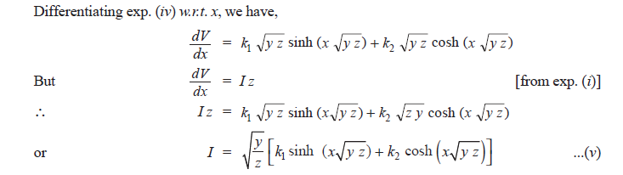

Slide 14
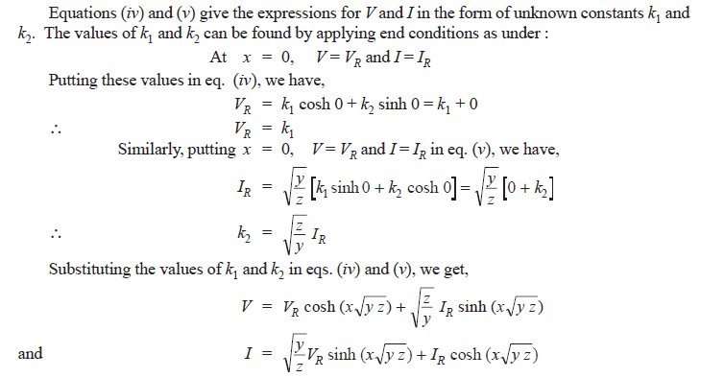

Slide 15
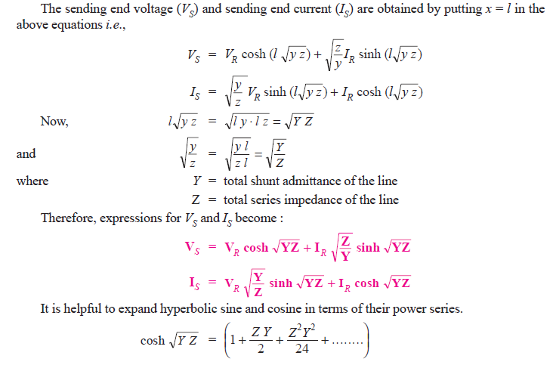


Slide 16
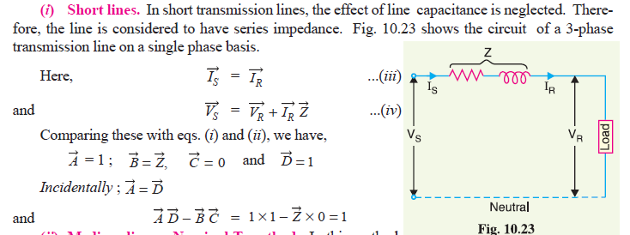

Slide 17
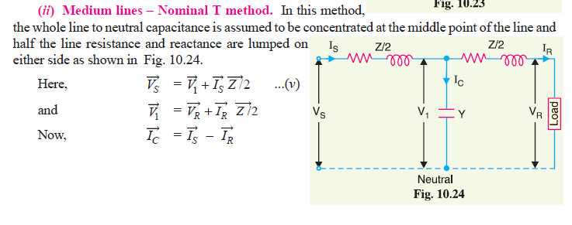

Slide 18
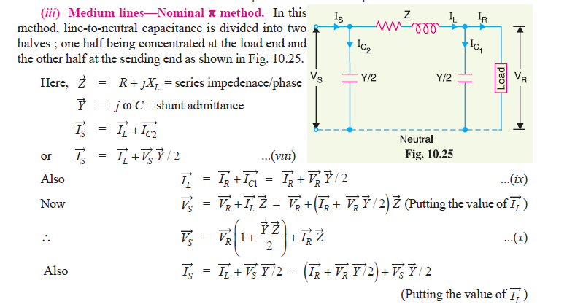

Slide 19
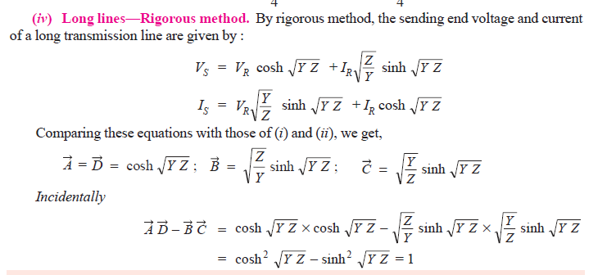

Slide 20
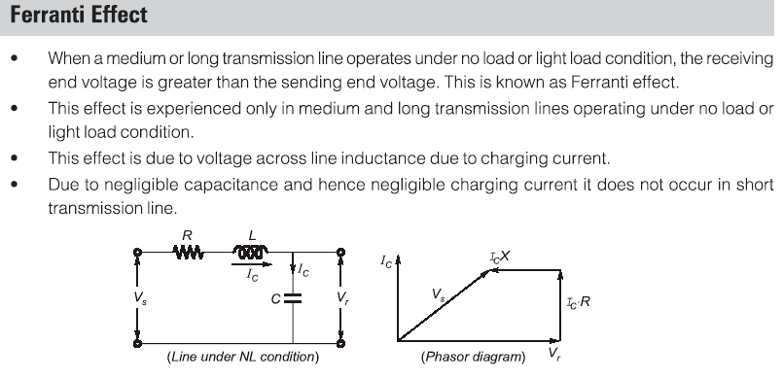
Ferranti Effect

Slide 21
THANK YOU

