Slide 1

BINESWAR BRAHMA ENGINEERING COLLEGE
DEPARTMENT OF ELECTRICAL ENGINEERING
POWER SYSTEM-I
Performance of Transmission line
BISWANATH HAJOARY
Asst. Professor
Department of electrical Engineering

Slide 2
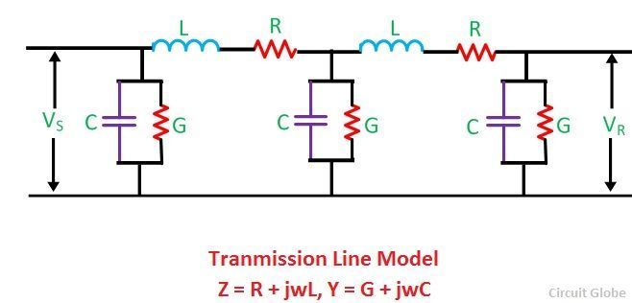
Performance of transmission line
The important considerations in the design and operation of a transmission line are-
  the determination of voltage drop
  Line losses
  efficiency of transmission
The performance of transmission line depends on the parameters of the line.
The transmission line has mainly four parameters, resistance, inductance, capacitance and shunt conductance.
These parameters are uniformly distributed along the line. Hence, it is also called the distributed parameter of the transmission line.
The inductance and resistance form series impedance
whereas the capacitance and conductance form the shunt admittance.

Slide 3
Line inductance – The current flow in the transmission line induces the magnetic flux. When the current in the transmission line changes, the magnetic flux also varies due to which emf induces in the circuit. The magnitude of inducing emf depends on the rate of change of flux. Emf produces in the transmission line resist the flow of current in the conductor, and this parameter is known as the inductance of the line.
Line capacitance – In the transmission lines, air acts as a dielectric medium. This dielectric medium constitutes the capacitor between the conductors, which store the electrical energy, or increase the capacitance of the line. The capacitance of the conductor is defined as the present of charge per unit of potential difference.
Capacitance is negligible in short transmission lines whereas in long transmission; it is the most important parameter. It affects the efficiency, voltage regulation, power factor and stability of the system.
Shunt conductance – Air act as a dielectric medium between the conductors. When the alternating voltage applies in a conductor, some current flow in the dielectric medium because of dielectric imperfections. Such current is called leakage current. Leakage current depends on the atmospheric condition and pollution like moisture and surface deposits.

Slide 4
Classification of Overhead Transmission Lines
(i) Short transmission lines.
Overhead transmission line is up .o about 50 km and the line voltage is comparatively low (< 20 kV).
Due to smaller length and lower voltage, the capacitance effects are small and hence can be neglected.
Therefore, while studying the performance of a short transmission line, only resistance and inductance of the line are taken into account.
(ii) Medium transmission lines.
Length of transmission line above 50km to 150km.
The line voltage is moderately high (>20 kV < 100 kV).
Due to sufficient length and voltage of the line, the capacitance effects are taken into account.
(iii) Long transmission lines.
When the length of an overhead transmission line is more than 150 km and line voltage is very high (> 100 kV).

Slide 5

Important Terms
While studying the performance of a transmission line, it is desirable to determine its voltage regulation and transmission efficiency.
(i) Voltage regulation.
When a transmission line is carrying current, there is a voltage drop in the line due to resistance and inductance of the line.
The result is that receiving end voltage (VR) of the line is generally less than the sending end voltage (Vs).
This voltage drop (VS -VR) in the line is expressed as a percentage of receiving end voltage VR and is called voltage regulation.
the voltage regulation of a transmission line should be low. i.e., the increase in load current should make very little difference in the receiving end voltage.

Slide 6
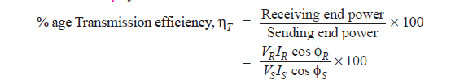
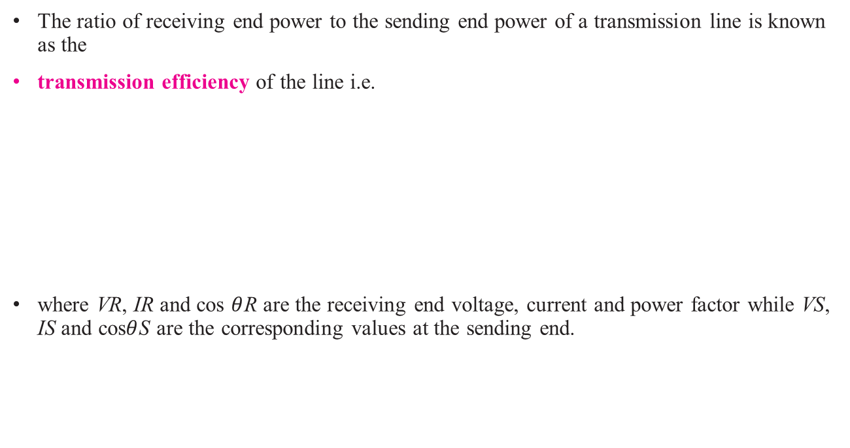
(ii) Transmission efficiency.
The ratio of receiving end power to the sending end power of a transmission line is known as the
transmission efficiency of the line i.e.
where VR, IR and cos $θ$R are the receiving end voltage, current and power factor while VS, IS and cos$θ$S are the corresponding values at the sending end.

Slide 7
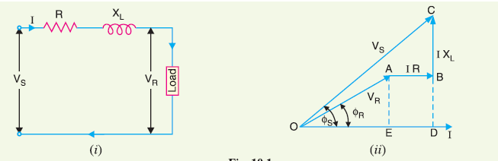
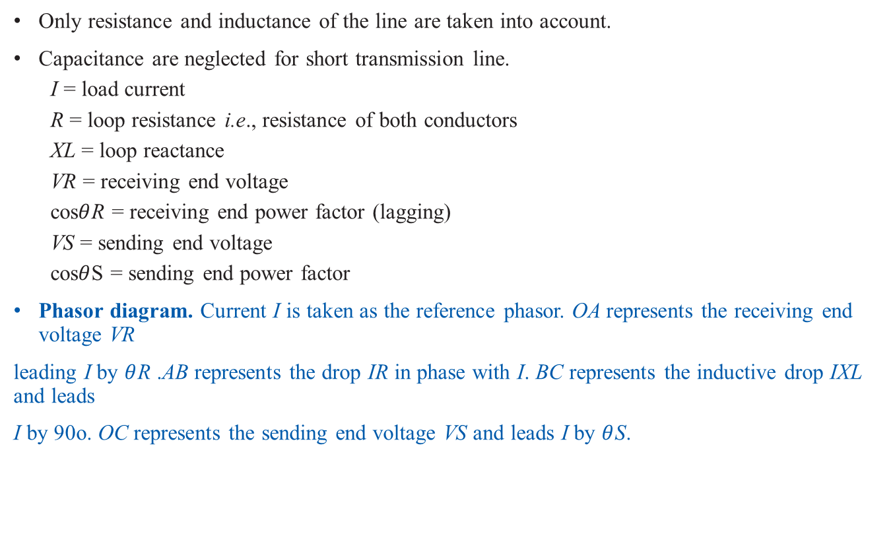
Performance of Single Phase Short Transmission Lines
Only resistance and inductance of the line are taken into account.
Capacitance are neglected for short transmission line.
  I = load current
  R = loop resistance i.e., resistance of both conductors
  XL = loop reactance
  VR = receiving end voltage
  cos$θ$R = receiving end power factor (lagging)
  VS = sending end voltage
  cos$θ$S = sending end power factor
Phasor diagram. Current I is taken as the reference phasor. OA represents the receiving end voltage VR
leading I by $θ$R .AB represents the drop IR in phase with I. BC represents the inductive drop IXL and leads
I by 90o. OC represents the sending end voltage VS and leads I by $θ$S.

Slide 8
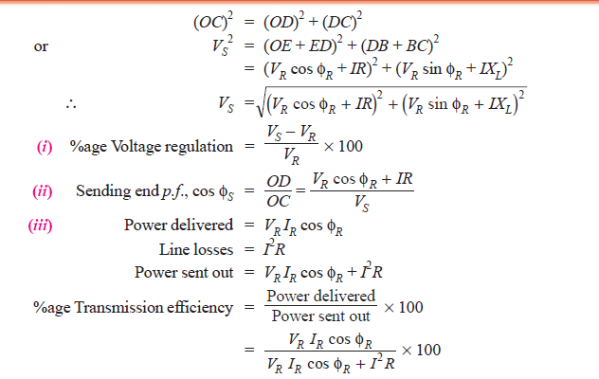
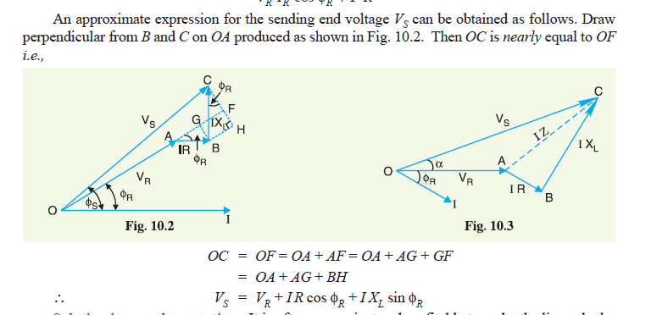

Slide 9
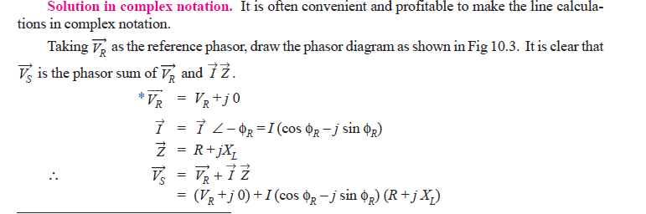
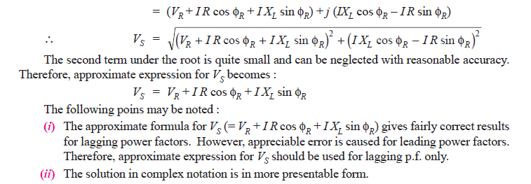

Slide 10
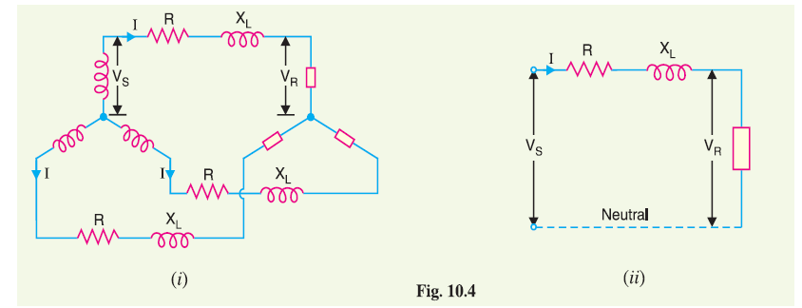
Three-Phase Short Transmission Lines
Fig. 10.4 (i) shows a Y-connected generator supplying a balanced Y-connected load through a transmission line. Each conductor has a resistance of RΩ and inductive reactance of XL Ω.
(ii) shows one phase separately. The calculations can now be made in the same way as for a single
phase line.

Slide 11
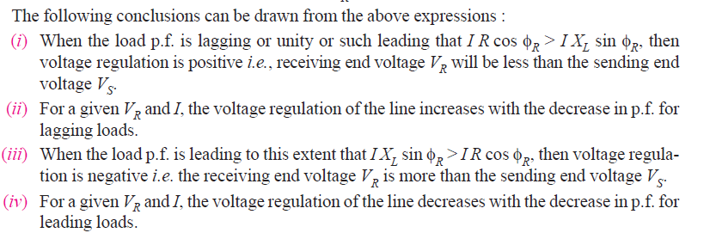
Effect of Load p.f. on Regulation and Efficiency
The regulation and efficiency of a transmission line depend to a considerable extent upon the power factor of the load.
1. Effect on regulation. The expression for voltage regulation of a short transmission line is given by :

Slide 12
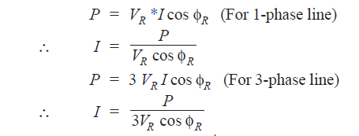
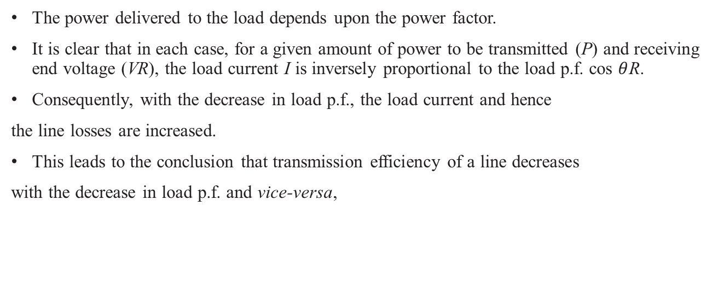
2. Effect on transmission efficiency.
The power delivered to the load depends upon the power factor.
It is clear that in each case, for a given amount of power to be transmitted (P) and receiving end voltage (VR), the load current I is inversely proportional to the load p.f. cos $θ$R.
Consequently, with the decrease in load p.f., the load current and hence
the line losses are increased.
This leads to the conclusion that transmission efficiency of a line decreases
with the decrease in load p.f. and vice-versa,

Slide 13
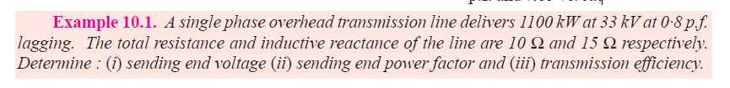
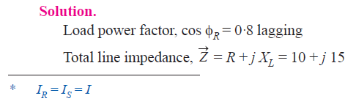
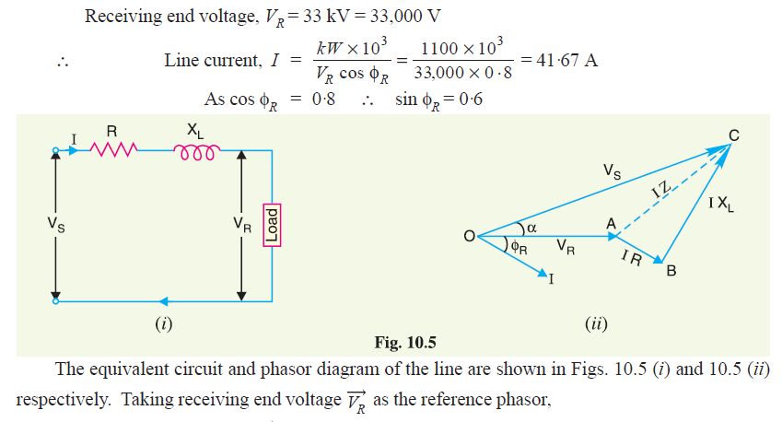

Slide 14
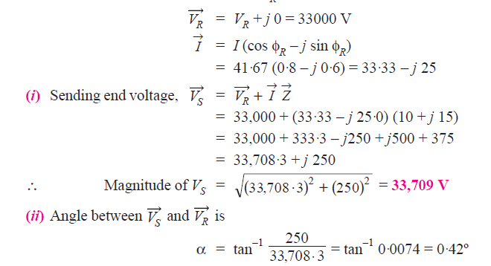
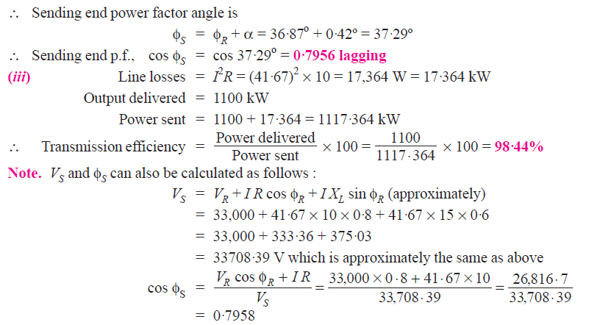

Slide 15
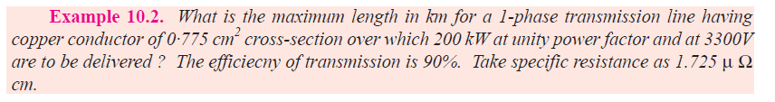

Slide 17
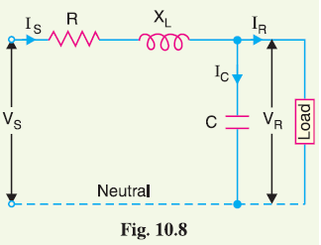
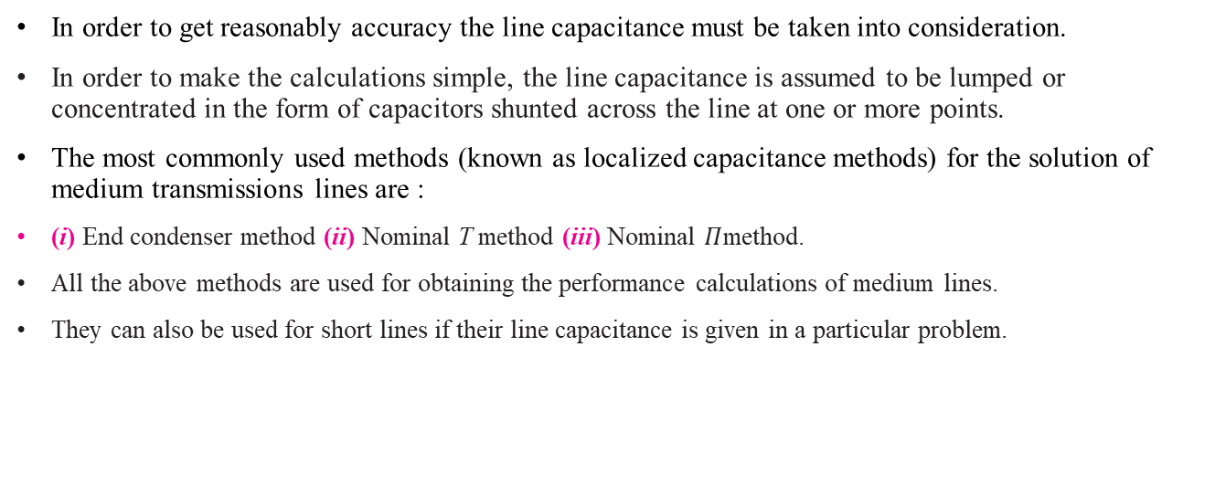
Medium Transmission Lines
In order to get reasonably accuracy the line capacitance must be taken into consideration.
In order to make the calculations simple, the line capacitance is assumed to be lumped or concentrated in the form of capacitors shunted across the line at one or more points.
The most commonly used methods (known as localized capacitance methods) for the solution of medium transmissions lines are :
(i) End condenser method (ii) Nominal T method (iii) Nominal $Π$method.
All the above methods are used for obtaining the performance calculations of medium lines.
They can also be used for short lines if their line capacitance is given in a particular problem.

Slide 18
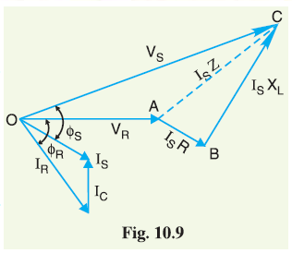


End Condenser Method
Let IR = load current per phase
R = resistance per phase
XL = inductive reactance per phase
C = capacitance per phase
cos $θ$R = receiving end power factor (lagging)
VS = sending end voltage per phase
The *phasor diagram for the circuit is shown in Fig 10.9.
Taking the receiving end voltage VR as the reference phasor,
we have, VR = VR + j 0

Slide 19
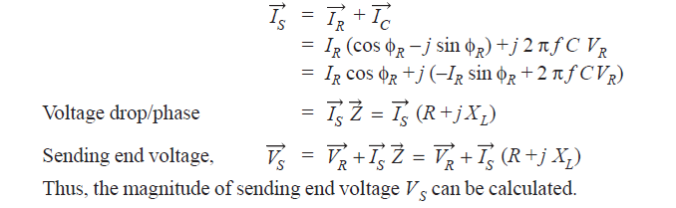
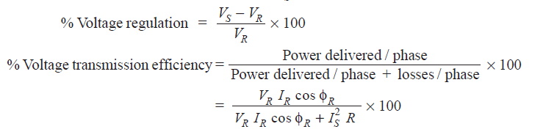
The sending end current $\vec{I}$S is the phasor sum of load current $\vec{I}$R and capacitive current $\vec{I}$C i.e.,
Limitations. Although end condenser method for the solution of medium lines is simple to work
out calculations, yet it has the following drawbacks :
(i) There is a considerable error (about 10%) in calculations because the distributed capacitance
has been assumed to be lumped or concentrated.
(ii) This method overestimates the effects of line capacitance.

Slide 20
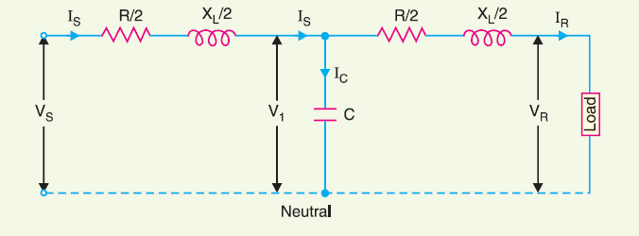
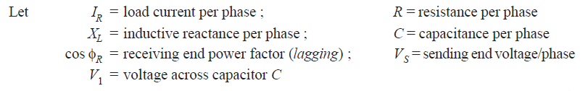
Nominal T Method
In this method, line capacitance is assumed to be concentrated at the middle point of the line and half the line resistance and reactance are lumped on its either side.

Slide 21
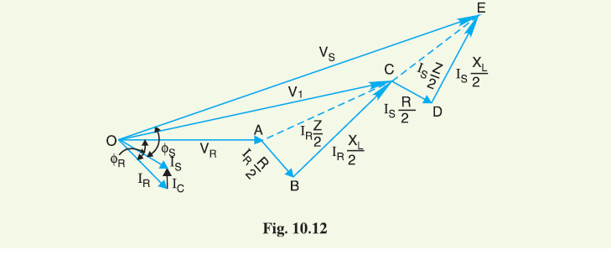
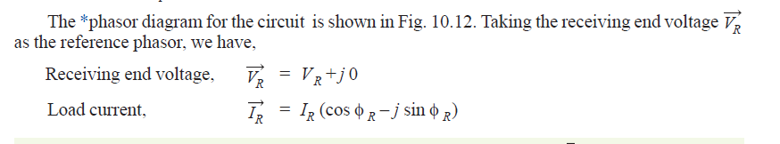
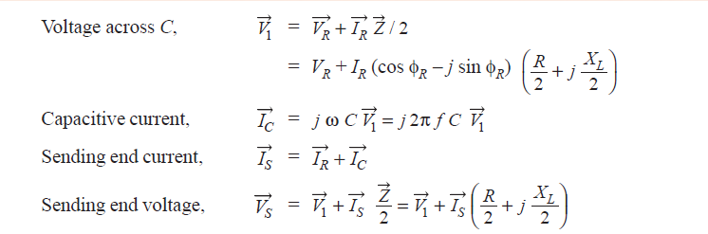

Slide 22
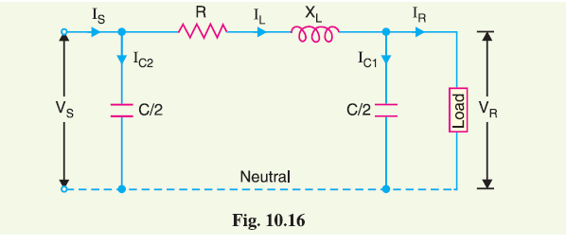
Nominal π Method
In this method, capacitance of each conductor (i.e., line to neutral) is divided into two halves; one half being lumped at the sending end and the other half at the receiving end.
It is obvious that capacitance at the sending end has no effect on the line drop. However, its charging current must be added to line current in order to obtain the total sending end current.

Slide 23
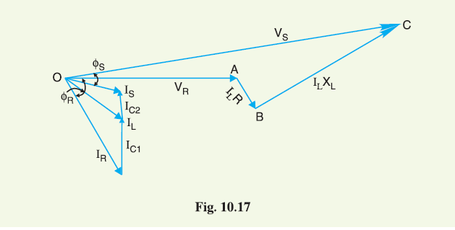
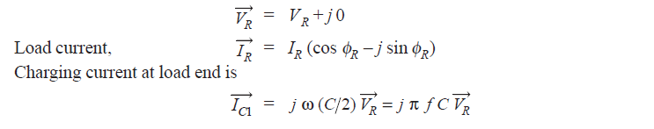
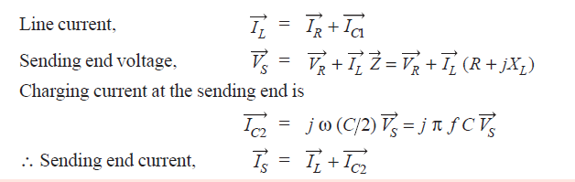
Let IR = load current per phase
R = resistance per phase
IR = load current per phase
XL = inductive reactance per phase
C = capacitance per phase
cos φR = receiving end power factor (lagging)
VS = sending end voltage per phase per phase
Taking the receiving end voltage as the reference phasor, we have,

Slide 24
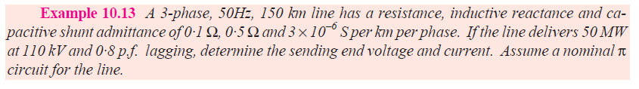

Slide 25
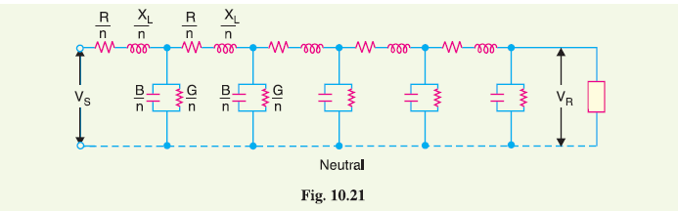
Long Transmission Lines
He transmission line are uniformly distributed over the entire length of the line.
In order to obtain fair degree of Accuracy in the performance calculations of long lines, the line constants are considered as uniformly distributed throughout the length of the line.
The whole line length is divided into n sections, each section having line constants 1/n th of The whole line length is divided into n sections, each section having line constants 1/n th of those for the whole line. those for the whole line.

Slide 26
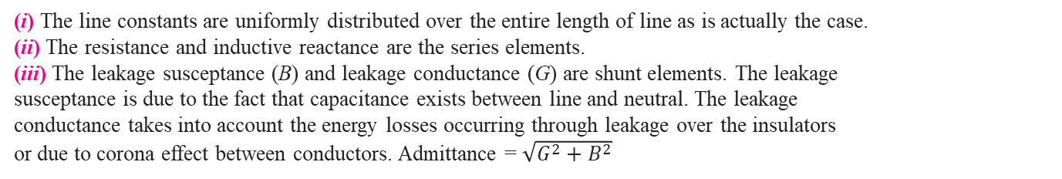
(i) The line constants are uniformly distributed over the entire length of line as is actually the case.
(ii) The resistance and inductive reactance are the series elements.
(iii) The leakage susceptance (B) and leakage conductance (G) are shunt elements. The leakage
susceptance is due to the fact that capacitance exists between line and neutral. The leakage
conductance takes into account the energy losses occurring through leakage over the insulators
or due to corona effect between conductors. Admittance = $\sqrt{G^{2}+B^{2}}$
(iv) The leakage current through shunt admittance is maximum at the sending end of the line and decreases continuously as the receiving end of the circuit is approached at which point its value is zero.

